Slide 1
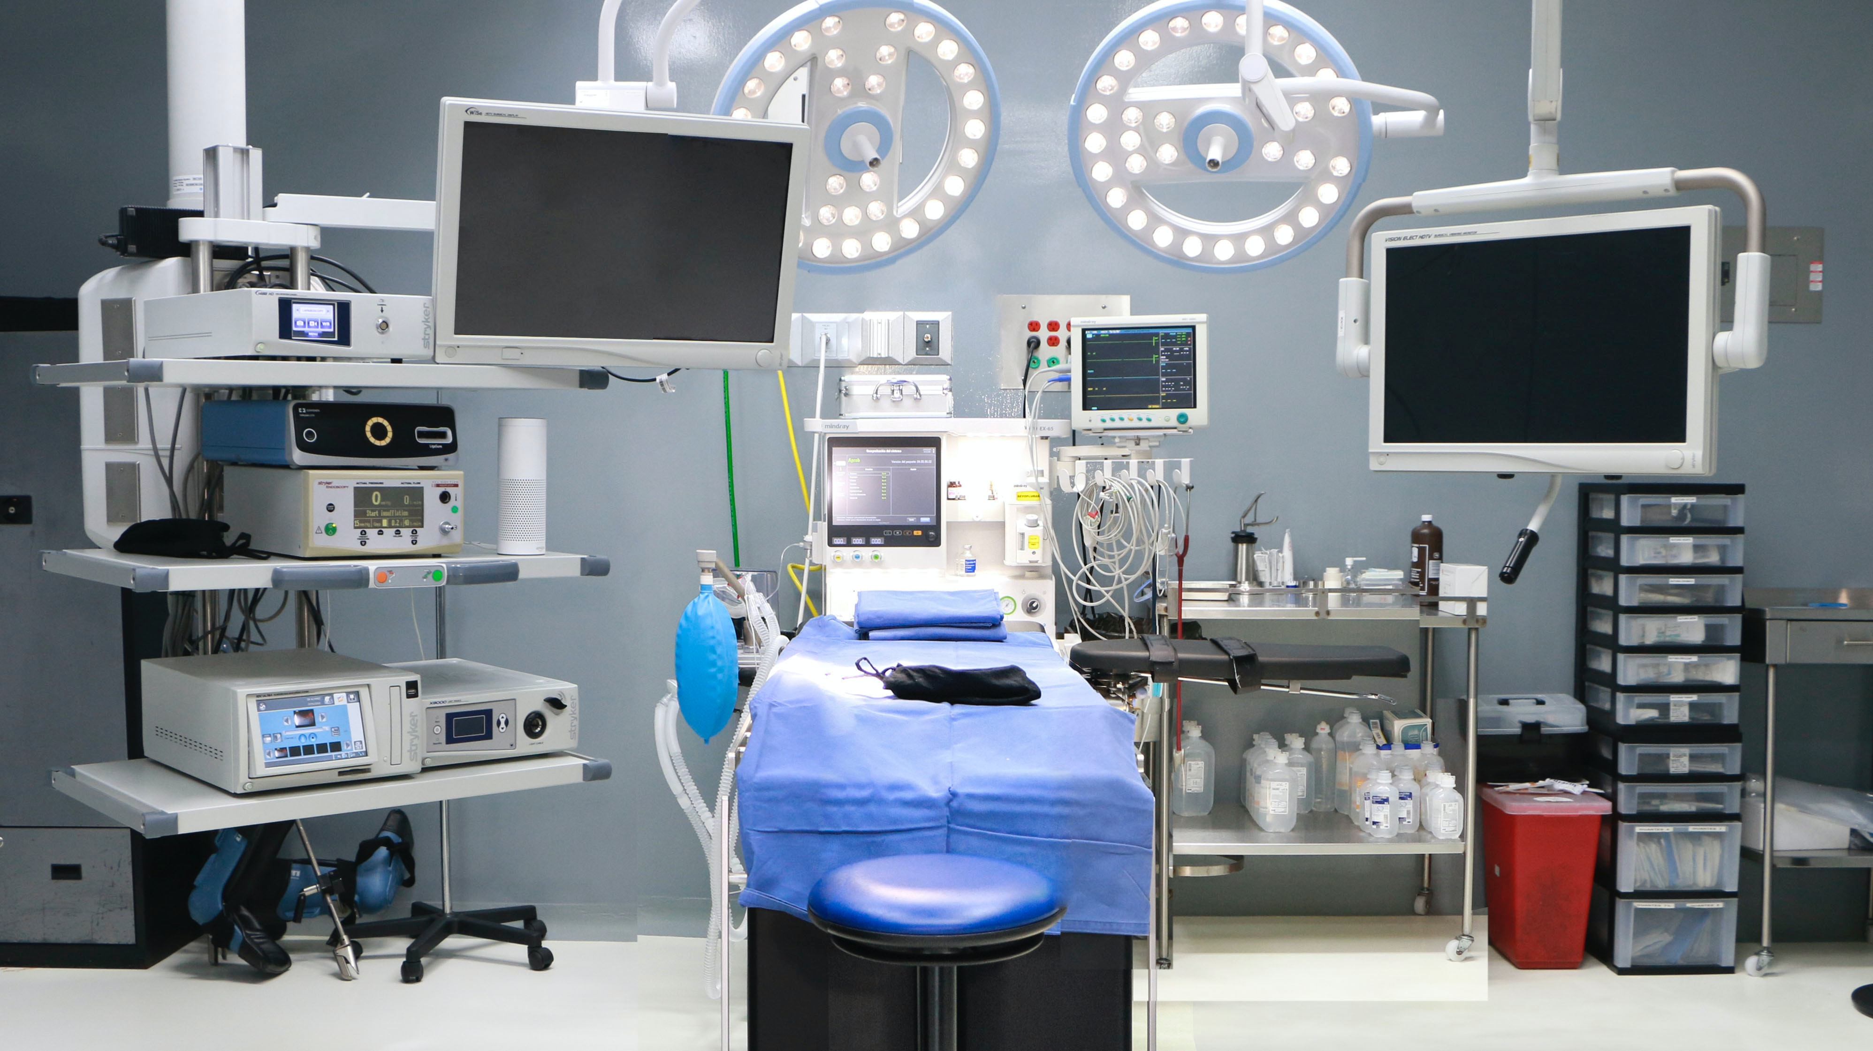

Welcome to the
Colorectal Cancer QII Kickoff
January 22, 2025

Slide 2


Objectives
Webinar participants will be able to:
  Share with others what the CRC project entails
  Identify project expectations and resources
  List the 4 next steps for the CRC project
  Understand other requirements of the 2025 P4P

Slide 3
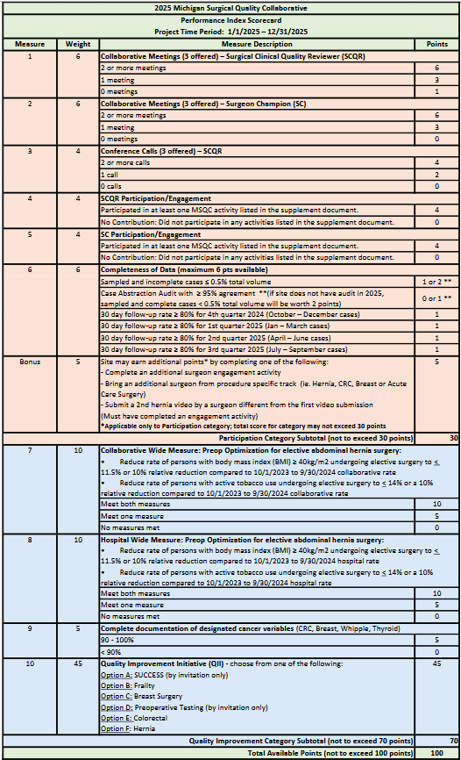
2025 P4P Scorecard
Participation
30 pts
Quality Improvement
70 pts
Notes:
Updated on 1/14/2025: updated SCQR meeting scoring, changed points for sampled & incomplete/audit measures for sites that don't have audit, changed wording from “hospital” to “collaborative” in CWM, measure 7

Slide 4



Recap: How can the CRC QII project help my hospital?
Improve the performance of evidence-based quality measures for patients undergoing colorectal cancer surgery and promote high-quality treatment to improve short- and long-term outcomes.
Dr. Harbaugh video: https://vimeo.com/1036020570

Slide 5
2025 MSQC CRC Surgical Quality Project Goals
Data collection
Identify a Surgeon Lead at your hospital
Establish quarterly Multidisciplinary Team meetings
Perform checklist review of flagged cases
Implement process improvement:
    Appropriate preoperative imaging (elective cases only)
    Obtain > 12 lymph nodes (elective colon cases only)
    MMR or MSI Testing
    PRO responses of CRC patients
Colorectal Cancer Tumor Board Project participation
See 2025 Colorectal Surgery QII Summary document
Use version with revised date of 1.13.2025

Slide 6
CRC Project Case Eligibility
Surgical priority-all (except for process measure a and b)
Included CPT Code: MSQC 2025 Program Manual, Appendix A
CRC Tab: Presence of Adenocarcinoma = Yes – Adenocarcinoma is the tumor type, and the portion of bowel with the cancer is removed
Included ICD-10 Codes:
ICD-10 code | Adenocarcinoma Location
C18.0 | Cecum/ileocecal valve
C18.2 | Ascending colon
C18.3 | Hepatic flexure
C18.4 | Transverse colon
C18.5 | Splenic flexure
C18.6 | Descending colon
C18.7 | Sigmoid colon
C18.8 | Overlapping sites of colon
C18.9 | Unspecified location of colon [double check path report before assigning this ICD-10]
C19 | Rectosigmoid junction
C20* | Rectum [only this ICD-10 enables rectal CA variables]

Slide 7
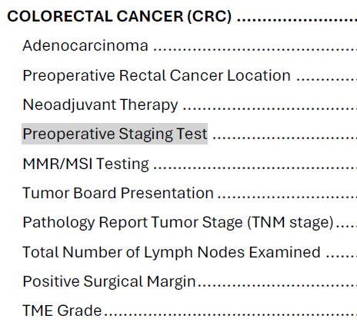
1. Data collection
All sites are already participating in mandatory colorectal tab data collection
5 Bonus points are available for collecting all eligible colorectal cancer cases (including those that were Not Sampled). The cases must be marked Oversampled.

Slide 8
2&3. Surgeon lead and multidisciplinary team
Identify surgeon lead
Team Participants: SCQR, Surgeon Lead, Medical Oncology, Pathology, Radiology, and Nursing or Cancer Care Navigator
Frequency:
  4 meetings- Kickoff meeting by March 29 and quarterly
Content:
  Review data including patient-reported outcomes (PROs)
  Progress toward Process Improvement goals
  Clinical review of flagged cases for the prior quarter
Submit minutes and attendees for each meeting with your 2025 QII Project Report
Notes:
The surgeon lead will help the SCQR disseminate information at the hospital, be active in developing and implementing a multidisciplinary engagement, and be engaged with MSQC

Slide 9

4. Perform checklist review of flagged cases
Cases from 1/1/2025 to 12/1/2025 OR dates
Receive a list of flagged cases (quarterly):
    Positive margins
    < 12 lymph nodes examined
    Rectal cancer not reviewed in a Tumor Board
    MMR/MSI testing not performed
Complete a checklist with the multidisciplinary team to understand the clinical course and identify potential opportunities for process improvement
Enter data into Redcap

Slide 10
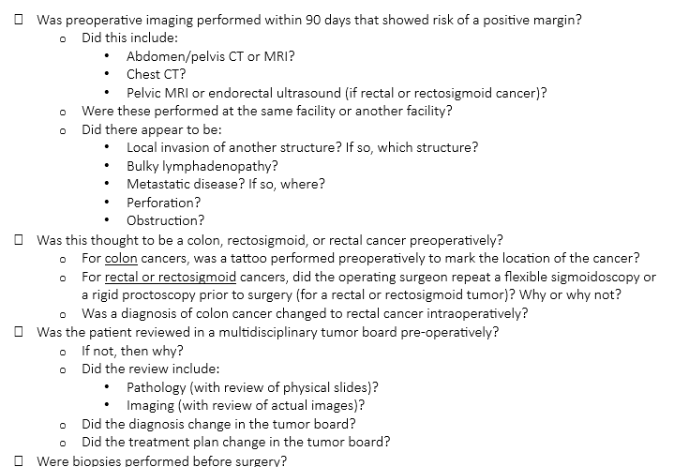
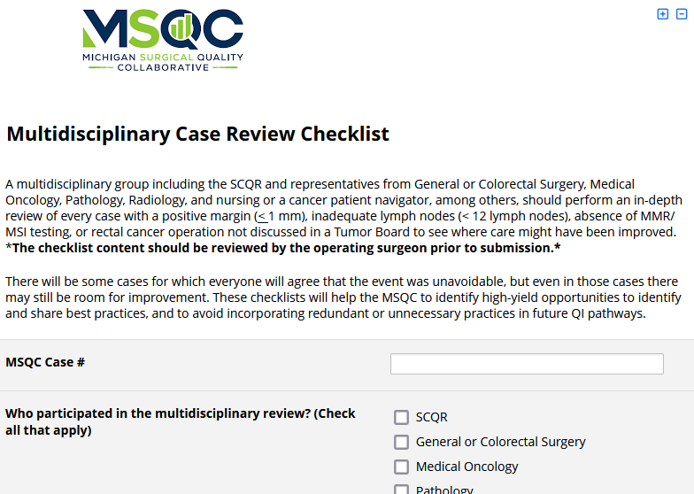
Checklist
  Most sites will have 5-15 cases to review
  Checklist is on last 2 pages of CRC QII Summary document and in Redcap

Slide 11
5. Implement process improvement (16 pts)
Measurement period: 4/1/2025 – 12/31/2025 OR Dates
Appropriate preoperative imaging (elective cases only) ≥ 80%
Obtain > 12 lymph nodes (elective colon cases only) ≥ 95%
MMR or MSI testing either before or after surgery ≥ 95%
Increase or maintain PRO response rates of CRC patients
Notes:
Each measure is worth 4 pts

Slide 12
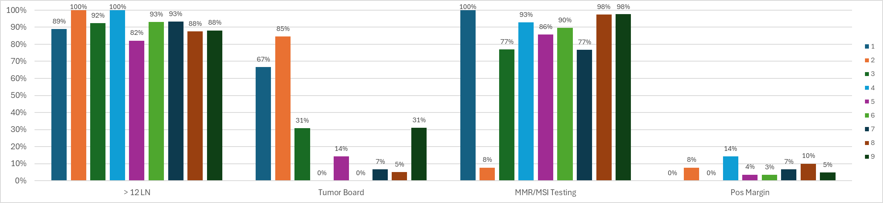
CRC Data 1/1/2024 - 9/30/2024 (participating sites only)

Slide 13
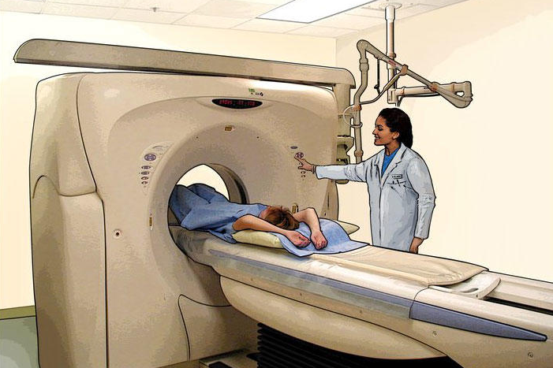
5a. Preoperative imaging for elective CRC Surgery
Goal: > 80% for elective CRC cases (colon and rectal)
  RECTAL CANCER
  CT of the Chest with or without contrast, and
  CT with IV contrast of the Abdomen and Pelvis or MRI of the abdomen with or without IV contrast, and
  MRI of the pelvis or endorectal ultrasound.
  COLON CANCER
CT of the Chest with or without IV contrast, and
CT with IV contrast of the Abdomen and Pelvis or MRI of the abdomen and pelvis with or without IV contrast.
https://www.cancer.gov/about-cancer/diagnosis-staging/ct-scans-fact-sheet
Testing should be performed within 90 days before surgery

Slide 14
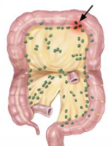
5b. Obtain > 12 lymph nodes for elective colon cancer
The National Quality Forum in 2007 established that in order to have an accurate prognosis for colon cancer patients, at least 12 lymph nodes should be examined
Definition: The number of lymph nodes, from the principal operative procedure, documented as having been examined by the pathologist, per the final pathology report.
Variable Options: Enter whole number between zero (0) and ninety-nine (99).
Goal:
> 95% for elective colon cases
Surgeons may need to ask pathology to re-review slides if < 12 lymph nodes were found

Slide 15
5c. MMR or MSI testing before or after surgery
Informs whether use of immunotherapy is the recommended treatment
20% of MSQC patients did NOT
have MMR testing documented
Variable Options:
1. MMR/MSI testing was not performed on the biopsy or surgical specimens
2. MMR/MSI testing was performed on the biopsy specimen
3. MMR/MSI testing was performed on the surgical specimen
4. MMR/MSI testing was performed on both biopsy and surgical specimen
Note: MMR/MSI Testing may be described as the specific MMR proteins that are tested and not specifically labeled as “MMR/MSI”: MLH1, MSH2, MSH6, PMS2, and sometimes MLH-1, MSH-2, MSH-6, PMS-2.
Goal: > 95% for all CRC cases

Slide 16
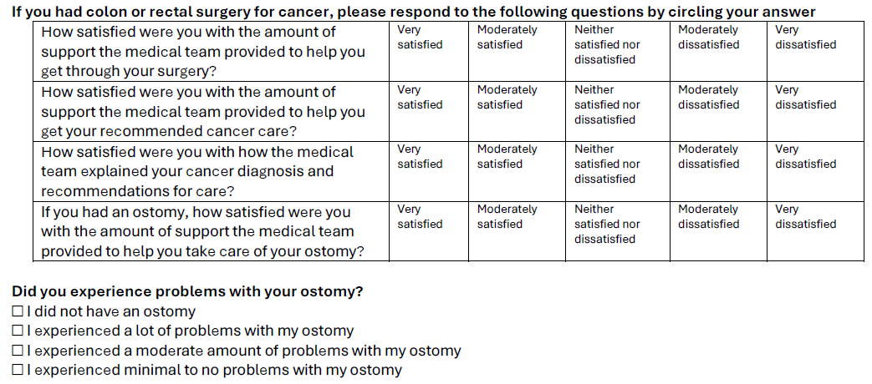
5d. PRO response rates of CRC patients
Increase or maintain the rate of PRO responses to the colorectal-specific questions from Q1 2025 compared to Q2 & Q3 2025.
If sending paper letters, be sure to print out 3rd page of the letter (“with colo” in Letter Generator
If making calls, be sure to ask these questions

Slide 17

6. Tumor Board Project participation (10pts)
Coordinator
Interview
(15 min)
Observation
Multidisciplinary
Virtual
Focus Group
(1 hr)
Observation
Observation
work with MSQC to facilitate contact with Tumor Board coordinator at your hospital | observation of three (3) tumor board sessions (2 pts each) | conduct a focus group with at least 5 multidisciplinary providers (4 pts)

Slide 18
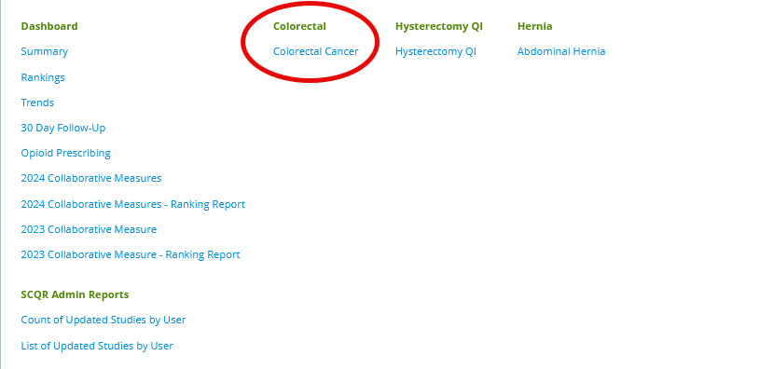
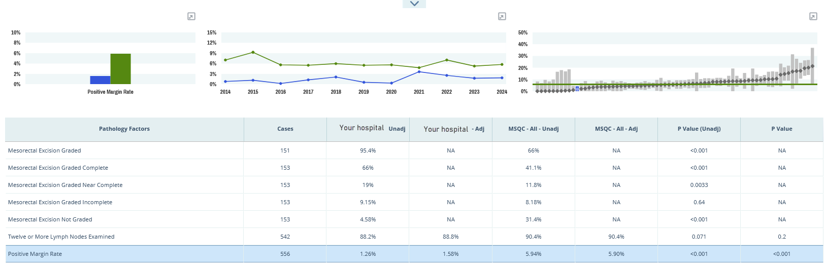
CRC Reports
Specific CRC reports in the MSQC workstation
Measure include:
  Process Measures
    Multidisciplinary Care
    Surgery
    Pathology
  Outcomes
  Utilization
Monthly Push reports to be developed
Notes:
CRC Data is available now in the MSQC Workstation and monthly push reports will be developed.

Slide 19

CRC QI Next Steps
Identify colorectal surgeon lead.
Assemble your multidisciplinary team, convene before March 29, 2025. Add your next 3 meetings to team calendars.
Arrange tumor board observation (3 sessions) and focus group with MSQC.
Continue or start including CRC PROs questions with follow-up.

Slide 20
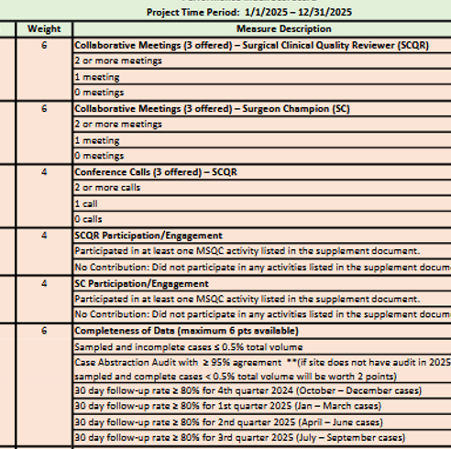
What else is on the P4P Scorecard?
SCQR/SC Collaborative Meetings
SCQR Conference Calls
SCQR/SC Engagement (see requirements document on MSQC 2025 QI webpage)
Completeness of Data
  Sampled and incomplete < 0.5%
  and/or
  Case abstraction Audit > 95%
  Follow Up rate > 80% x 4 quarters
Notes:
Updated on 1/14/2025: updated SCQR meeting scoring, changed points for sampled & incomplete/audit measures for sites that don't have audit, changed wording from “hospital” to “collaborative” in CWM, measure 7

Slide 21
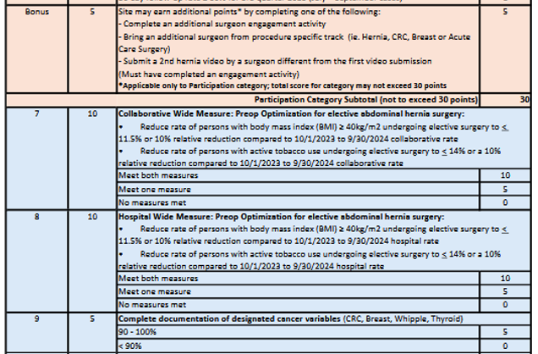
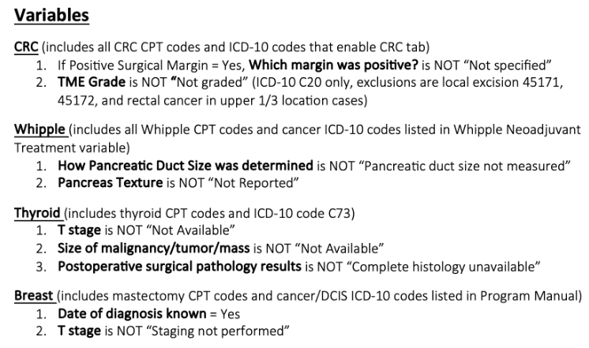
What else is on the P4P Scorecard?
Bonus points (applicable to participation points)
CWM – collaborative and hospital measures
Document cancer variables (see “documentation report” Dropbox QI folder for report)

Slide 22
Resources
Dr. Harbaugh video: https://vimeo.com/1036020570
2025 QI Webpage: https://www.msqc.org/quality-improvement/2025-msqc-quality-initiatives
Questions? Contact Cheryl Rocker – ccrocker@med.umich.edu

Slide 23

Thank you!
Questions?

