Slide 1


Kickoff for Surgical Urinary Catheter Care Enhancement Safety Study (SUCCESS)
2025 Quality Improvement Project
January 28, 2025

Slide 2
Welcome 2025 SUCCESS Participants
Corewell Health Beaumont Grosse Pointe Hospital
Corewell Health Beaumont Troy Hospital
Corewell Health Dearborn Hospital
Corewell Health Farmington Hills Hospital
Corewell Health Taylor Hospital
Corewell Health Trenton Hospital
Corewell Health Wayne Hospital
Corewell Health William Beaumont University Hospital
Detroit Receiving Hospital
Henry Ford Macomb Hospital
Henry Ford Rochester Hospital
Henry Ford Wyandotte Hospital
Marshfield Medical Center - Dickinson
Michigan Medicine
Oaklawn
Sinai-Grace Hospital

Slide 3

Housekeeping
The SUCCESS team has a listserv where project participants can ask each other questions: successproject@umich.edu
Let us know if you and your Surgeon Champion are interested in serving on the SUCCESS Stakeholder Advisory Board. Must attend 2 meetings for P4P.
These slides and the recording will be available on the MSQC 2025 QI webpage after the meeting: https://www.msqc.org/quality-improvement/2025-msqc-quality-initiatives

Slide 4

Objectives
Webinar Participants will be able to:
  Share with others what the SUCCESS project is about
  Identify SUCCESS project tools, resources, and expectations for 2025
  List the next steps for the SUCCESS project
  Understand the other requirements of the 2025 P4P

Slide 5
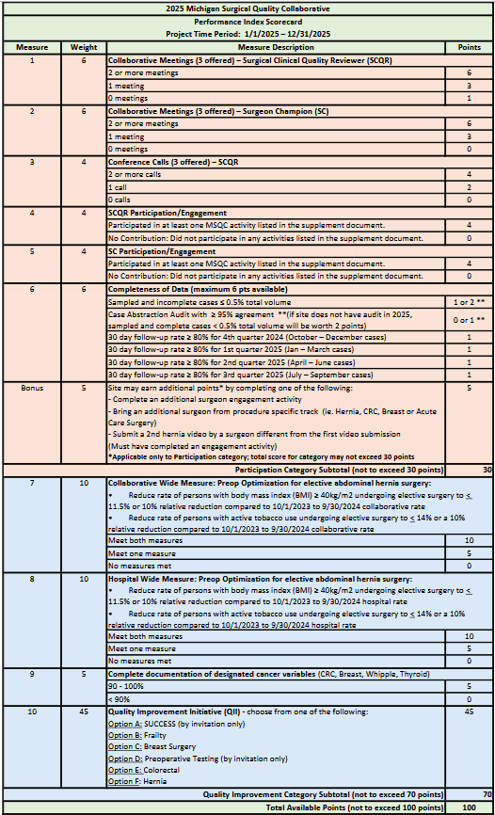


2025 P4P Scorecard
Participation
30 pts
Quality Improvement
70 pts
Notes:
Updated on 1/14/2025: updated SCQR meeting scoring, changed points for sampled & incomplete/audit measures for sites that don't have audit, changed wording from “hospital” to “collaborative” in CWM, measure 7

Slide 6
2025 SUCCESS QI Project Goals Overview
1. Capture all SUCCESS data in Workstation (3 points)
2. Three (3) Multidisciplinary meetings including Kickoff by 3/31 (8 points)
3. Meet 5 process/outcome measures (4 points each)
4. Refine the MSQC SUCCESS urinary care pathway (4 points)
5. Quality review of designated cases (10 points)
Submit 2025 SUCCESS Project Summary to the MSQC no later than January 16, 2026.
Notes:
Use 1/16 SUCCESS Summary document (measures 3a/b added)

Slide 7
1. Capture all data
Review the SUCCESS Categories by CPT code, 2024 Process Measure Specs and SUCCESS data dictionary (updated 7/30/2024) document
See 2024 QI Process Measure Specs sheet, last column:
Look for "0" in column K. These are cases that do not have the required variables entered.
Commonly missed is the epidural variable, column Q
if catheter used (column S) = 1 (Yes) then the following should not be blank:
catheter_discont_location_e (column V)
discharged_with_catheter_b (column X)
urinary_cath_trauma (column AE)
(Columns are subject to change if edits are made to raw data report in 2025)

Slide 8
Suggested invited participants
  Executive leadership team
  Surgeon leadership
  Surgeons (general & urology)
  Anesthesiology
  Nursing supervisors for ER, perioperative, PACU, and surgical units
  Director, quality department
  Patient safety
  Director, nursing education
  Administrative director
  Finance
  Logistics
  Patient experience officer
2. Multidisciplinary Meeting (8 points total)
Kickoff: Meet with key stakeholders by March 31, 2025, to review project requirements. (4 pts)
  This is a working meeting. Review data and case review analysis from 2024. Include PRO data. Plan for what you should focus on in 2025.
Two (2) additional multidisciplinary meetings before December 1, 2025, which include a review of SUCCESS data and a quality review for cases in Goal 5 (2 pts each)
Submit minutes, slides, and attendees with roles with your 2025 Project Summary

Slide 9
3. Meet 5 process/outcome measures
(20 points total, 4 points each measure)
Measurement period 1/1/2025 - 12/31/2025 OR dates:
Catheter use measures
a1. Indwelling catheters are not used intraoperatively for > 90% of Category A* cases (excluding lap appy)
a2. Indwelling catheters are not used intraoperatively for > 50% of Category A* cases (lap appy only)
b. Indwelling catheters, if used, are removed in OR for > 90 % of Category B* cases
Urinary retention diagnosis and management measures
c. Bladder scan volume is documented > 90 % of the time before urinary catheterization, if used, for POUR was performed
d. No urinary catheter is used for bladder scan volumes < 300 ml for > 90 % of cases with POUR
e. ISC was performed as opposed to an indwelling catheter (unless volume > 500) for > 90 % of cases with POUR

Slide 10
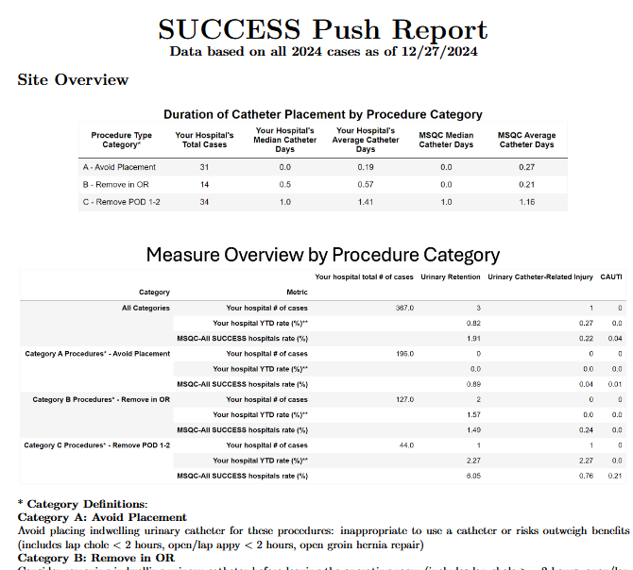
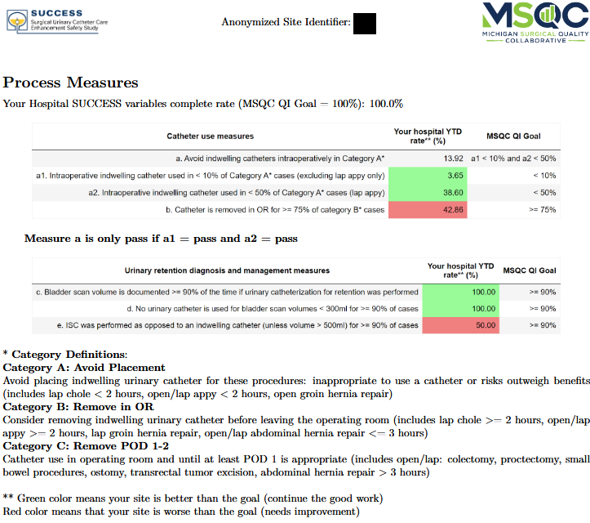
SUCCESS Data Feedback Report
  Pushed to your hospital’s Dropbox monthly
  Distribute your SUCCESS data to leaders and frontline clinicians
  Share data at meetings
  Will be updated to include list of case review cases

Slide 11
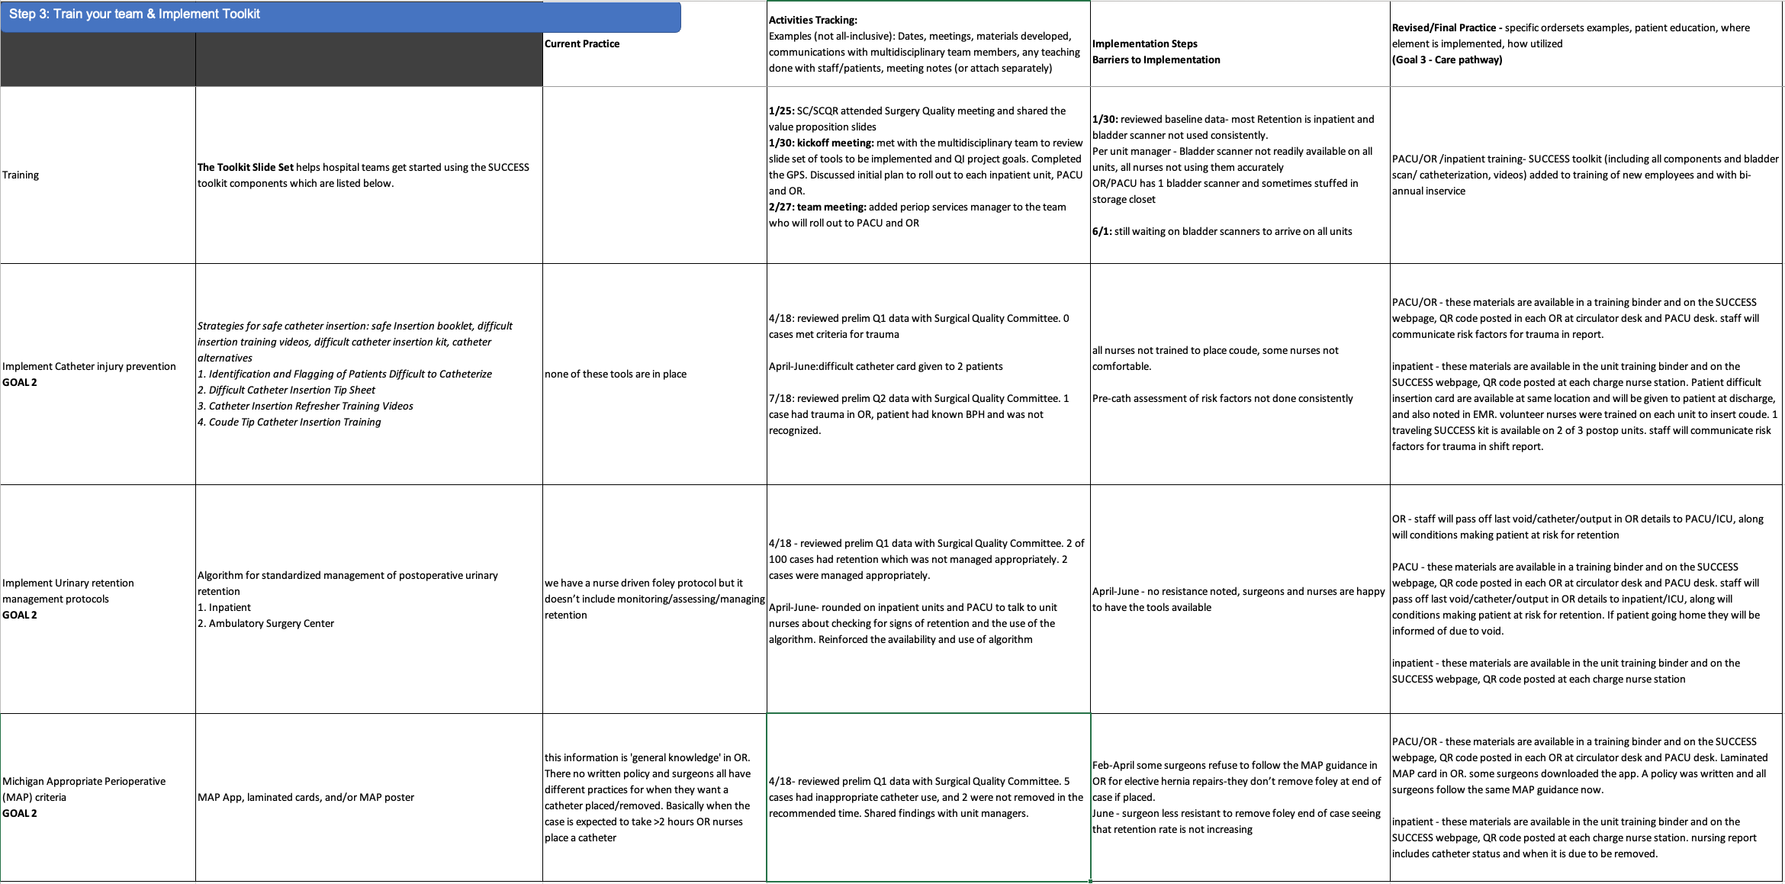
4. Refine your Urinary Care Pathway (4 points)
(Example from 2023)
Include narrative of how any processes and toolkit elements were modified from 2024 and include updated care pathway in project tracking sheet

Slide 12
5. Perform quality review for these cases (10 points)
From 1/1/2025 to 12/1/2025 OR dates
a. Patients in Category A who have an indwelling urinary catheter placed in OR.
b. Retention is assigned for patients who had a urinary catheter (ISC or indwelling) placed when < 300 ml is documented via a bladder scanner or the catheter use
c. Patients who return to ED with Retention
d. Patients who were discharged with an indwelling catheter or need for ISC
e. Patients who have Urinary Catheter-Related Trauma assigned
Case tracking sheet and instructions for finding cases is available (It includes conditional formatting for measure fallouts or cases that need to be reviewed (the cell turns pink)).
Quality review case list will be added to raw data report in 2025
Start doing concurrent case review and add cases to tracking sheet

Slide 13
Continue Implementing/Refining the Toolkit
Tips:
Implement of a Difficult Catheter Care Kit to targeted units
Catheter blitz to (re)introduce toolkit
Monthly stakeholder meeting
Introduce project to ED
Hang posters in surgical rooms, lounges, nursing station
Keep Urinary Retention and Safe Catheter Insertion Algorithm and 10 Practical Tips for Safe Urinary Catheter Insertion Booklet at nurse stations
Walk the units, is it still happening? Talk to frontline staff and educators
For no cath with lap appy – have surgeons do a trial of no cath use; void before OR

Slide 14
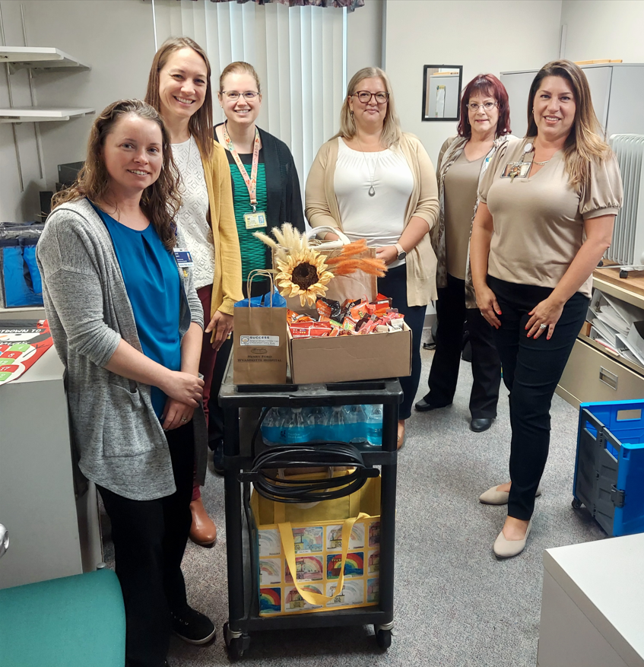
Site visits, SUCCESS Stakeholder Committee
  Site visits
  If you didn’t have a site visit yet, let our team know if you are interested in scheduling a site visit that meets your needs (in-person or virtual)
  SUCCESS Stakeholder Committee
  Open for new members
  Must be SC and SCQR
  Must join 2 meetings in 2025 for P4P participation points
  Current Members:
Marina Kane | SCQR | Corewell Health William Beaumont Univ-Royal Oak
John Bauman | SC | Corewell Health William Beaumont Univ-Royal Oak
Jen Wolf/ Dawne Robertson | SCQR | Michigan Medicine
Dr. Fergusen | SC | Michigan Medicine
Notes:
Please contact us to let us know if you are interested in scheduling a site visit with our team that meets your needs, either in-person or virtual.

Slide 15
Next Steps
Download the P4P Scorecard with date of 1/14/2025 and SUCCESS project Summary with date of 1/16/2025
Re-Assemble your multidisciplinary team, convene before March 31, 2025. Get 2 other meetings on calendars.
Bookmark the project website: https://msqc.org/success/
Download project tracking sheet, start using it early
Download case review tracking sheet, start doing concurrent case review
Walk the units, do toolkit elements need refining?
Examine care pathway - any modifications needed – should be hospital specific
Let Cheryl know about site visit, SUCCESS Stakeholder Advisory Board interest

Slide 16

SUCCESS Webpage: https://msqc.org/success/
All project materials can be found on the SUCCESS Webpage, including printable Toolkit resources

Slide 17
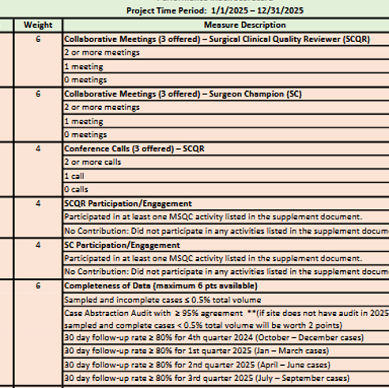
What else is on the P4P Scorecard?
SCQR/SC Collaborative Meetings
SCQR Conference Calls
SCQR/SC Engagement (see requirements document on MSQC 2025 QI webpage)
Completeness of Data
  Sampled and incomplete < 0.5%
  and/or
  Case abstraction Audit > 95%
  Follow Up rate > 80% x 4 quarters
Notes:
Updated on 1/14/2025: updated SCQR meeting scoring, changed points for sampled & incomplete/audit measures for sites that don't have audit, changed wording from “hospital” to “collaborative” in CWM, measure 7

Slide 18
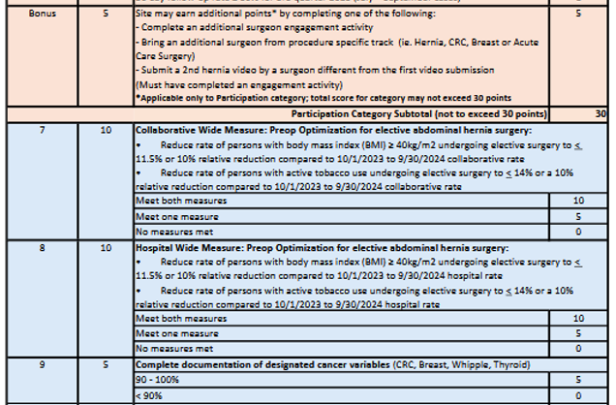
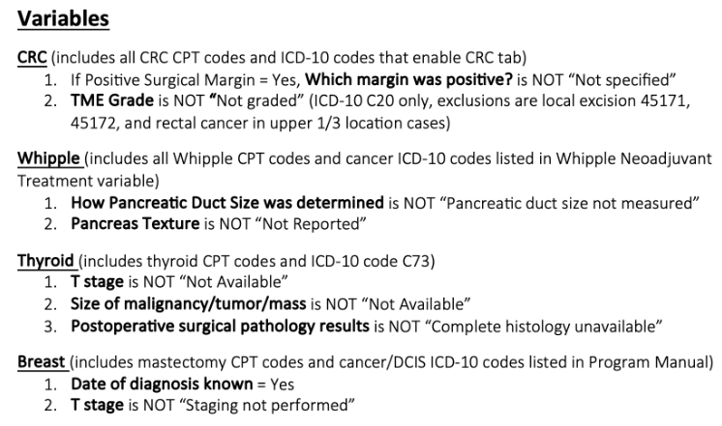
What else is on the P4P Scorecard?
Bonus points (applicable to participation points)
CWM – collaborative and hospital measures
Document cancer variables (see “documentation report” Dropbox QI folder for report)

Slide 19
Review SUCCESS Data

Slide 20
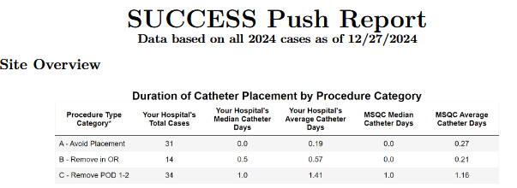
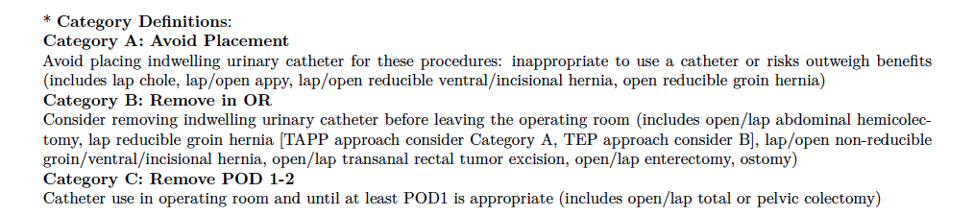
Total cases in each category with a catheter

Slide 21
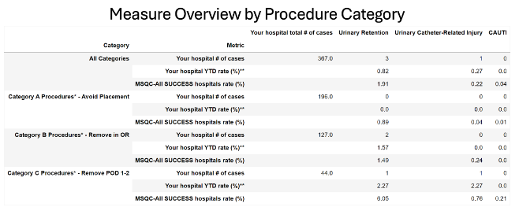
Total cases in each category (with or without a catheter)

Slide 23
Raw Data Demo
SUCCESS CPT code-Categories (7/30/2024)
December SUCCESS raw data file

Slide 24

Thank You!
Questions?
Contact Cheryl Rocker ccrocker@med.umich.edu

