Slide 1
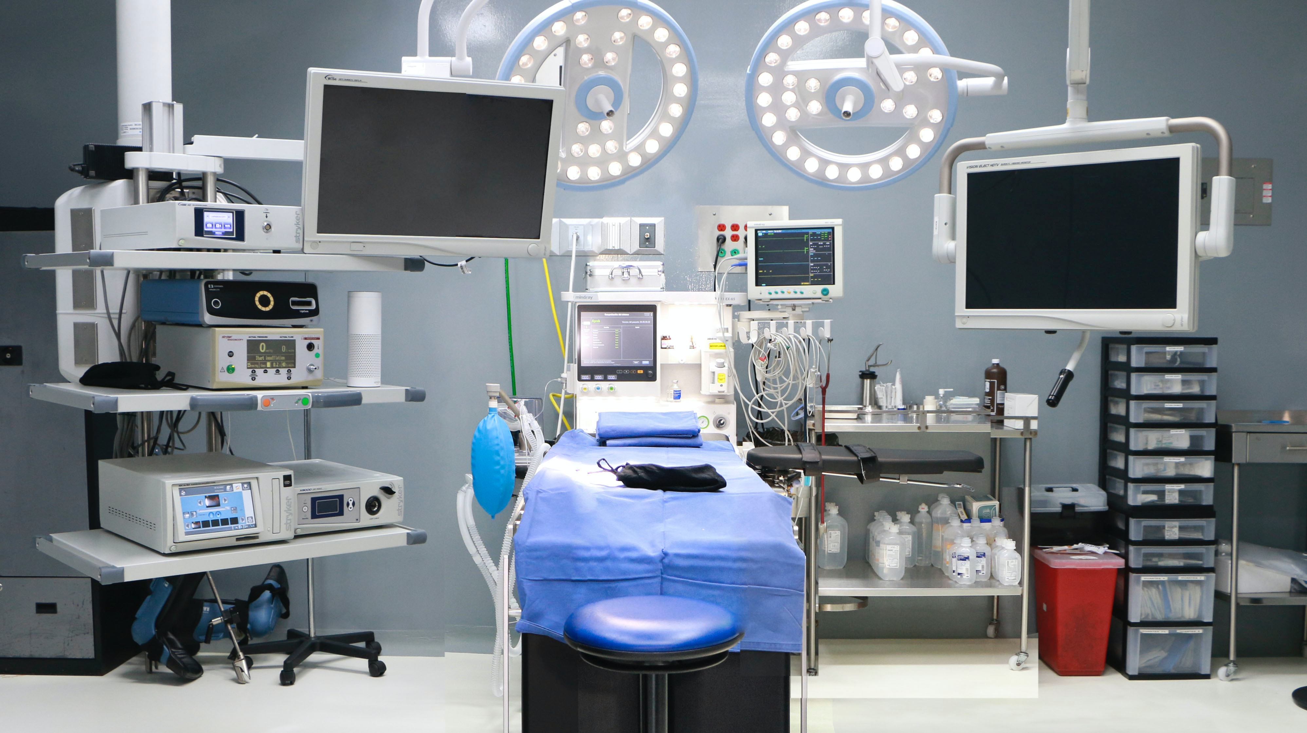


Hernia QI Kickoff Meeting
Annie Ehlers, MD MPH
1/29/2025

Slide 2
Updates for MSQC-COHR
MSQC-COHR: Summary and work to date
First annual 2024 Hernia Summit
QI Updates for 2025

Slide 3



Why care about hernia?
Common
1.6M Persons
Costly
3.2 Billion
Morbid
25% Adverse Events

Slide 4

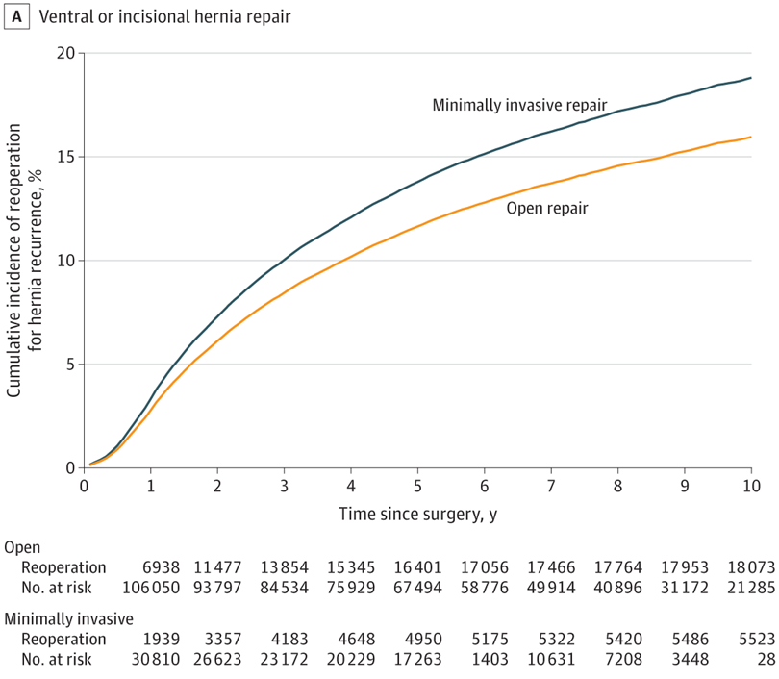
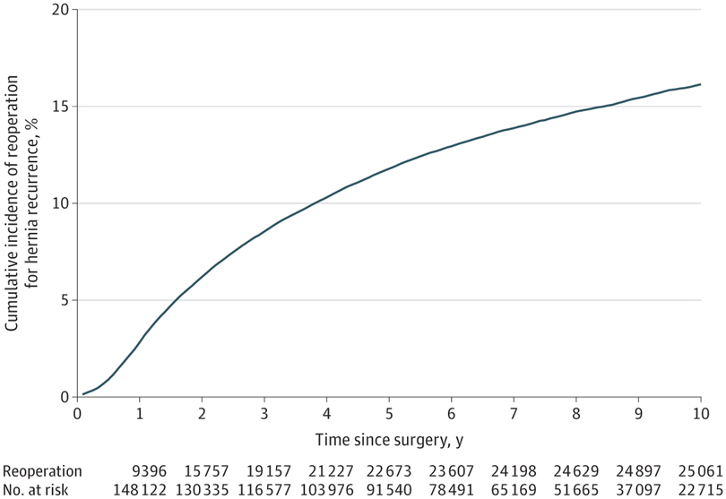
Outcomes have not improved over time

Slide 5
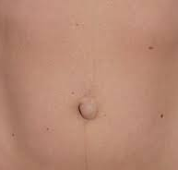
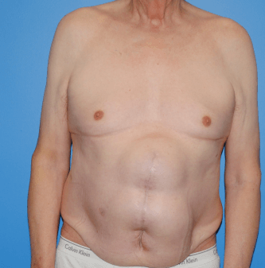
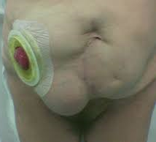
Data are needed to improve care
Challenges pre 2023
Challenges persist post 2023
Approach
Primary versus incisional
Location
CPT: 49560, 49561, 49565, 49566
CPT: 49560, 49561, 49565, 49566
Claims data are meant primarily for billing and not research!
CPT: 49560, 49561, 49565, 49566

Slide 6

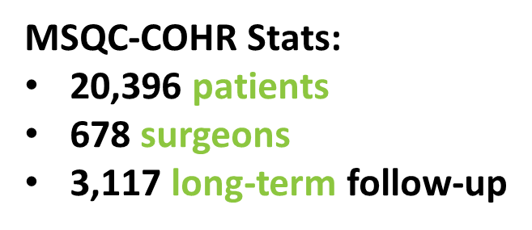
Developed a Statewide population level registry
What COHR collects (in addition to MSQC):
Hernia specific variables (e.g., size, location)
Operative details (e.g., technique, mesh)
Weighted long term population level survey
  Ventral hernia recurrence index
  Promis 3A
  Abdominal core health (AHQ)**
  Decision regret

Slide 7
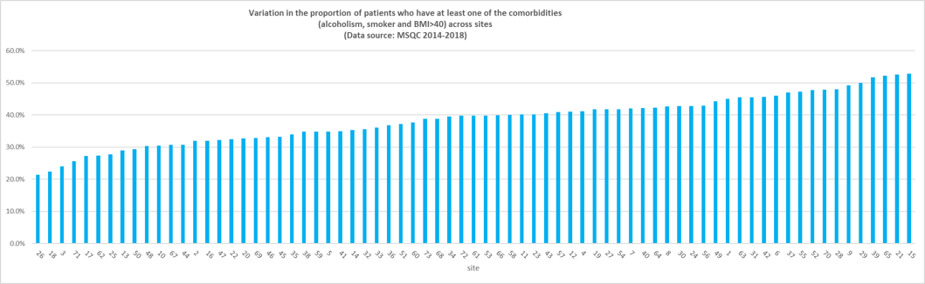
Wide variation in adherence to optimization across MSQC sites from 2013-2018
(Population: Persons actively smoking or with Body Mass index>40kg/m2 who underwent elective hernia repair, n=22,644)
60
50
40
% Non-Adherence
30
20
10
0
Site

Slide 8

“Right operation, Right person, Right time”
Who should we operate on?
When should we operate?
What operation should we do?
Preoperative Decisions

Slide 9
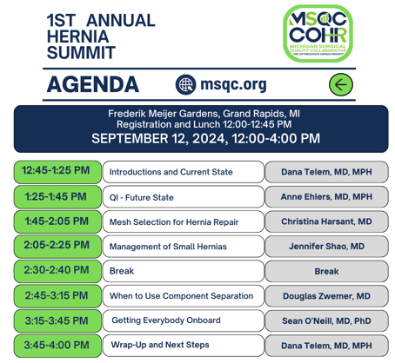
2024 Hernia Summit – 9/12/24
Attendees
  30 surgeons
  23 SCQRs and Quality staff
Consensus building
  Use of mesh
  Management of small hernias
  Component Separation
Video Review

Slide 10
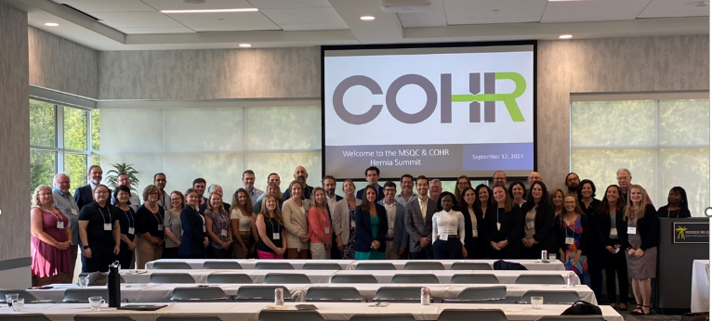

Slide 11
“Core” COHR Committee
Jenny Shao, MD (Michigan)
Sean O’Neill, MD PhD (Michigan)
Scott Laker, MD (Corewell – Farmington Hills)
Eric Davies, MD (Trinity Health – Ann Arbor/Howell)
Thomas Martin, MD (Corewell – Grand Rapids)
Christina Harsant, MD (Trinity Health – Ann Arbor)
Douglas Zwemer, MD (Trinity Health – Muskegon)
Anthony Falvo, DO (Henry Ford – Detroit)
Joel Strehl, DO ( Munson Medical Center – Traverse City)
Notes:
Fill in

Slide 12
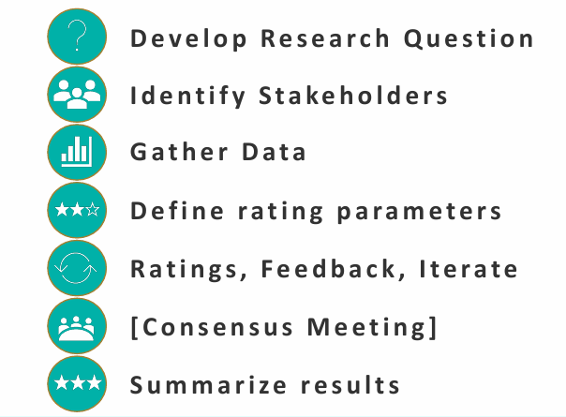
Getting everybody on board - Consensus

Slide 13
2025 Hernia Summit –TBD

Slide 14


Summary
-The focus of this project will continue to build upon the gains of the past MSQC hernia project and to garner the engagement of more hernia surgeons across the state of Michigan to increase the quality of care for hernia surgery patients

Slide 15
2025 MSQC Hernia Quality Project Goals
Data collection
Identify a Surgeon Lead at your hospital
Establish quarterly Multidisciplinary Team meetings
Surgeon Goals
Implement process

Slide 16
1. Data collection
  For abdominal hernia repair patients, in addition to MSQC core data collection, participating hospitals should collect the complete hernia variable tab.
  This should already be in practice but is essential for a successful project.

Slide 17
2&3. Surgeon lead and multidisciplinary team
Identify surgeon lead: The expectations are that the surgeon lead will help the SCQR disseminate information at the hospital, be engaged with MSQC for the Hernia Surgery QI project, which may also include attending the 2025 MSQC Meetings pertaining to hernia surgery and the 2025 Hernia Summitt.
Team Participants: SCQR, hernia surgeon champion, other surgeons who perform hernia surgery, nursing, patient navigator, IT to help with the dot phrase into the EMR
Frequency: 3 meetings-
  Kickoff meeting by March 29 and (2) additional multidisciplinary meetings (minimally) before December 1, 2025, which include a review of the implementation of the HErOIQ tool into practice
  Progress toward Process Improvement goals
  Submit minutes and attendees for each meeting with your 2025 QII Project Report
Notes:
The surgeon lead will help the SCQR disseminate information at the hospital, be active in developing and implementing a multidisciplinary engagement, and be engaged with MSQC

Slide 18
4. Surgeon Goals
All hernia surgeons at your site will watch the training video (Module)
Have all your hernia surgeons start using the HerOIQ risk communication tool (Measurement starts 4/1/2025 cases)
This would be documented by a dot phrase that could be abstracted from the EMR like the preop optimization pathway. This will need to be built into the EMR which will take some time.
While waiting for the dot phrase to be built you will need to document in the preop note that the HerOIQ risk communication tool was used.
Integrate HerOIQ risk communication tool into your practice, The 2025 goal would be the use of the tool >50% of the time.
Hernia video submission and review: Your hernia surgeon champion will need to submit a hernia surgery video for review and participate in the review of other videos from surgeons across the state.
Notes:
The surgeon lead will help the SCQR disseminate information at the hospital, be active in developing and implementing a multidisciplinary engagement, and be engaged with MSQC

Slide 19
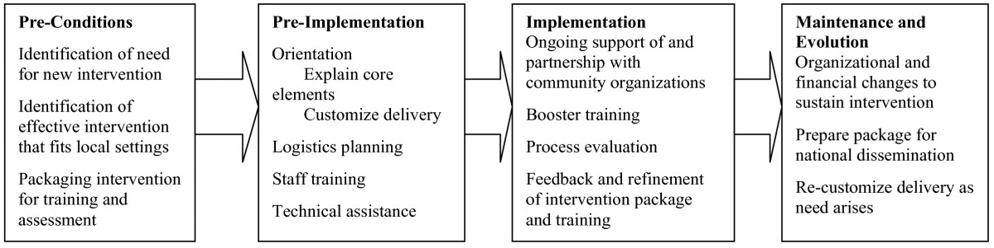
HerOIQ: Addressing knowledge and resources
Based on evidence that teaching skills modularly increases behavior change
Incorporates opinion leaders
Designed to increase the ease in which clinicians learn practice guidelines
Facilitates learning on how to deliver the guideline
Follows the Replicating Effective Practices (REP) Framework
Notes:
dtelem@gmail.com 123456

Slide 20
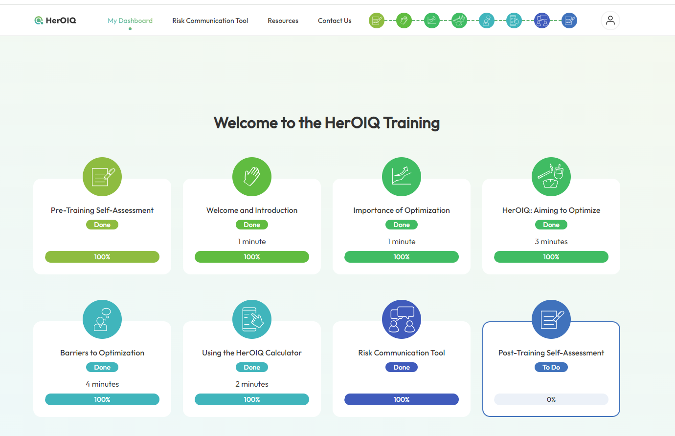
https://herniacalc.com/welcome/
https://herniacalc.com/dashboard/
Notes:
dana12345

Slide 21
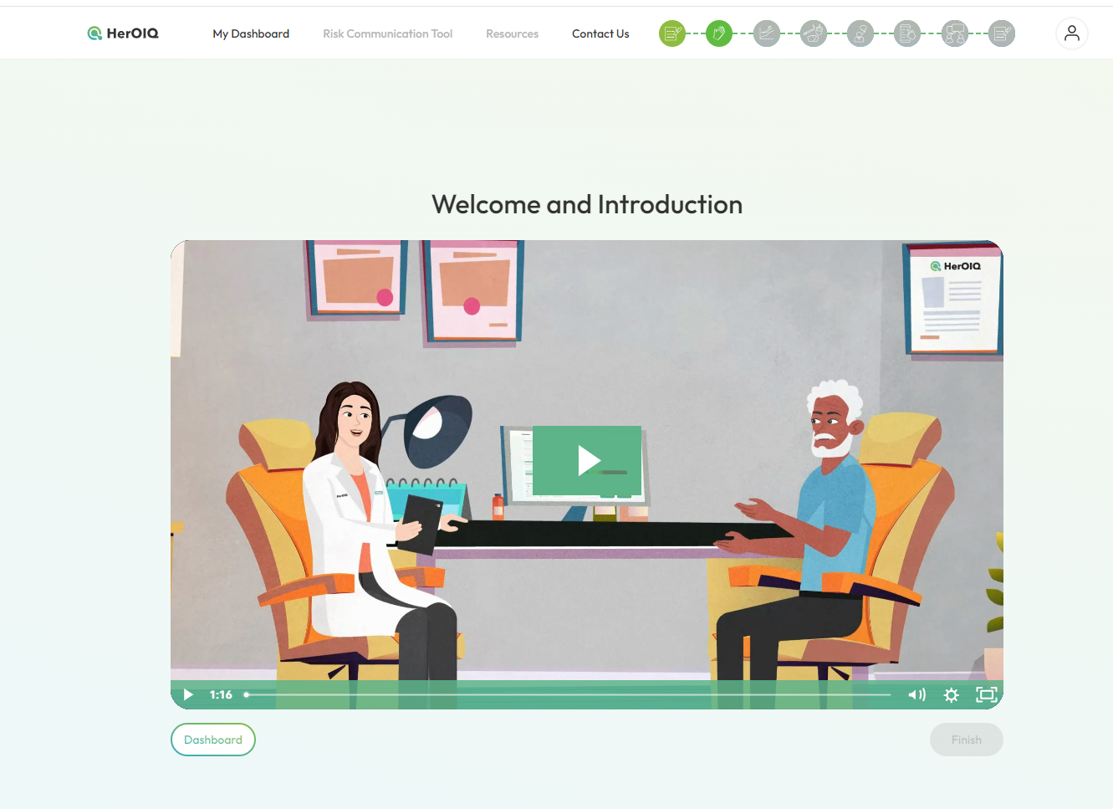
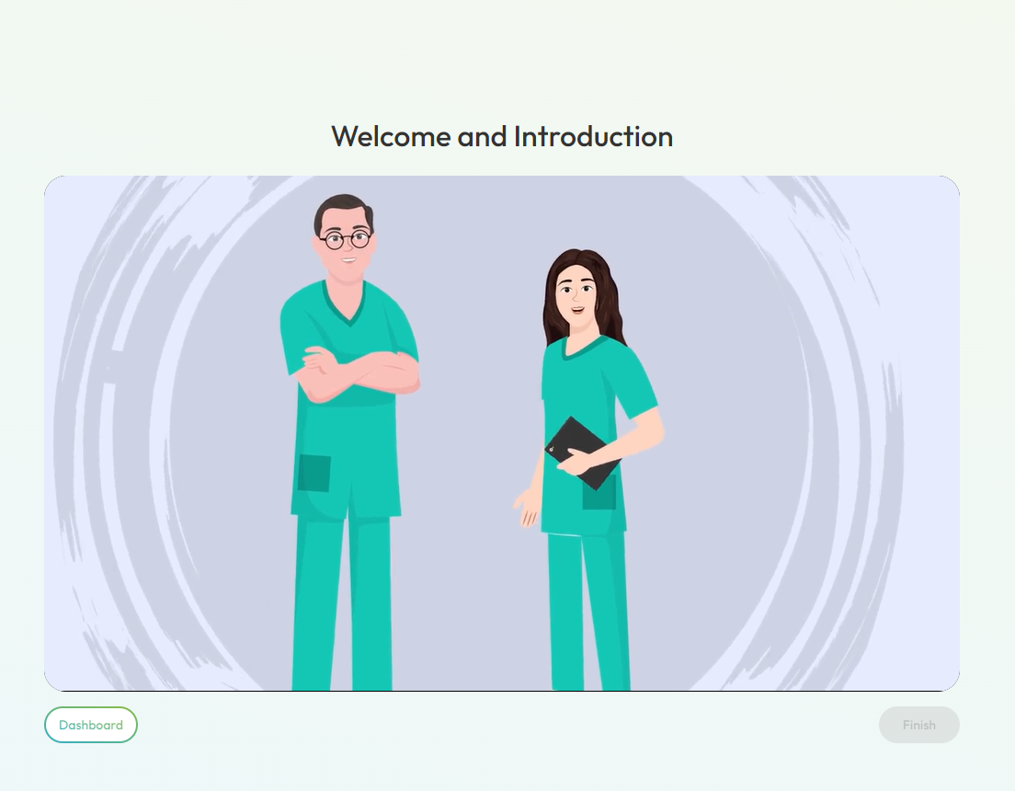
https://herniacalc.com/welcome
Addressing knowledge and resources
Notes:
dana12345

Slide 22
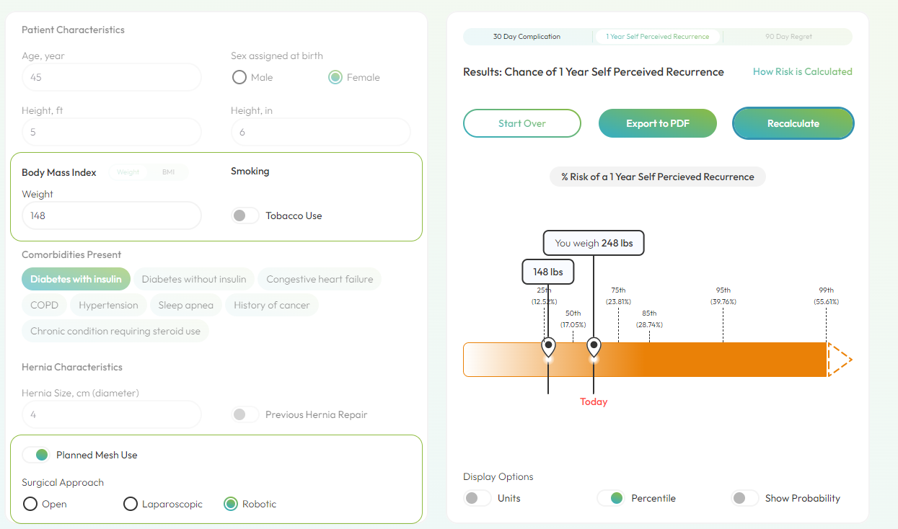
Risk communication
Heroiq Calculator – Heroiq Platform

Slide 23
5. Implementation Goals
The 2025 goal would be the use of the tool >50% of the time.
Measurement starts 4/1/2025 cases
Notes:
The surgeon lead will help the SCQR disseminate information at the hospital, be active in developing and implementing a multidisciplinary engagement, and be engaged with MSQC

Slide 24
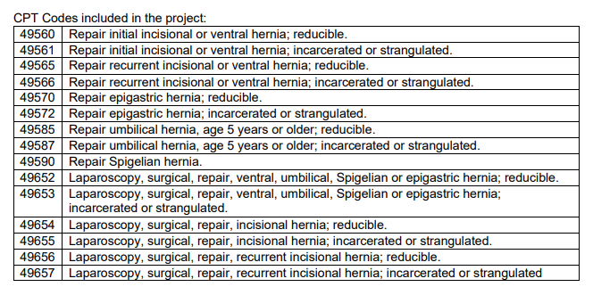
CPT codes included-Hernia 2025
Notes:
The surgeon lead will help the SCQR disseminate information at the hospital, be active in developing and implementing a multidisciplinary engagement, and be engaged with MSQC

Slide 25
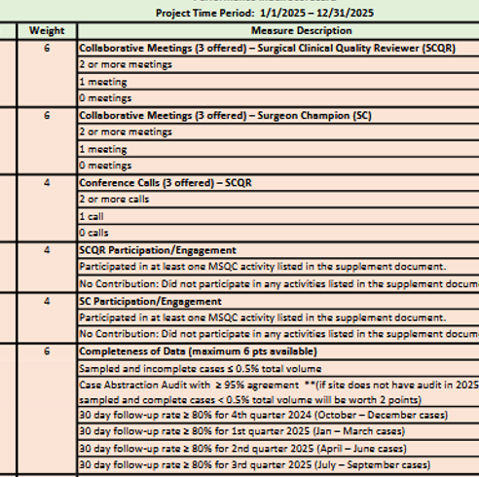
What else is on the P4P Scorecard?
Updated version on the website
SCQR/SC Collaborative Meetings
SCQR Conference Calls
SCQR/SC Engagement (see requirements document on MSQC 2025 QI webpage)
Completeness of Data
  Sampled and incomplete < 0.5%
  and/or
  Case abstraction Audit > 95%
  Follow Up rate > 80% x 4 quarters
Notes:
Updated on 1/14/2025: updated SCQR meeting scoring, changed points for sampled & incomplete/audit measures for sites that don't have audit, changed wording from “hospital” to “collaborative” in CWM, measure 7

Slide 26
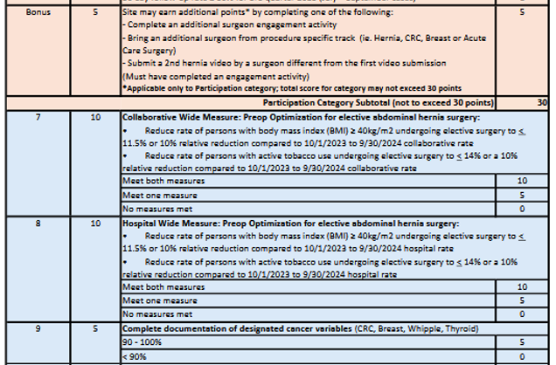
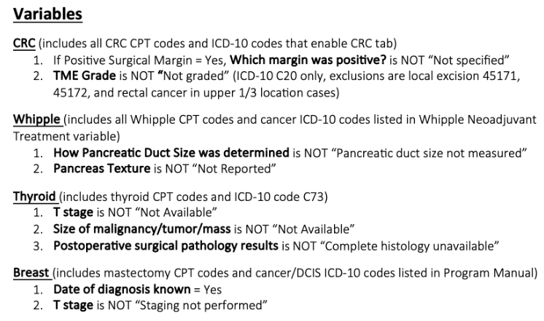
What else is on the P4P Scorecard?
Bonus points (applicable to participation points)
CWM – collaborative and hospital measures
Document cancer variables (see “documentation report” Dropbox QI folder for report)

Slide 27


Thank You! dtelem@med.umich.edu aehlers@med.umich.edu

