Slide 1
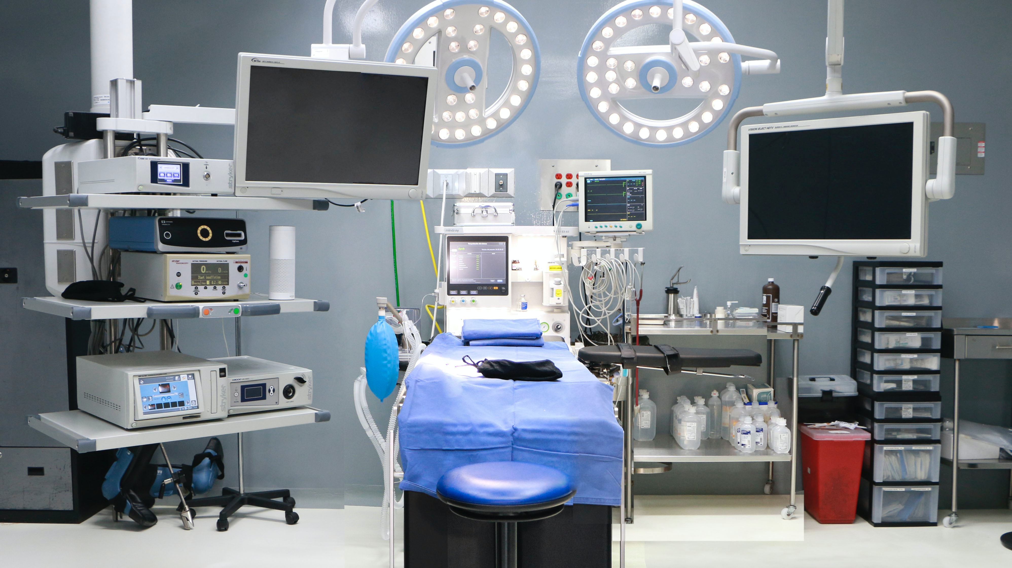

Welcome to the
Frailty QII Kickoff
February 4, 2025

Slide 2


Objectives
Webinar participants will be able to:
  Why Frailty project is important
  Share with others what the Frailty project entails
  Identify project expectations and resources
  List the 5 next steps for the Frailty project
  Understand other requirements of the 2025 P4P

Slide 3
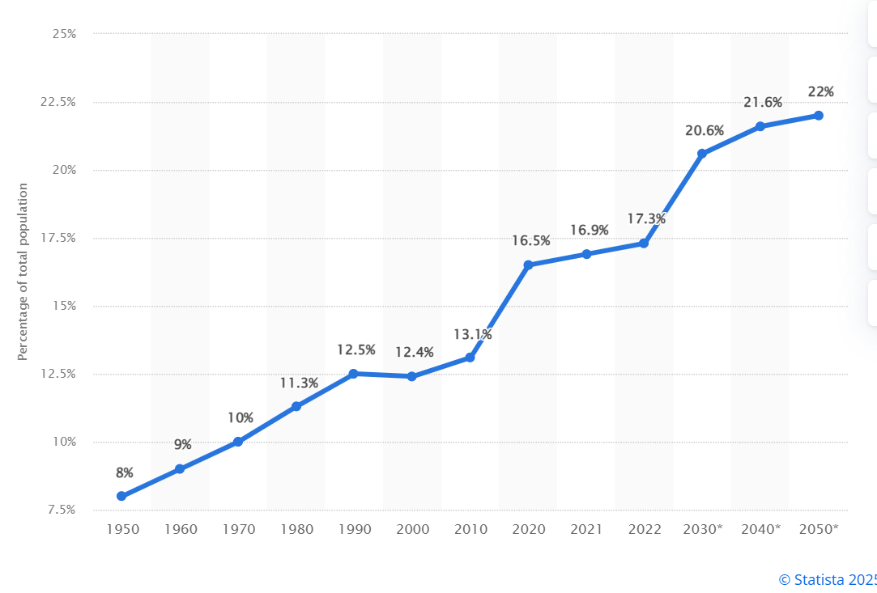
Percentage of Population over 65 years old

Slide 4
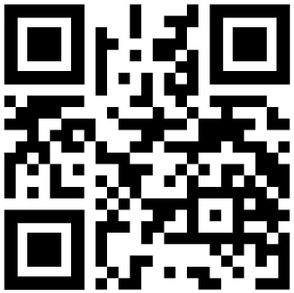
CMS Age Friendly Measures
Eliciting Patient Healthcare Goals: Ensures patient health-related goals and treatment preferences are obtained to inform shared decision-making.
Responsible Medication Management: Optimizes medication management by monitoring pharmacological records to avoid inappropriate drugs for older adults.
Frailty Screening and Intervention: Screens for cognitive impairment (including delirium), mobility, and malnutrition, allowing for early detection and intervention.
Social Vulnerability: Recognizes and addresses social issues impacting older adults as part of the care plan such as social isolation, economic insecurity, ageism, caregiver stress, limited access to healthcare and elder abuse.
Age-Friendly Care Leadership: Identifies an age friendly champion or committee in the hospital to ensure compliance with all components of the measure.
ACS Leads Development of New CMS Age Friendly Hospital Measure to Improve Care of Older Adult Patients | ACS (2024)

Slide 5
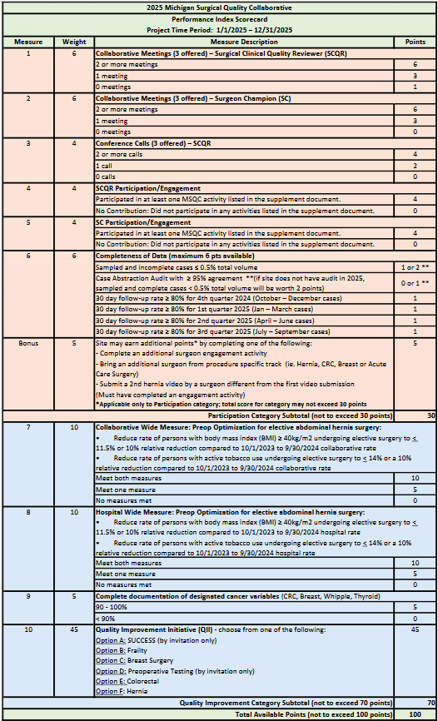
2025 P4P Scorecard
Participation
30 pts
Quality Improvement
70 pts
Notes:
Updated on 1/14/2025: updated SCQR meeting scoring, changed points for sampled & incomplete/audit measures for sites that don't have audit, changed wording from “hospital” to “collaborative” in CWM, measure 7

Slide 6
2025 MSQC Frailty QII Project Goals
Data collection in Frailty tab
Three (3) Multidisciplinary meetings
Screen eligible patients for Frailty – Use of Frailty Tool
Conversation between surgeon and patient/caregiver
Patient/caregiver goals for surgery documented
Provide preoperative patient and/or caregiver education
Submit the 2025 Frailty Project Summary to the MSQC Coordinating Center no later than January 16, 2025.

Slide 7
2025 MSQC Frailty QII Project Measurement
  Continuing sites:
    Measurement period is 1/1/2025-12/31/2025 OR dates
    Must include one new additional surgeon or group and will measure OR dates 4/1/2025 to 12/31/2025
  New sites:
    Measurement period is 4/1/2025 to 12/31/2025 OR dates

Slide 8
1&2. Data collection and Meetings
  1. Sites selecting the frailty pathway will collect MSQC data in the Frailty tab for eligible cases
2. Hold three (3) multidisciplinary meetings. Submit minutes and attendees to the coordinating center with the final project submission (9 points):
  Kickoff meeting by March 29, 2025, to review project requirements and preliminary data. (3 points)
  Two (2) additional multidisciplinary meetings (minimally) before
  December 1, 2025, which includes a data review (3 points each)
For full points, meetings need to
include at least 3 disciplines attending at the same time
be a dedicated MSQC/Frailty working meeting (not a meeting within a standing hospital meeting)

Slide 9
3. Use of Frailty Tool
  Use of Frailty Tool for preoperative frailty screening in ≥ 75% of eligible patients (10 points).
  Sites will distribute and implement a frailty screening tool that will be completed during the preoperative planning period and be completed prior to the final decision to proceed with surgery on all* elective surgery patients meeting any of the following criteria:
    Age ≥ 60 years on the day of surgery
    Current dialysis as defined in MSQC core variable definitions.
    Current cancer as defined in MSQC core variable definitions.
    Functional health status identified as “Not Independent” in MSQC core variable definitions
    Current CHF as defined in MSQC core variable definitions.
  If frailty screening is not completed for a patient who qualifies the SCQR will discern the rationale for failure to use the frailty tool. If this information is unavailable in the chart, the SCQR may also obtain this information by communication with office staff.
* A subset of surgeons may be identified for eligible sites
Notes:
The surgeon lead will help the SCQR disseminate information at the hospital, be active in developing and implementing a multidisciplinary engagement, and be engaged with MSQC

Slide 10
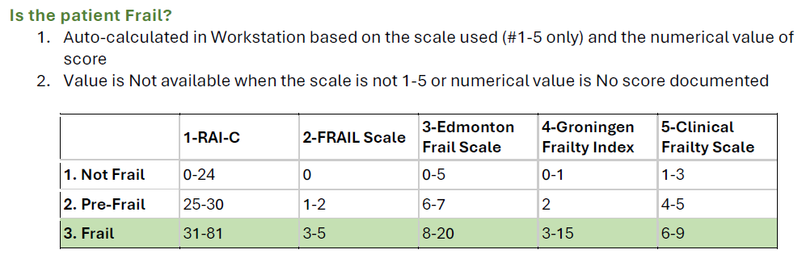
3. Frailty Tool
Resource: Alvarez-Nebreda, et al. (2018). Recommendations for Preoperative Management of Frailty from the Society for Perioperative Assessment and Quality Improvement (SPAQI). J Clin Anesth, 47:33-42. https://pubmed.ncbi.nlm.nih.gov/29550619/

Slide 11
4. A Conversation
  A conversation between surgeon and patient/caregivers occurs for ≥ 75% of patients who screened as frail or pre-frail (8 points).
  The discussion will occur during the surgical planning process by a surgeon or an appropriate healthcare professional designee acting on behalf of the surgeon.
  This guided discussion and an attestation statement in the medical record are required and ensure that a conversation of the risks and benefits has taken place with the patient and/or caregivers.

Slide 12
4. A Conversation
  The conversation and attestation statement regarding frailty screening, goals, and surgical plan must include the following elements:
    General information on frailty
    Interpretation of the scoring results (pre-frail or frail) according to the frailty screening
    Discussion of the potential impact that frailty can have on surgical outcomes
    The participants in the discussion, i.e., patient, family, caregiver
    Any adjustments decided on in the plan of care (if applicable)

Slide 13
4. A Conversation
  Appropriate designees for this conversation are defined as:
    An advanced practice provider (Nurse Practitioner or Physician Assistant) working in collaboration with the surgical team within the clinic setting.
    A provider (MD, DO, NP, CRNA, or PA) acting in partnership with the surgical team to provide preoperative screening, evaluation, or treatment that may occur outside the surgical clinic, on a day prior to the surgical date to facilitate surgical planning.

Slide 14
5. Goals for surgery
  Patient/caregiver goals for surgery are documented for ≥ 75% of patients who screened as frail or pre-frail. (8 points)
  These goals should be in the patient’s words and identify the patient specific wishes for post-surgical outcomes, and should address their overall health goals and/or priorities in addition to the goals that are specific to surgical outcomes. For examples, prioritizing living independently or maintaining the ability to participate in a certain activity.

Slide 15
6. Patient and Caregiver Education
  Provide preoperatively patient and/or caregiver education to ≥ 75% of patients who screen frail or pre-frail (positive for frailty). (10 points)
    *measurement period 4/1/2025-12/31/2025
  The education may be completed by the surgeon or an appropriate healthcare professional designee which may include a Registered Nurse or Advanced Practice provider and must
    be provided verbally and in writing regarding the impact of frailty on surgical outcomes.
    include how increased risk could be mediated pre-and postoperatively.
  Submit the educational materials that are being used to the MSQC coordinating center for approval by February 15, 2025.

Slide 16
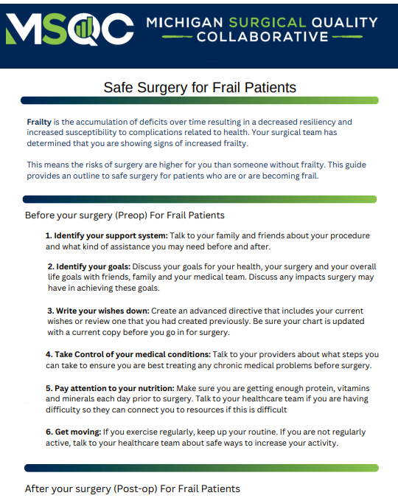
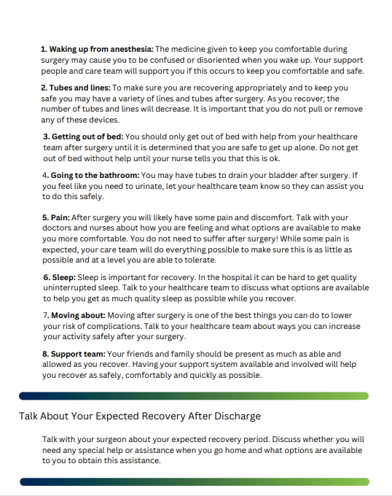
6. Patient and Caregiver Education

Slide 17
7. Project Summary
  Submit the 2025 Frailty Project Summary to the MSQC Coordinating Center no later than January 16, 2025.
  An additional 0-10 implementation points may be granted based on the detail of the project narrative, tracking log, and analysis; to be added to achieve the maximum of 45 project points.

Slide 18
7. Next Steps for Frailty Project
  Identify the Multidisciplinary Team and add meeting dates to calendars early. SCQR, SC or another surgeon lead, and office staff is ideal.
  Identify the Frailty Tool that will be used (new sites) or identify reasons the Frailty Tool wasn’t always used (continuing sites).
  Educate office staff and participating surgeons on the project requirements.
  Develop patient/caregiver educational materials and send to MSQC by February 15th.
  Continuing Sites: Review data from 2024 to determine where improvements need to be made and where the gaps in the process are.

Slide 19
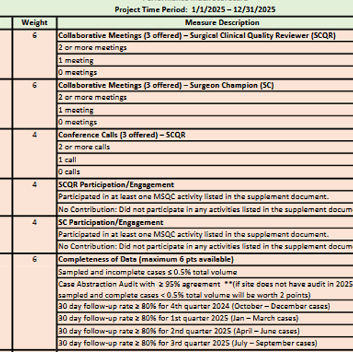
What else is on the P4P Scorecard?
SCQR/SC Collaborative Meetings
SCQR Conference Calls
SCQR/SC Engagement (see requirements document on MSQC 2025 QI webpage)
Completeness of Data
  Sampled and incomplete < 0.5%
  and/or
  Case abstraction Audit > 95%
  Follow Up rate > 80% x 4 quarters
Notes:
Updated on 1/14/2025: updated SCQR meeting scoring, changed points for sampled & incomplete/audit measures for sites that don't have audit, changed wording from “hospital” to “collaborative” in CWM, measure 7

Slide 20
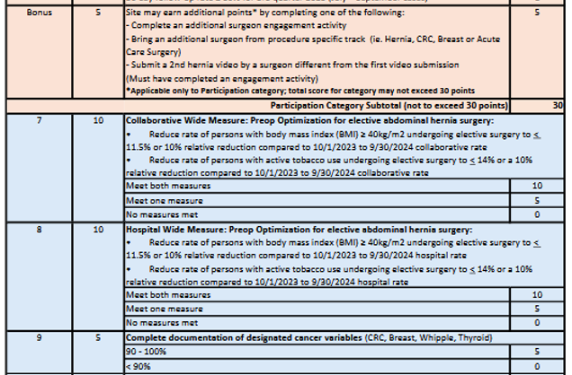
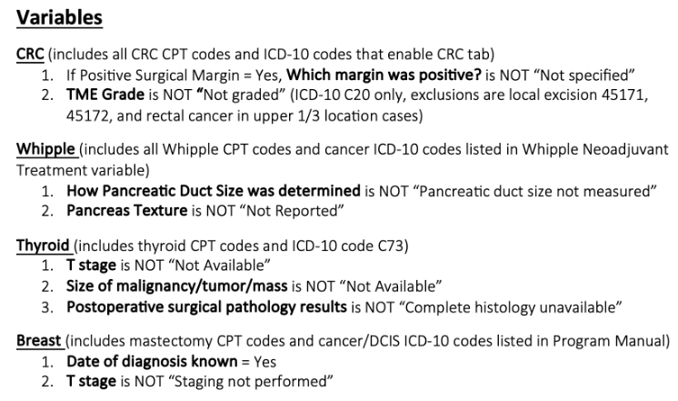
What else is on the P4P Scorecard?
Bonus points (applicable to participation points)
CWM – collaborative and hospital measures
Document cancer variables (see “documentation report” Dropbox QI folder for report)

Slide 21
Resources
2025 QI Webpage: https://www.msqc.org/quality-improvement/2025-msqc-quality-initiatives
Frailty Resources Toolkit | MSQC
Questions? Contact Jami Boyd- jamig@med.umich.edu

Slide 22

Questions?

