Slide 1
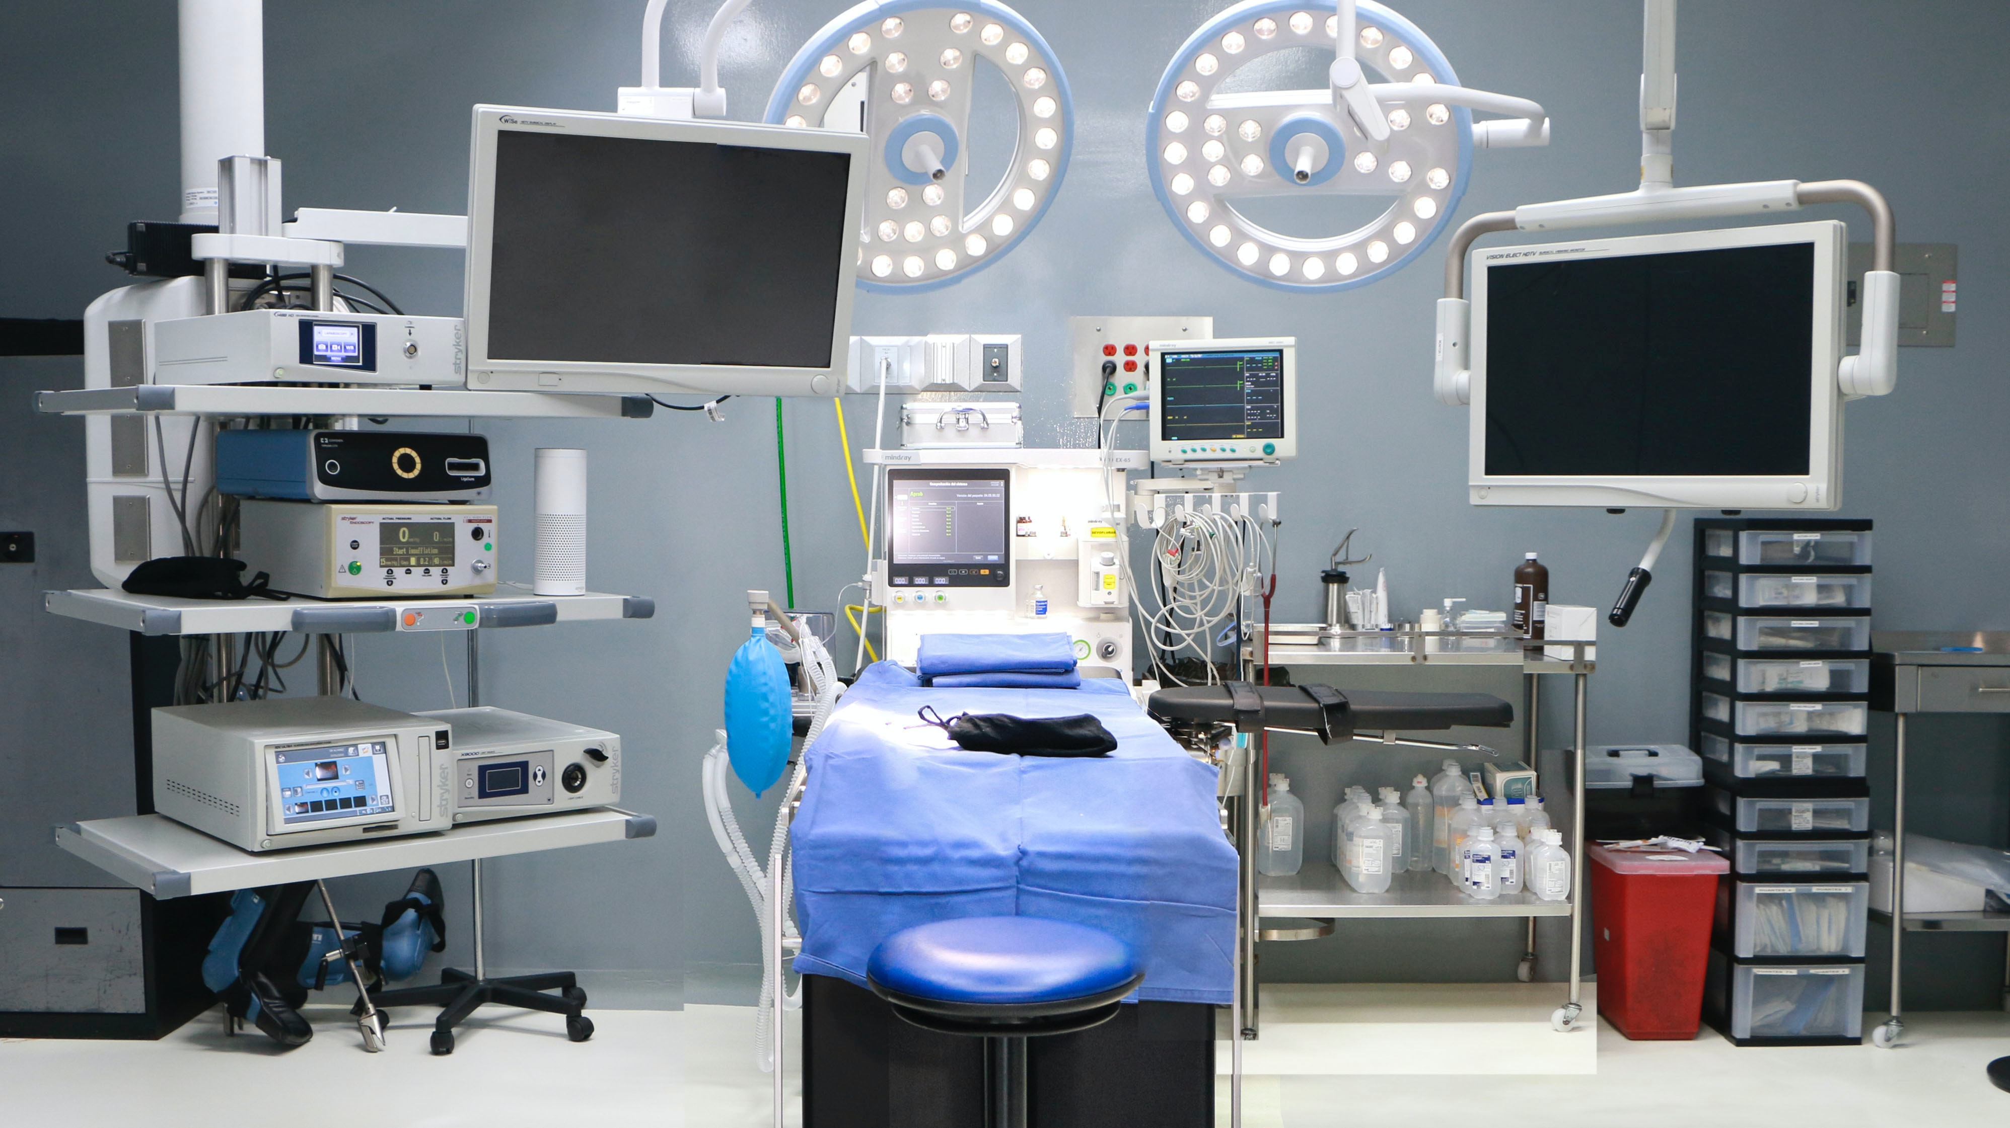

Frailty QI Kickoff
January 31, 2023

Slide 2

What is “Frailty”?
  Frailty is defined as the accumulation of health-related deficits over time that lead to decreased physiologic reserve

Slide 3
Why Assess for Frailty?
Presence of frailty increases the probability of:
  New postoperative patient reported disability
  A decrease post-op in patient reported measures of quality of life
  Non-home discharge for patients who were living at home pre-op
  Postoperative delirium
  Longer length of stay, higher cost of care, and increasedutilization of healthcare resources
Use of frailty tools can highlight potentially modifiable preoperative conditions that could lead to a complicated recovery
Simply screening for frailty has been shown to decrease the incidence of negative surgical outcomes

Slide 4
Frailty Screening Tools
A variety of screening tools have been developed for assessing frailty.
We are recommending five you can choose from:
Clinical Frailty Scale
Edmonton Frail Scale
FRAIL Scale
Groningen Frailty Index
Risk Analysis Index (RAI)

Slide 5
Clinical Frailty Scale
This scale is based on patient assessment by a qualified healthcare provider (APP, MD, DO, CRNA)
Needed information, such as asking the patient if they need help from someone else to complete their daily activities, may be gathered by unlicensed staff if the questions are standardized and they are appropriately trained
No additional physical exam/measurements needed to complete the scale

Slide 6
Edmonton Frail Scale
EFS
This scale involves patient reported factors as well as clinical assessments
The patient reported responses may be collected through a preoperative questionnaire
  Assistance of trained office staff (MA’s) may be used to facilitate answering questions if pt has difficulty
The clock test should be scored by a licensed provider (RN, APP, MD)
Timed up and go test can be administered by unlicensed staff who have been trained in the test and maintain competency

Slide 7
FRAIL Scale
Please ask the participant the following questions (not a self-assessment):
Age: ________
Fatigue: How much of the time during the past 4 weeks did you feel tired? 1 = All of the time, 2 = Most of the time, 3 = Some of the time, 4 = A little of the time, 5 = None of the time.
Responses of “1” or “2” are scored as 1 and all others as 0.
Score_____
Resistance: By yourself and not using aids, do you have any difficulty walking up 10 steps without resting? 1 = Yes, 0 = No.
Score_____
Ambulation: By yourself and not using aids, do you have any difficulty walking a couple of blocks (e.g. several hundred yards)? 1 = Yes, 0 = No.
Score_____
Illnesses: Did a doctor ever tell you that you have [illness]? How many (see list below): _____
The total illnesses (0–11) are recoded as 0–4 = 0 and 5–11 = 1.
The illnesses include hypertension, diabetes, cancer (other than a minor skin cancer), chronic lung disease, heart attack, congestive heart failure, angina, asthma, arthritis, stroke, and kidney disease.
Score_____
Loss of weight: How much do you weigh? __________[current weight]
One year ago in (enter month/year), how much did you weigh?_________[weight 1 year ago]”
Percent weight change is computed as: [[weight 1 year ago - current weight]/weight 1 year ago]] * 100.
Percent change > 5 (representing a 5% loss of weight) is scored as 1 and < 5% as 0.
Score_____
Total Score: _______
A score of 0 represents robust health status
1-2: Pre-frail
3-5: Frail
Questions are designed to be asked of pt/caregiver, not filled out by patient directly
Unlicensed staff may administer the survey and record/calculate the results if trained to do so
Some data may be available via chart review but whenever possible should be obtained in person from the patient or caregiver

Slide 8
Groningen Frailty Index
If administered by unlicensed personnel, wording of questions should be scripted and standardized
May be completed by the patient/caregiver prior to appointment
Does not require additional assessment by licensed practitioner

Slide 9
Risk Analysis Index
Questions may be presented to pt/caregiver to complete prior to visit
Unlicensed personnel may assist with answering questions if trained appropriately
Calculation by unlicensed personnel should only be done after training/competency evaluation
Final score 0-81
  0-15 Robust
  16-25 Pre-Frail
  26-35 Frail
  36+ Very Frail

Slide 10
Informed Discussion
During preoperative planning, the surgeon or a designee acting on the surgeon’s behalf should review the results of frailty screening with every patient screened.
The frailty status of the patient (robust, prefrail, frail, very frail) should be used to guide discussion of additional risks that may exist for the patient.
Discussion should include pt/caregiver’s overall goals of care
  Examples of overall goals of care are: to cure a symptom/condition; continue to live independently; provide relief from pain, etc.
The treatment plan should align with the identified goals of care and both surgical and non-surgical interventions should be presented and discussed.

Slide 11
Benefits of Informed Discussion
Simply screening and discussing risk has been shown to improve post operative outcomes
Identification of potentially modifiable factors specific to the patient may result in adjusting surgical plan to allow for pt optimization
The decided-on intervention should align with the patient’s overall goals of care
  Ex: If continued independence is of utmost importance, the possibility of extended recovery time or need for post acute care should be discussed
  Both surgical and non-surgical interventions, along with the risks and benefits relative to the pt condition should be discussed
Education should be provided to pt/caregivers on possible complications they may encounter while recovering in hospital or at home and what to do if signs of complication arise

Slide 12

So your patient is frail…..
Collaboration with a geriatrics team for a Comprehensive Geriatric Assessment and involving a geriatrician in care haver been shown to greatly improve outcomes
Relatively simple measures and increased surveillance can help mitigate the risk of an adverse outcome
Involvement and education of patient and family in home management/what to expect postoperatively can help identify issues and facilitate early intervention if issues arise
The frailty toolkit contains articles and tools with ways to improve the care of frail patients in all stages of the operative period

Slide 13
Important Dates
March 31, 2023: Completion of multidisciplinary meeting
May 1, 2023: Deadline for reporting of selected frailty screening tool to Coordinating Center
July 1, 2023: Tracking begins on use of screening tool and description/documentation of informed discussion

Slide 14
Tracking and Grading | Frailty “one pager”
Collaborative wide measure: Decrease elective operations on patients who have smoked in the 30 days pre-op (20 points)
Denominator | All elective procedures
Numerator | Preop tab → Tobacco use within 30 days/cigarette = yes
 | ≤ 13.9% = 20 14.0%-14.4% = 15 14.5%-15.0% = 10 15.1%-15.6% = 5 ≥ 15.7% =0
Frailty QI project (25 points)
Presence of frailty screening tool (Goal ≥ 75%)
Denominator | Elective Procedure + any of the following: Age > 60, preop tab → Dialysis=yes, Current CA=yes, CHF=yes OR Not Independent
Numerator | Frailty Tab→ Was a frailty tool used? ≠ no frailty tool used + How was the score reported ≠ no score documented
Conversation between pt and surgeon (Goal ≥ 75%)
Denominator | Elective Procedure + any of the following: Age > 60, preop tab → Dialysis=yes, Current CA=yes, CHF=yes OR Not Independent
Numerator | Frailty Tab → Was there a conversation between the pt/surgeon about risk/benefit=yes
Site Specific Measure | {insert name of project} (20 points)
Current status | {enter baseline % here}
Denominator | {per declaration}
Numerator | {per declaration}
Goal | ≥ 10% improvement={enter goal here} (20) 7.5%=9.9% improvement={enter goal here} (15) 5.0%-7.4% improvement={enter goal here} (10) 2.5%-4.9% improvement={enter goal here} (10)
Complete documentation of size and location of hernia (5 points) Goal ≥ 90%
Denominator | Surgical Profile Tab → Principal operative procedure/CPT code=CPT code included in Hernia category (appendix A)
Numerator | Hernia tab contains ALL of the following: 1. Hernia size→ length and width entered and=non-zero value OR diameter entered and=non-zero value 2 Hernia location≠ Not Documented

Slide 15

Questions?

