Slide 1



Onboarding for Surgical Urinary Catheter Care Enhancement Safety Study (SUCCESS)
Michigan Surgical Quality Collaborative: Quality Improvement Project
January 24, 2023

Slide 2
Welcome SUCCESS Participants!

Slide 3
Objectives
Webinar Participants will be able to:
  Share with others what the SUCCESS project is about
  Identify project tools and resources
  List the 3 next steps for the project

Slide 4


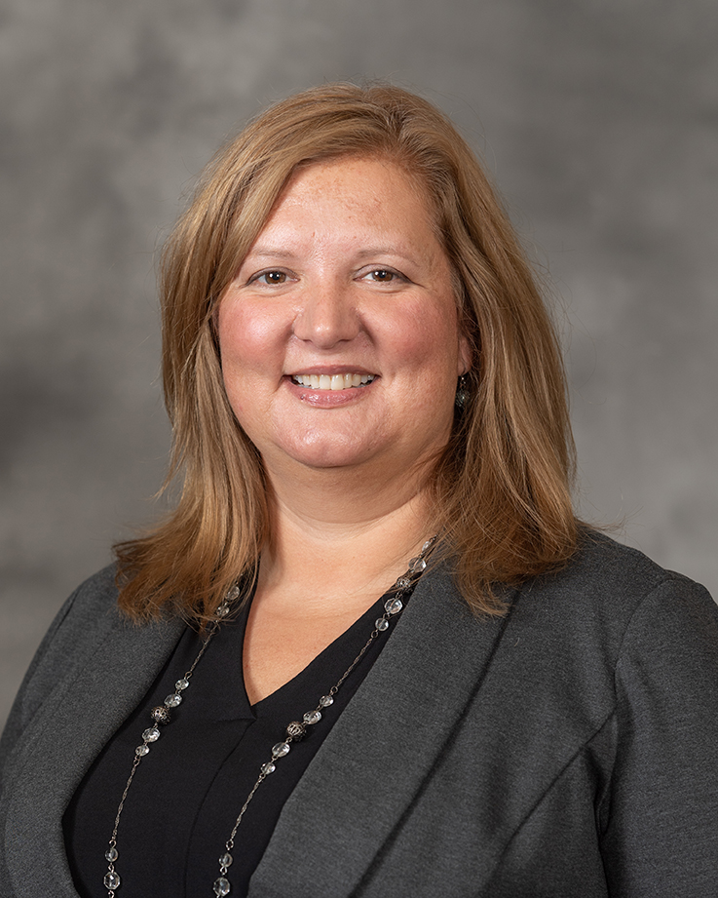
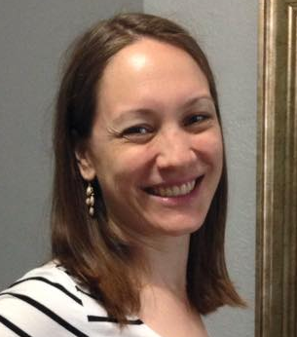

Project Team
Jennifer Meddings
Principal Investigator
Internist
Samantha Hendren
Co-Investigator
MSQC Associate Director
Cheryl Rocker
RN, MSQC Education Coordinator
Jessica Ameling
Project Manager
Jordan Young
Research Assistant

Slide 5
Project Overview: Why Urinary Catheter Safety Needs to be a Priority Now
Urinary catheter-associated injury is not minor
Urinary catheter-associated complications and urethral injuries are preventable and costly
Safer and more appropriate urinary catheter use can occur with the implementation of low-cost evidenced-based strategies to:
Avoid unnecessary catheterization
Standardize management of post-operative urinary retention (POUR)
Ensure safer insertion

Slide 6
Project Goals
Goal #1
Avoid unnecessary catheterization
Decrease use of unnecessary catheters during surgery
Goal #2
Standardize management of Post-op Urinary Retention
Implement standardized management of Post-op Urinary Retention
Ensure necessary equipment and resources (Bladder Scanners, Coudes)
Goal #3
Ensure safer insertion
Increase refresher and new employee training for safer catheter insertion
Ensure necessary equipment and resources (Difficult Catheter Care kit)

Slide 7
Implementing SUCCESS at Your Hospital
Step 1: Prepare your hospital
  Multidisciplinary meeting with key stakeholders by March 31
Step 2: Make a Plan
  Complete the Urinary Catheter Guide to Patient Safety (GPS)
  Step 3: Implement the SUCCESS Toolkit (Tailor the Urinary Catheter Pathway Template to describe your process)
Step 4: Evaluate
Notes:
Thank you Dr. Meddings for that great overview. Dr. Meddings went over the “why”, why this should be a priority when caring for our patients. Now I’m going to go over the “how.” How we recommend you can implement this project at your hospital. And we broke it down into 4 main steps.
Step 2 – like a GPS in your car, it’s meant to help guide you on your SUCCESS journey.
Step 3 – Tailor the urinary catheter pathway template to describe your process. This template can be found on the “SUCCESS QI Tracking Template.”

Slide 8

SUCCESS Webpage: https://msqc.org/success/
All project materials can be found on the SUCCESS Webpage, including printable Toolkit resources

Slide 9

Step 1: Prepare Your Hospital
Orient leaders to change
  The SUCCESS Toolkit Value Proposition¹ provides statistics and stories about urinary catheter harm that are useful to engage leadership and raise awareness of the problem
Notes:
Now I’m going to walk through the steps of the project in more detail. If you have any questions as I’m speaking, please feel free to pop them in the chat.

Slide 10

Suggested invited participants
  Executive leadership team
  Surgeon leadership
  Surgeons (general & urology)
  Anesthesiology
  Nursing supervisors for ER, perioperative, PACU, and surgical units
  Director, quality department
  Patient safety
  Director, nursing education
  Administrative director
  Finance
  Logistics
  Patient experience officer
Multidisciplinary Meeting
Meet with key stakeholders by March 31, 2023, to review project requirements
Review baseline SUCCESS data (instructions available on website)

Slide 11
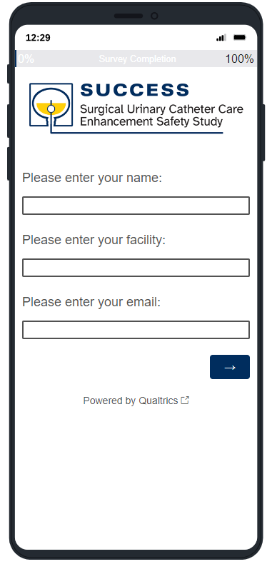
Step 2: Make a Plan
Self-audit & Site visit
  The Catheter Guide to Patient Safety (GPS)² is a brief self-audit tool to help your hospital’s SUCCESS team identify areas of focus
  After completing the GPS, you will receive an email with your results
  In February we will contact you to gauge interest in scheduling a site visit that meets your needs (in-person or virtual)
Notes:
We would like you to complete this by the end of February. After you complete it we will contact you to gauge your interest in scheduling a site visit with our team that meets your needs, either in-person or virtual.

Slide 12
Step 3: Implement the Toolkit
Value Proposition (clinicians and leadership)
Catheter Guide to Patient Safety (GPS)
Algorithm for standardized management of postoperative urinary retention
Safe catheter insertion booklet
Training and education videos
Post difficult urinary catheter insertion card
SUCCESS project supplies
Poster (for OR and Post-Op area) for Urinary Catheter Appropriateness
A phone app for Urinary Catheter Appropriateness
24/7 analytics available in workstation
A Community of Practice
Notes:
These are the 11 components of the toolkit that I’ll describe in more detail in the following slides. It’s important to remember that you can tailor this project to make it work for your hospital. So you may not implement all the tools, and that’s okay. Or you may need to modify some to work for your hospital.
We know there are a lot of components, so first I wanted to break them down by target audience.

Slide 13
Surgeon AND Nurse Toolkit Components
Value Proposition (clinicians and leadership)
Catheter Guide to Patient Safety (GPS)
Algorithm for standardized management of postoperative urinary retention
Safe catheter insertion booklet
Training and education videos
Post difficult urinary catheter insertion card
SUCCESS project supplies
Poster (for OR and Post-Op area) for Urinary Catheter Appropriateness
A phone app for Urinary Catheter Appropriateness
24/7 analytic display in MSQC dashboard
A Community of Practice

Slide 14
Surgeon Specific Toolkit Components
Value Proposition (clinicians and leadership)
Catheter Guide to Patient Safety (GPS)
Algorithm for standardized management of postoperative urinary retention
Safe catheter insertion booklet
Training and education videos
Post difficult urinary catheter insertion card
SUCCESS project supplies
Poster (for OR and Post-Op area) for Urinary Catheter Appropriateness
A phone app for Urinary Catheter Appropriateness
24/7 analytic display in MSQC dashboard
A Community of Practice

Slide 15
Nurse Specific Toolkit Components
Value Proposition (clinicians and leadership)
Catheter Guide to Patient Safety (GPS)
Algorithm for standardized management of postoperative urinary retention
Safe catheter insertion booklet
Training and education videos
Post difficult urinary catheter insertion card
SUCCESS project supplies
Poster (for OR and Post-Op area) for Urinary Catheter Appropriateness
A phone app for Urinary Catheter Appropriateness
24/7 analytic display in MSQC dashboard
A Community of Practice

Slide 16
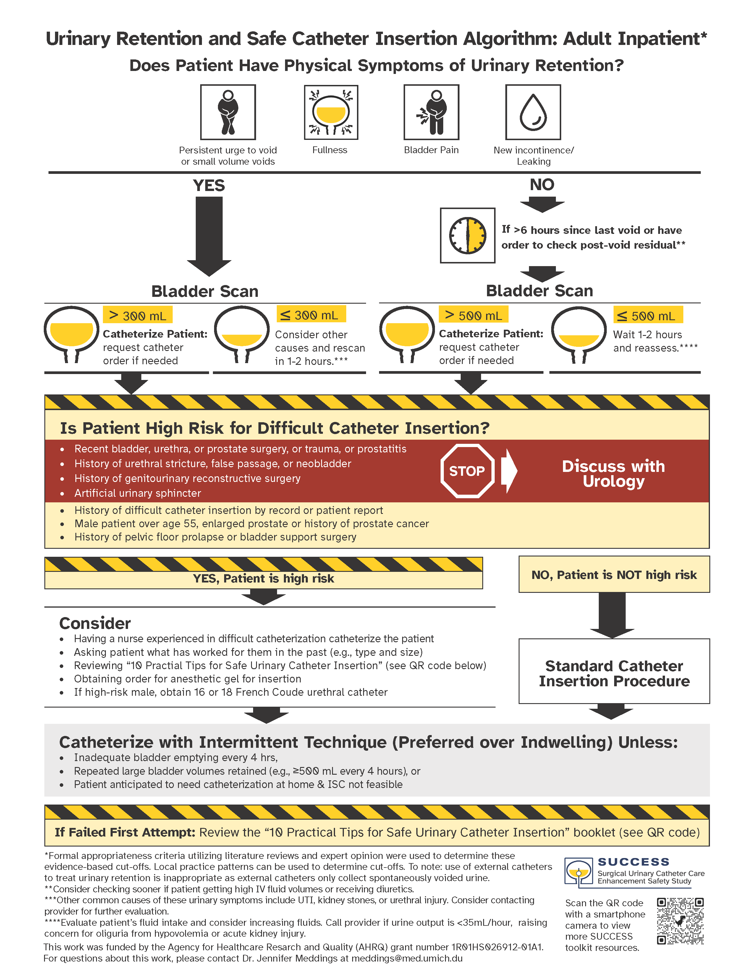
Implement the Toolkit
Urinary Retention
  Algorithm for standardized management of postoperative urinary retention³
    This algorithm is a clinician recourse aimed to help standardize the management of postoperative urinary retention

Slide 17
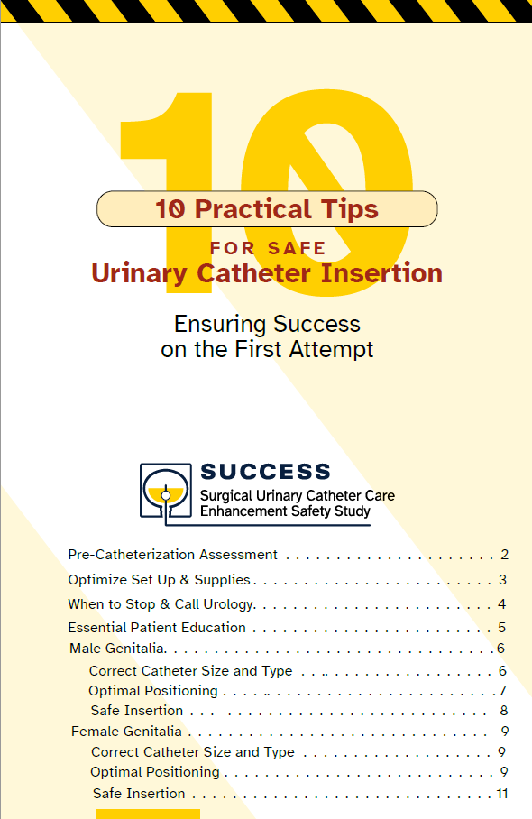
Implement the Toolkit
Catheter injury prevention
  Safe Urinary Catheter Insertion Booklet⁴
    This booklet is a resource to help guide clinicians when inserting a urinary catheter.
    Implementation strategy: use this booklet for an educational session on the ward

Slide 18
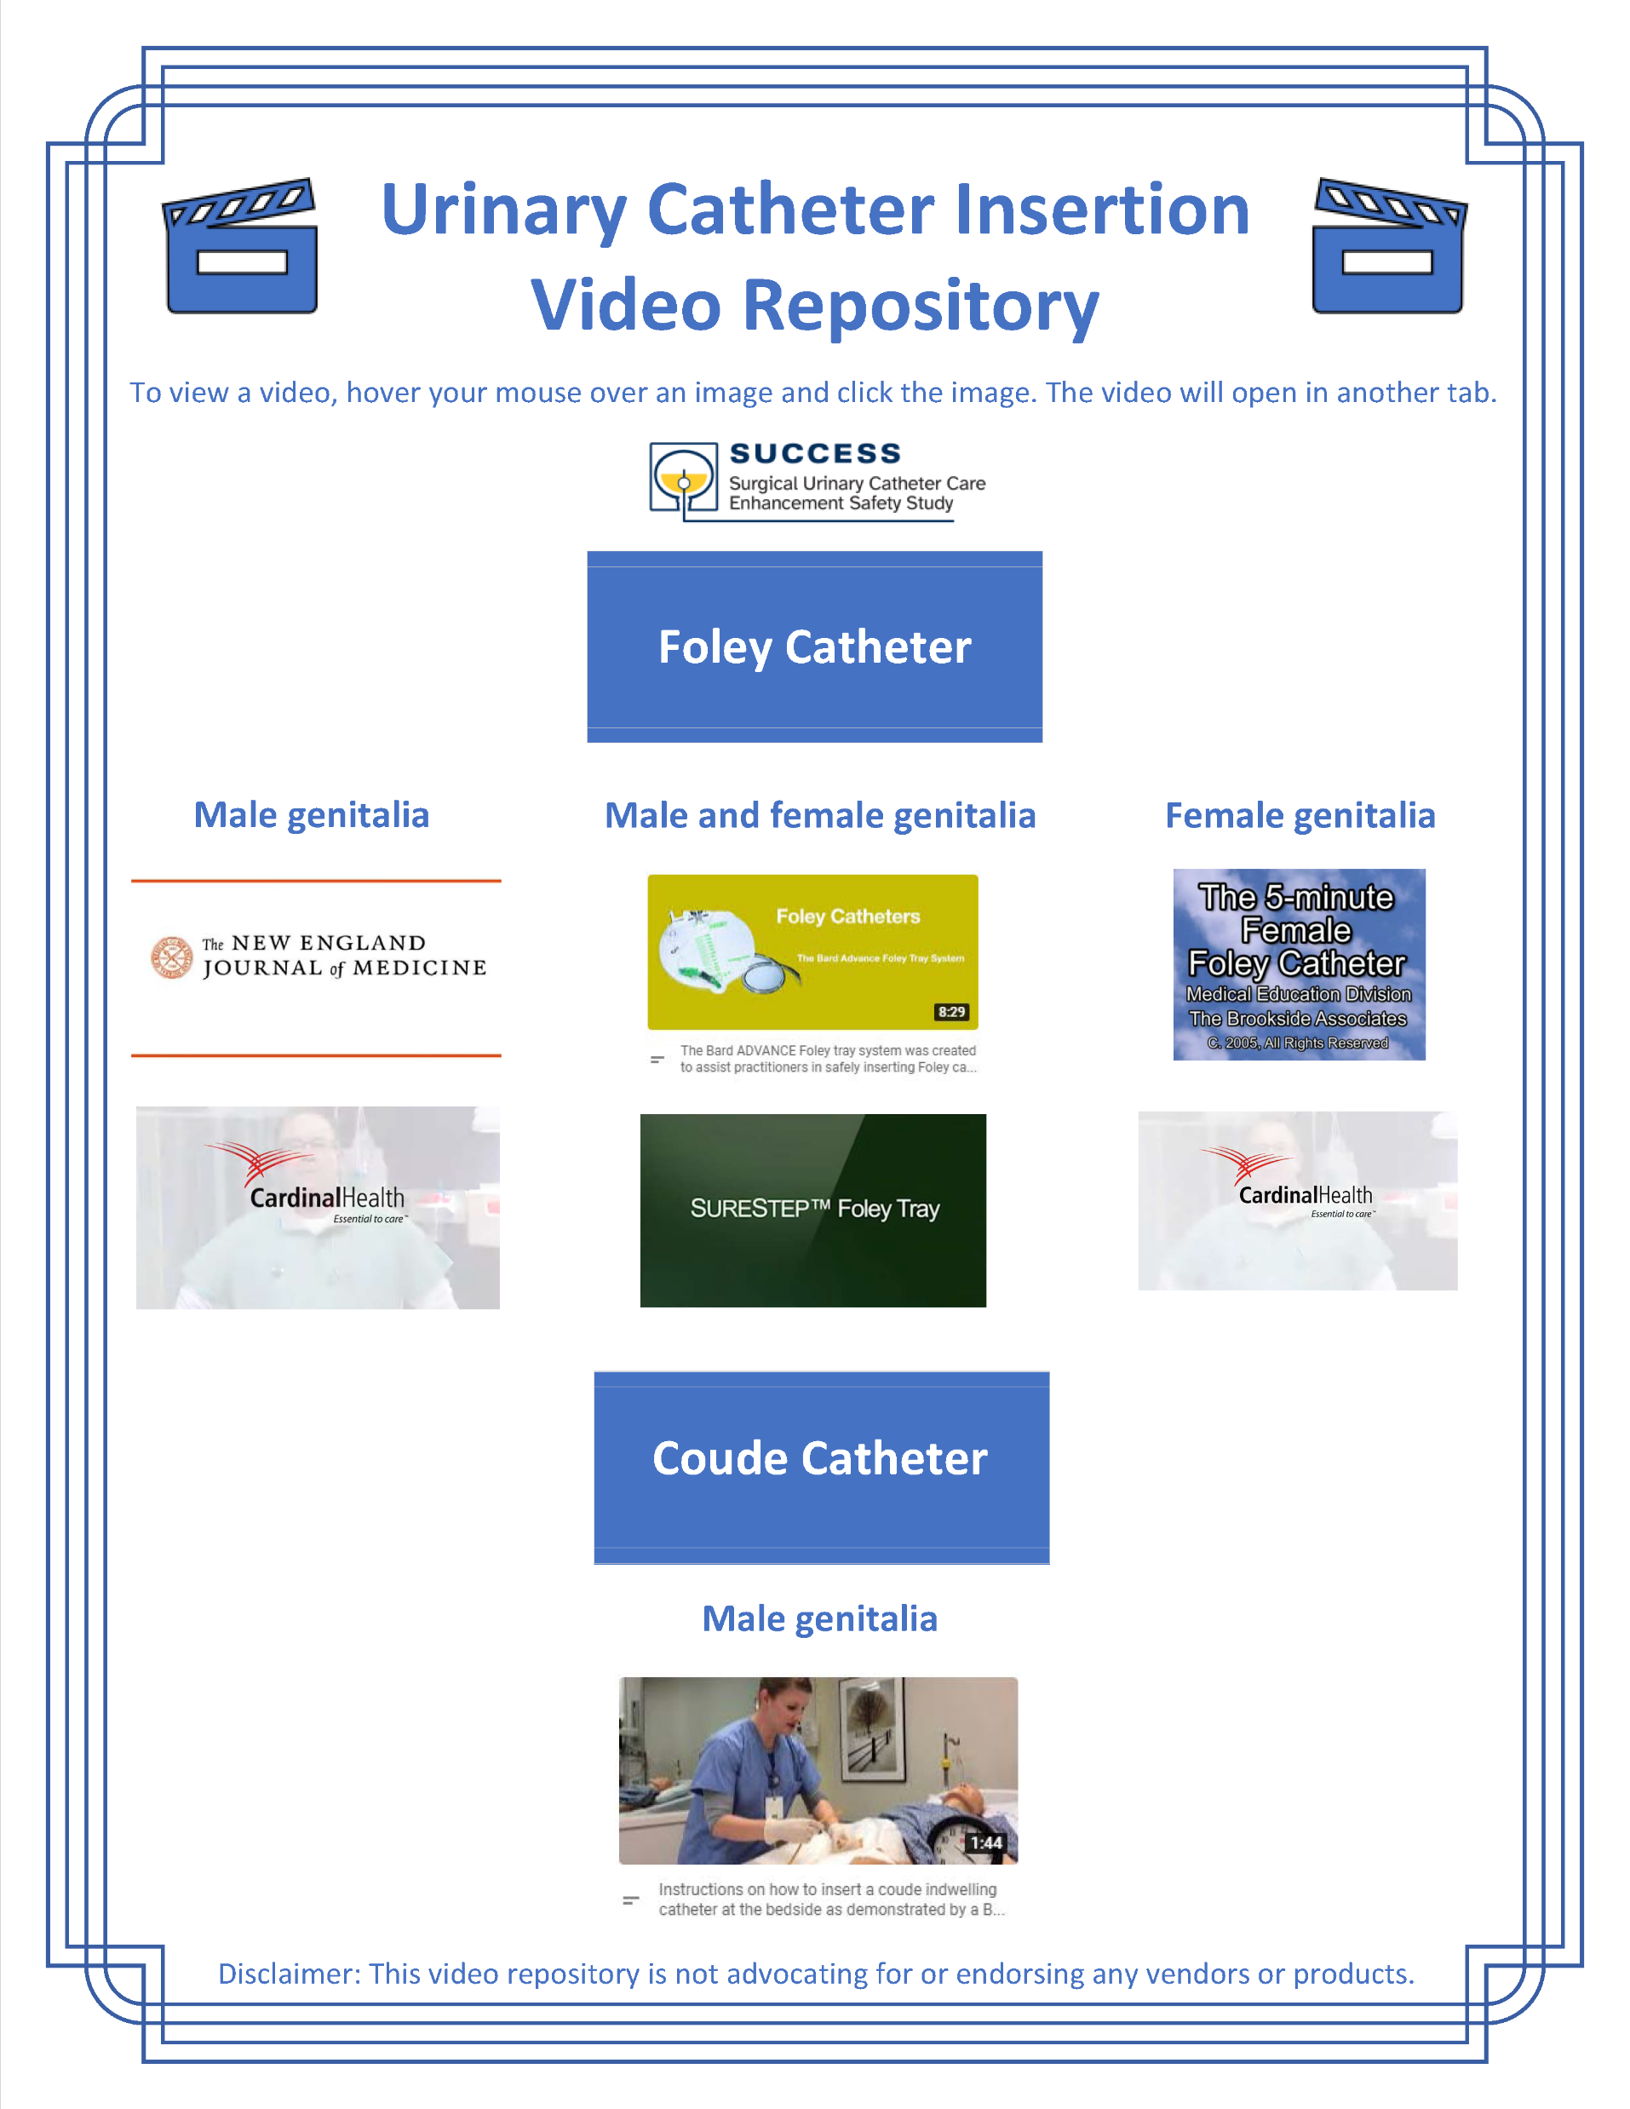
Implement the Toolkit
Catheter injury prevention
  Difficult Urinary Catheter Insertion Training Videos⁵
    This resource is a video repository for clinicians that reviews how to safely insert different types of urinary catheters

Slide 19
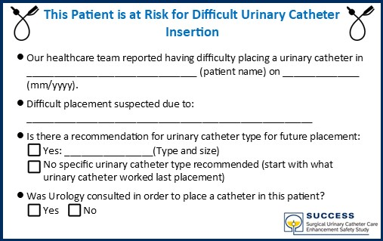
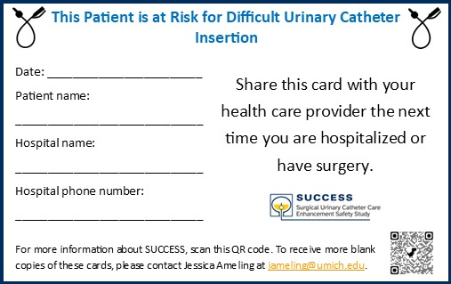
Implement the Toolkit
Catheter injury prevention
  Post Difficult Urinary Catheter Insertion Card⁶
    This card is a patient resource that would be provided to any patient who was difficult to catheterize

Slide 20
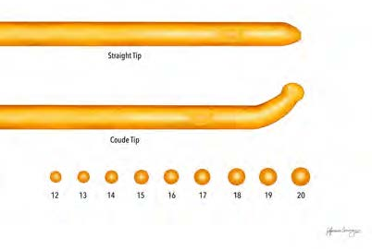
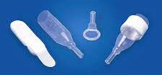
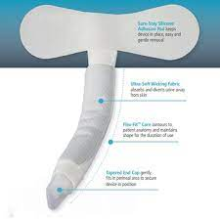
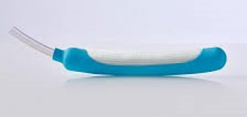
Implement the Toolkit
Coude catheter
Condom catheters
Catheter injury prevention
  Supplies needed for the SUCCESS project⁷
  Bladder scanners
  Coude catheters
  Catheter alternatives such as condom catheters and female wicking devices
  Printed SUCCESS toolkit items (retention algorithm, MAP poster, safe insertion booklet, post difficult catheter insertion cards)
External wicking catheter
External wicking catheter

Slide 21
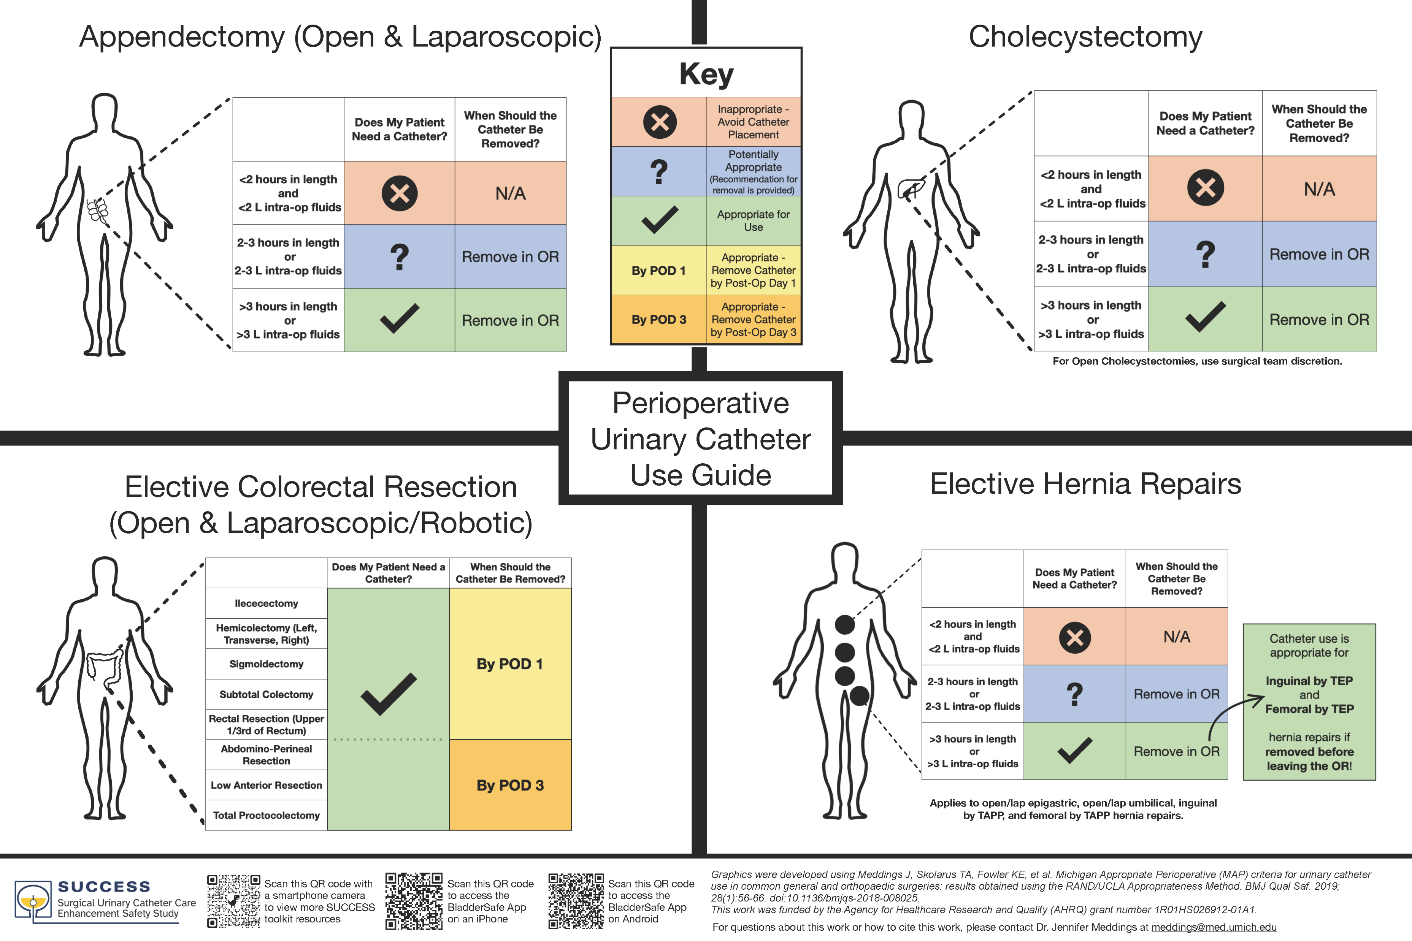
Implement the Toolkit
Appropriate Catheter Use
  Michigan Appropriate Perioperative (MAP) Criteria Poster⁸
    This poster is a clinician resource outlining appropriate perioperative urinary catheter use in four different procedures

Slide 22
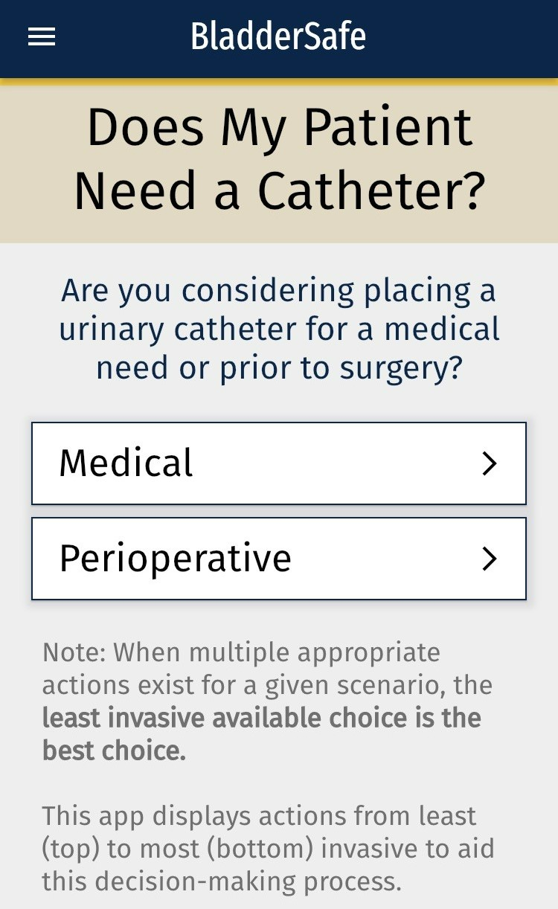
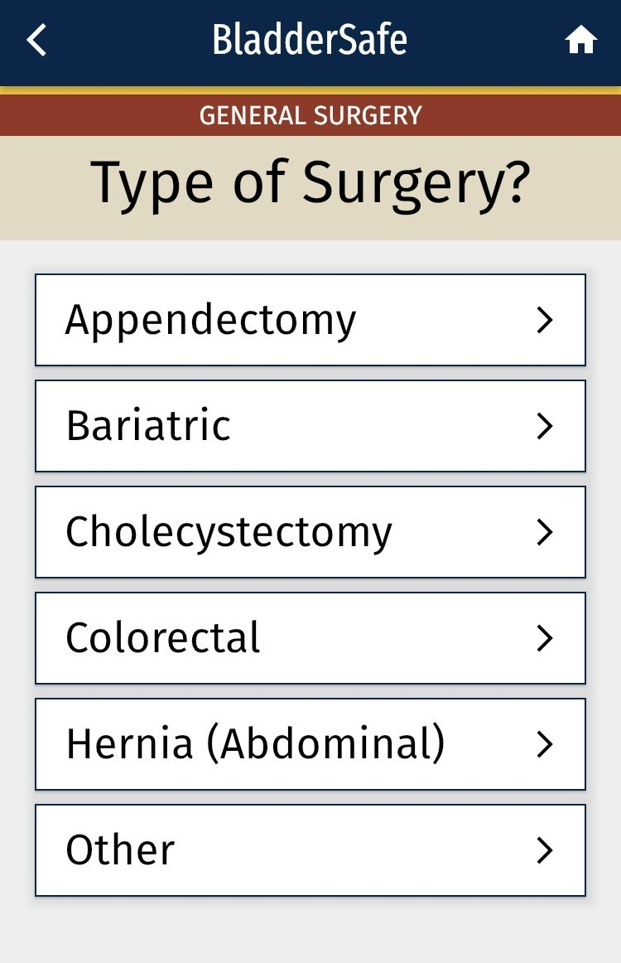
Implement the Toolkit
Appropriate Catheter Use
  BladderSafe⁹
    This smartphone app is a clinician resource guiding appropriate perioperative urinary catheter use in various procedures.
  Search “BladderSafe” in the app store and freely download the app

Slide 23
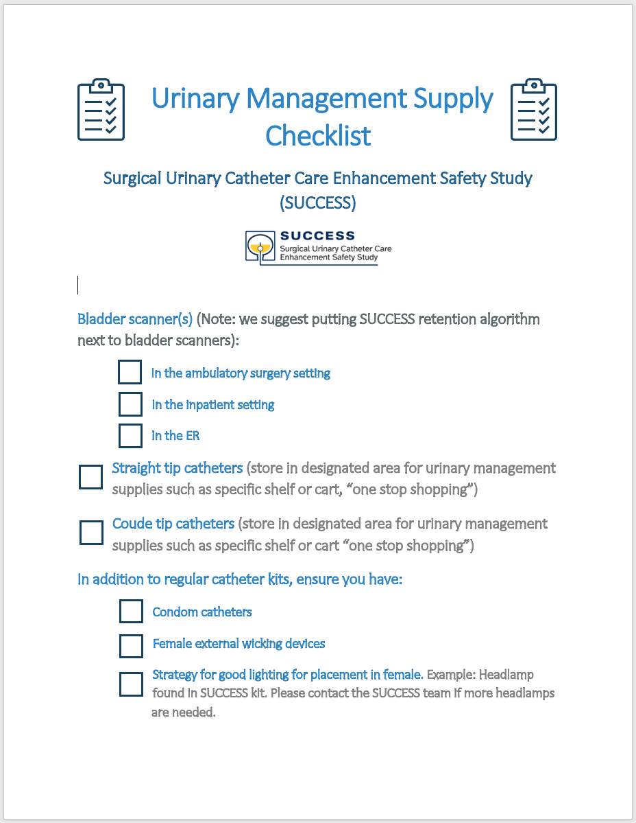
Implement the Toolkit
Catheter injury prevention
  Urinary Management Supply Checklist
    A handy checklist of the supplies needed for the SUCCESS project

Slide 24
Step 4: Evaluate
Capture all SUCCESS data in MSQC workstation for eligible cases
Review SUCCESS data with your multidisciplinary team, submit meeting minutes
  MSQC reports will be provided (one-pager for easy sharing and electronic version with more in-depth data)
  Source data export from workstation¹⁰
Ad hoc check-ins or site visits with SUCCESS team
Peer-to-peer sharing on listserv or at MSCQ Collaborative Meetings¹¹

Slide 25
How Does this Connect to my MSQC QI Scorecard?
Goal 1: Multidisciplinary kickoff meeting with key stakeholders by March 31, 2023 (2 points)
Goal 2: Implement the SUCCESS toolkit and submit a narrative of how the toolkit elements were implemented and/or utilized (0-16 points)
Goal 3: Refine and tailor the MSQC SUCCESS urinary care pathway (2 points)
Goal 4: Bi-annual (minimally) review of SUCCESS data during multidisciplinary meetings. Submit meeting minutes (2 points)
Goal 5: Capture all SUCCESS data in MSQC Workstation for eligible cases (3 points)
Goal 6: Submit the SUCCESS Project Summary to the MSQC Coordinating Center to later than January 16, 2024.
Implementation Points: An additional 0-5 implementation points may be granted based on the detail of the project narrative, tracking log and analysis, to be added to achieve the maximum of 25 project points.

Slide 26
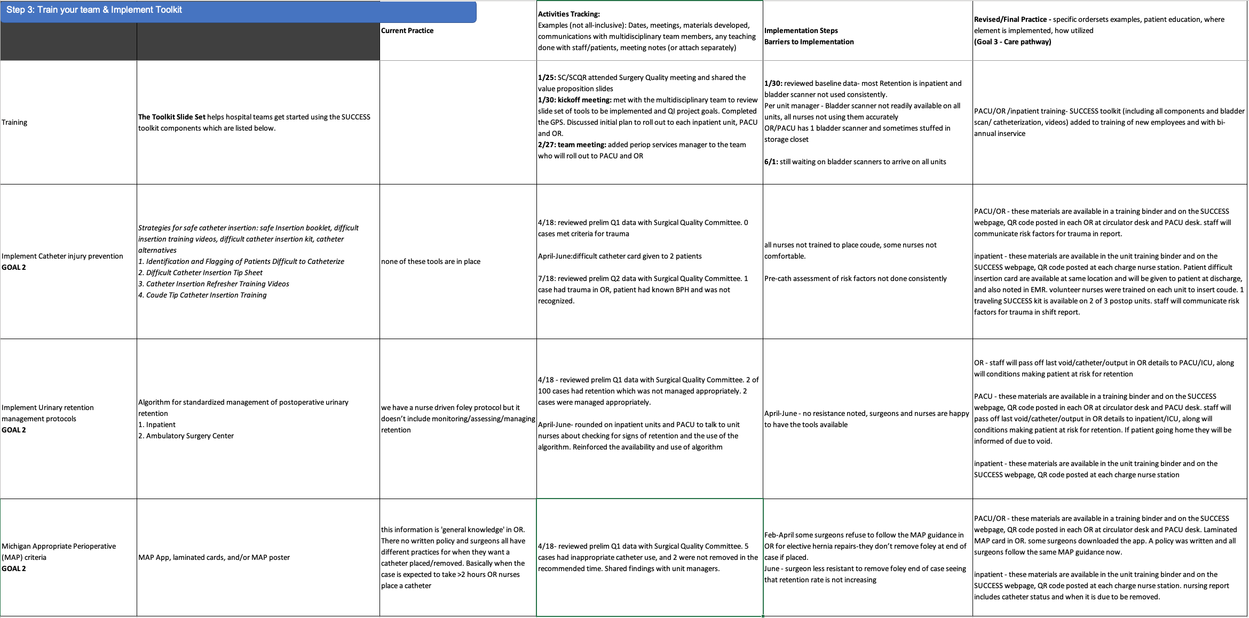
Documenting your Urinary Care Pathway
(Example of Goals 2 & 3)

Slide 27
Next Steps
Assemble your multidisciplinary team, convene before March 31, 2023
Complete the Urinary Catheter GPS (Guide to Patient Safety)
Bookmark the project website: https://msqc.org/success/
The SUCCESS team will set up a listserv where clinicians can ask each other questions
Questions? Contact Jessica Ameling – jameling@umich.edu

Slide 28
Thank You!
Questions?

