Slide 1


Kickoff for Surgical Urinary Catheter Care Enhancement Safety Study (SUCCESS)
2024 Quality Improvement Project
January 24, 2024

Slide 2
Welcome 2024 SUCCESS Participants – both new and continuing!

Slide 3

Housekeeping
Please type your name and hospital into the chat so that we know who is here
The SUCCESS team has a listserv where project participants can ask each other questions: successproject@umich.edu
New sites should have received physical toolkits via UPS. Headlamps will be distributed at April in-person meeting.
Let us know if you and your Surgeon Champion are interested in serving on the SUCCESS Stakeholder Advisory Board
These slides and the recording will be available on the MSQC 2024 QI webpage after the meeting: https://msqc.org/quality-improvement/2024-msqc-quality-initiatives/

Slide 4

Objectives
Webinar Participants will be able to:
  Share with others what the SUCCESS project is about
  Identify project tools, resources, and expectations
    For continuing participants, learn what changed
  List the 3 next steps for the project

Slide 5





Project Team
Jennifer Meddings
Principal Investigator
Jessica Ameling
Project Manager
Samantha Hendren
MSQC Associate Director
Cheryl Rocker
MSQC Clinical Site Coordinator
Jordan Young
MSQC Project Coordinator

Slide 6
Project Overview: Why Urinary Catheter Safety Needs to be a Priority Now
Urinary catheter-associated injury is not minor
Urinary catheter-associated complications and urethral injuries are preventable and costly
Safer and more appropriate urinary catheter use can occur with the implementation of low-cost evidenced-based strategies to:
Avoid unnecessary catheterization
Standardize management of post-operative urinary retention (POUR)
Ensure safer insertion

Slide 7
Project Goals
Goal A
Avoid unnecessary catheterization
Decrease use of unnecessary catheters during surgery
Goal B
Standardize management of Post-op Urinary Retention
Implement standardized management of Post-op Urinary Retention
Ensure necessary equipment and resources (Bladder Scanners, Coudes)
Goal C
Ensure safer insertion
Increase refresher and new employee training for safer catheter insertion
Ensure necessary equipment and resources (Difficult Catheter Care kit)

Slide 8
2024 SUCCESS QI Project Goals Overview
1. Capture all SUCCESS data in Workstation (3pts)
2. Three (3) Multidisciplinary meetings including Kickoff by 3/29 (2 points each)
3. New sites: Implement SUCCESS Toolkit (15 points)
Continuing sites: Meet 5 process/outcome measures (3 points each)
4. Develop (new sites) or refine (continuing sites) the MSQC SUCCESS urinary
care pathway (8 points)
5. Quality review of designated cases (8 points)
Submit SUCCESS Project Summary to the MSQC no later than January 15, 2025.
Notes:
Thank you Dr. Meddings for that great overview.

Slide 9
Implementing SUCCESS at Your Hospital – NEW SITES
Prepare your hospital: Multidisciplinary meeting with key stakeholders by March 29
Make a Plan: Complete the Urinary Catheter Guide to Patient Safety (GPS) and review baseline data
  Implement the SUCCESS Toolkit and develop the Urinary Catheter Pathway Template to describe your process
Evaluate: Perform quality review
Step 1:
Step 2:
Step 3:
Step 4:
Notes:
Dr. Meddings went over the “why”, why this should be a priority when caring for our patients. Now I’m going to go over the “how.” How we recommend you can implement this project at your hospital. And we broke it down into 4 main steps.
Step 2 – like a GPS in your car, it’s meant to help guide you on your SUCCESS journey.
Step 3 – Develop the urinary catheter pathway template to describe your process.

Slide 10
Implementing SUCCESS at Your Hospital – CONTINUING SITES
Prepare your hospital: Multidisciplinary meeting with key stakeholders by March 29
Make a Plan: Re-review your GPS results and baseline data
  Implement the SUCCESS Toolkit: Continue the implementation, refine the Urinary Catheter Pathway Template
Evaluate: Perform quality review; monitor process/ outcome measures
Step 1:
Step 2:
Step 3:
Step 4:

Slide 11

Step 1: Prepare Your Hospital
Orient leaders and team to change
  The SUCCESS Toolkit Value Proposition provides statistics and stories (Mr. Fine and Mr. Hurt!) about urinary catheter harm that are useful to engage leadership and raise awareness of the problem
  Short video to show at your hospital’s kick-off meeting is available
Notes:
Now I’m going to walk through the steps of the project in more detail. If you have any questions as I’m speaking, please feel free to pop them in the chat.

Slide 12
Suggested invited participants
  Executive leadership team
  Surgeon leadership
  Surgeons (general & urology)
  Anesthesiology
  Nursing supervisors for ER, perioperative, PACU, and surgical units
  Director, quality department
  Patient safety
  Director, nursing education
  Administrative director
  Finance
  Logistics
  Patient experience officer
Multidisciplinary Meeting
Meet with key stakeholders by March 29, 2024, to review project requirements – draft agenda on website
  New sites: complete the GPS with the team
Two (2) additional multidisciplinary meetings before December 1, 2024, which include a review of SUCCESS data and a quality review for cases in goal 6
Submit minutes and attendees with your 2024 Project Summary
GOAL 2

Slide 13
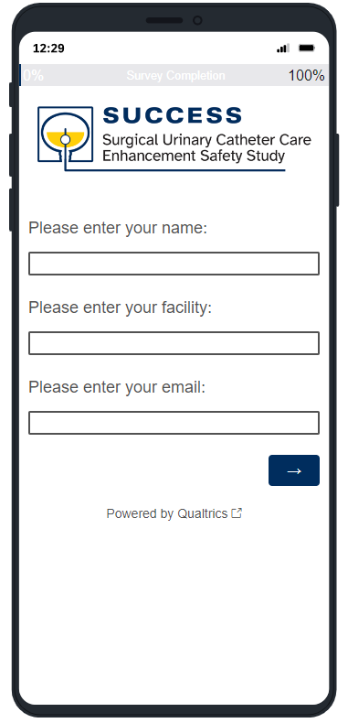
Step 2: Make a Plan
Self-audit
NEW SITES: The Catheter Guide to Patient Safety (GPS) is a brief self-audit tool to help your hospital’s SUCCESS team identify areas of focus (on SUCCESS website). After completing the GPS, you will receive an email with your results
CONTINUING SITES: Re-review your GPS for any gaps from 2023
Notes:
We would like you to complete this by the end of February. After you complete it you will receive an email with your results.

Slide 14

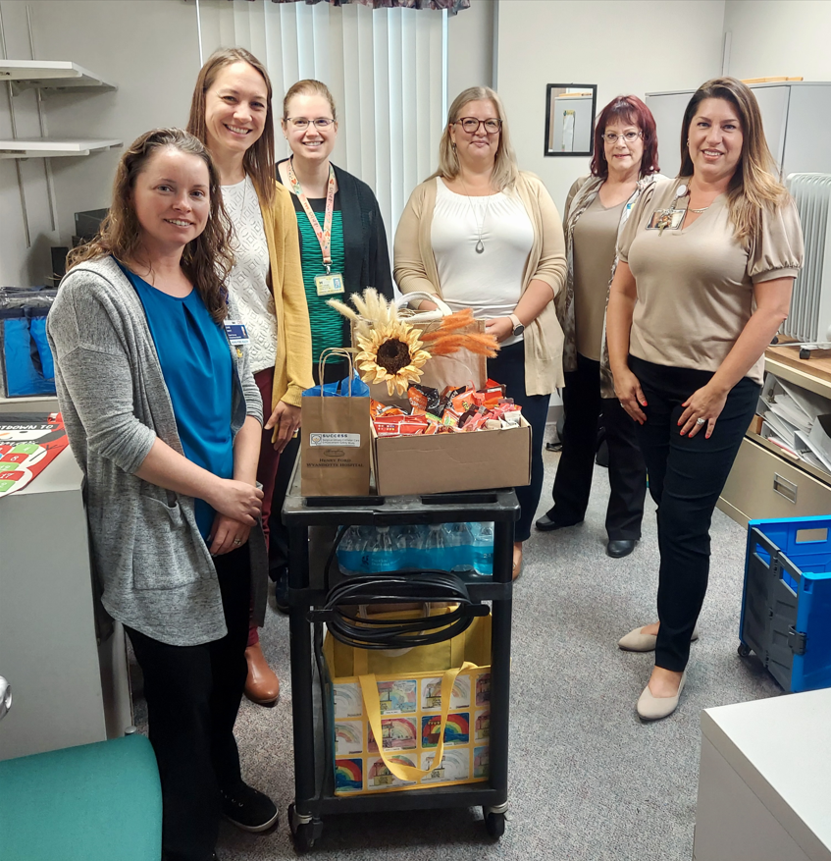
Baseline data review, Site visits, Mentoring
  Mentoring
  NEW SITES: Let us know if you would like to be paired with a returning site as a mentor
  CONTINUING SITES: Let us know if you want to be a mentor
  Requirements apply for P4P credit – see P4P Participation document on 2024 QI webpage
  Site visits
  If you didn’t have a site visit last year, let our team know if you are interested in scheduling a site visit that meets your needs (in-person or virtual)
Baseline data review
Review baseline SUCCESS data in Dropbox (or pull with instructions available on website)
Notes:
Please contact us to to let us know if you are interested in scheduling a site visit with our team that meets your needs, either in-person or virtual.

Slide 15


Step 3: Implement the Toolkit
Perioperative Urinary Catheter Use Guide (MAP Poster) & BladderSafe App
Urinary Retention and Safe Catheter Insertion Algorithm
Algorithm for Voiding Trials – NEW – COMING SOON!
10 Practical Tips for Safe Urinary Catheter Insertion Booklet
Coude Catheter insertion Video
Post-Difficult Catheter Insertion Patient Cards
Visit the SUCCESS webpage to
view the full SUCCESS toolkit!
GOAL #1
Avoid Unnecessary Catheterization
GOAL #2
Standardized Management of POUR
GOAL #3
Ensure Safer Insertion
GOAL 3
Notes:
These are the 11 components of the toolkit that I’ll describe in more detail in the following slides. It’s important to remember that you can tailor this project to make it work for your hospital. So you may not implement all the tools, and that’s okay. Or you may need to modify some to work for your hospital.
We know there are a lot of components, so first I wanted to break them down by target audience.

Slide 16

SUCCESS Webpage: https://msqc.org/success/
All project materials can be found on the SUCCESS Webpage, including printable Toolkit resources

Slide 17
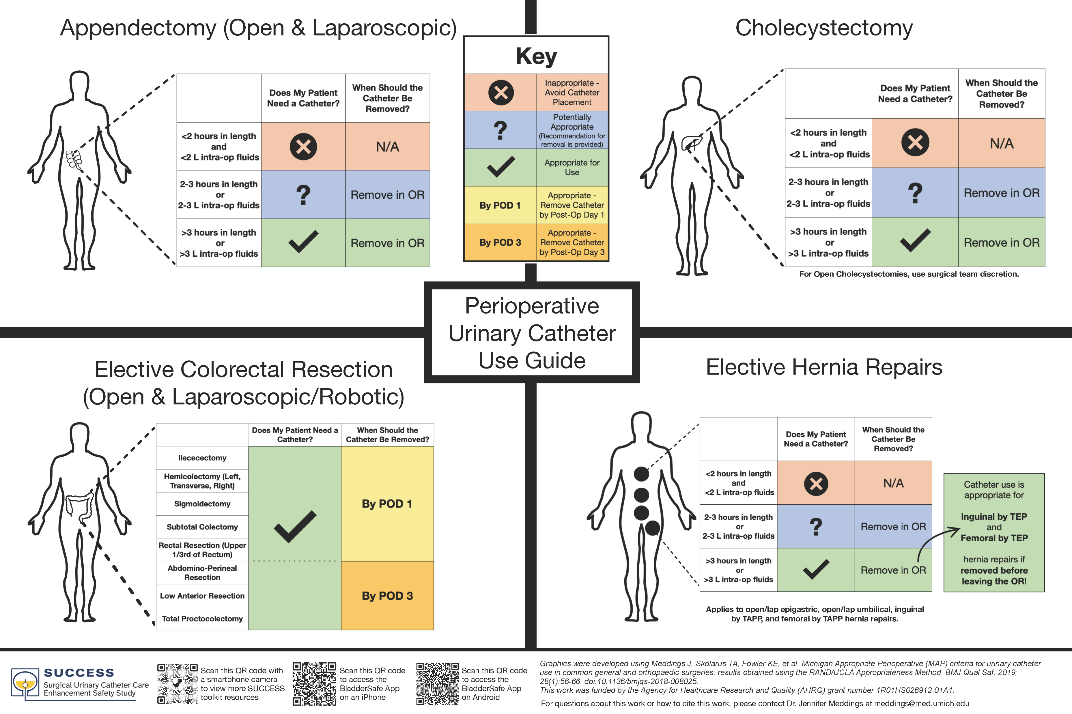
Implement the Toolkit
Appropriate Catheter Use
  Michigan Appropriate Perioperative (MAP) Criteria Poster
    This poster is a clinician resource outlining appropriate perioperative urinary catheter use in four different procedures

Slide 18
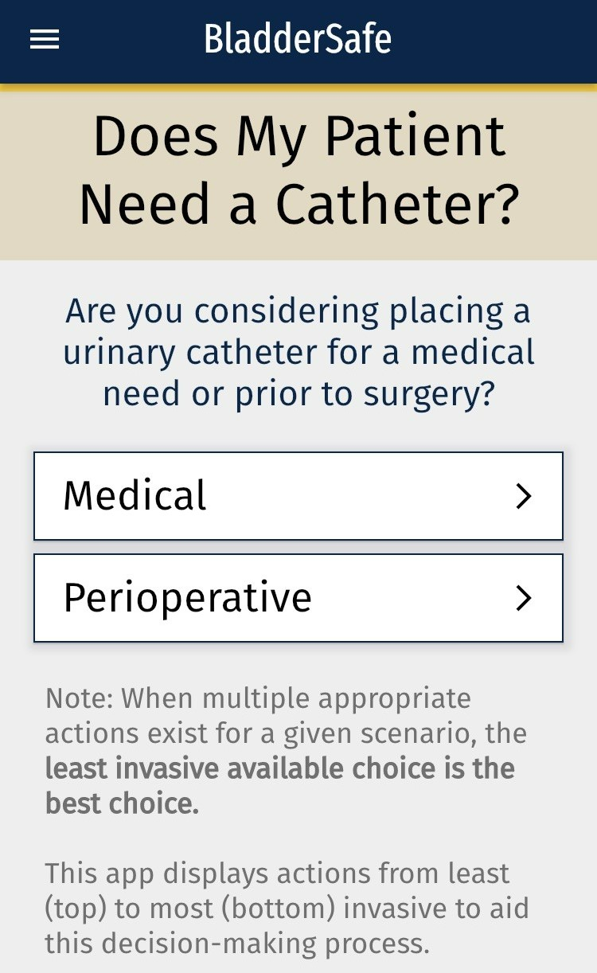
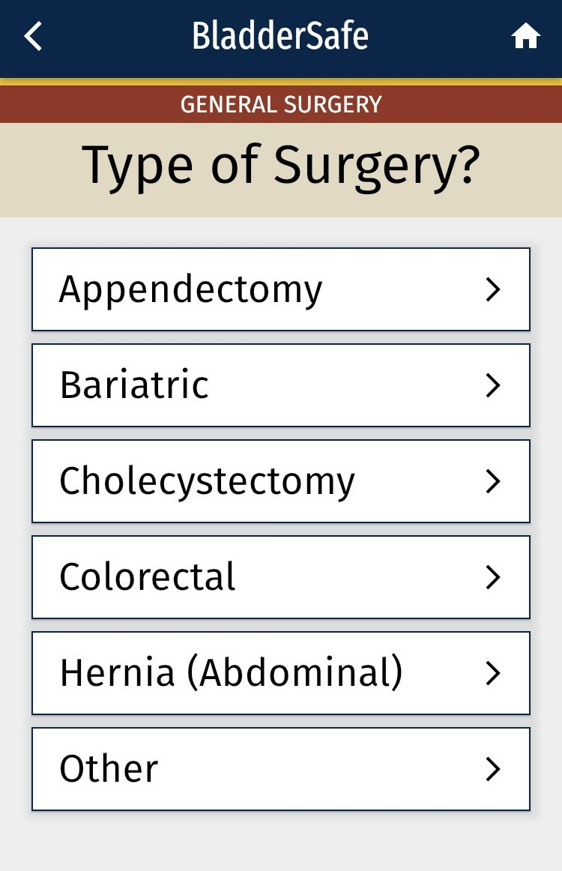

Implement the Toolkit
Appropriate Catheter Use
  BladderSafe
    This smartphone app is a clinician resource guiding appropriate perioperative urinary catheter use in various procedures.
  Search “BladderSafe” in the app store and freely download the app. App logo looks like this:

Slide 19
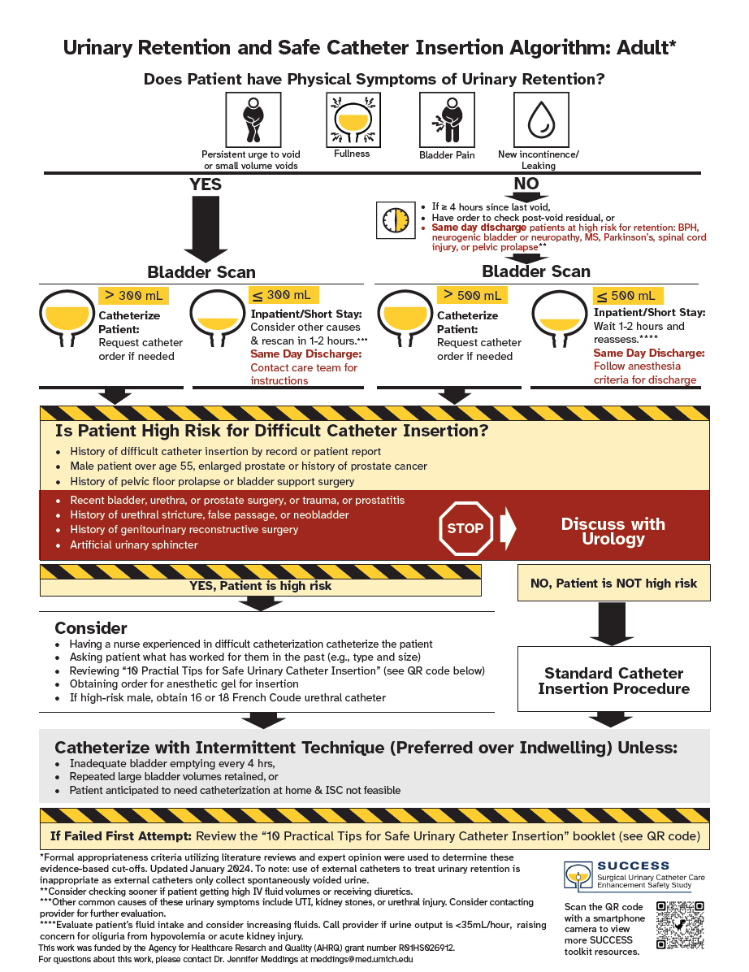
Implement the Toolkit
Urinary Retention
  Algorithm for standardized management of postoperative urinary retention
    This algorithm is a clinician recourse aimed to help standardize the management of postoperative urinary retention
    NEW THIS YEAR – Same day discharge instructions (red font)

Slide 20
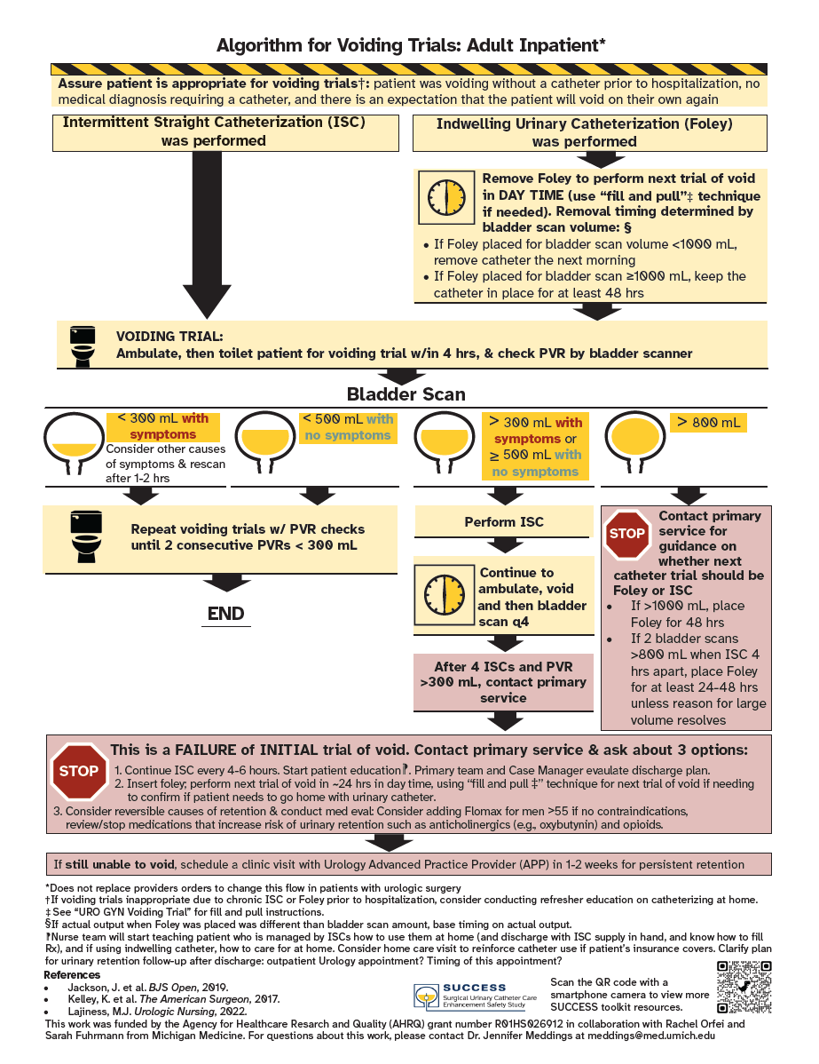
Implement the Toolkit
Voiding Trial Algorithm
  New this year – coming soon!
Notes:
For patient who required catheterization for retention, particularly when they’ve required it multiple times.

Slide 21
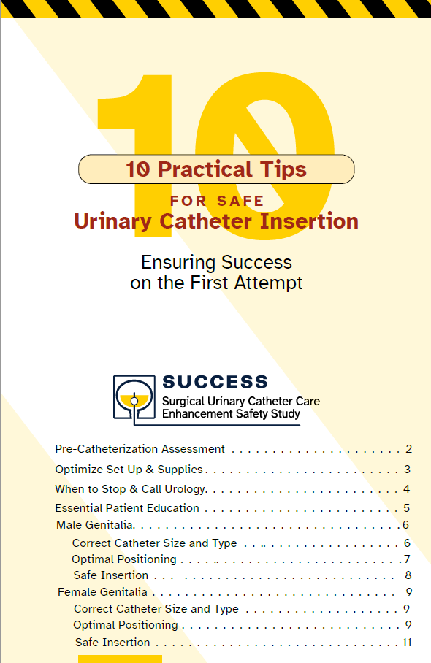
Implement the Toolkit
Catheter injury prevention
  Safe Urinary Catheter Insertion Booklet
    This booklet is a resource to help guide clinicians when inserting a urinary catheter.
    Implementation strategy: use this booklet for an educational session on the ward

Slide 22
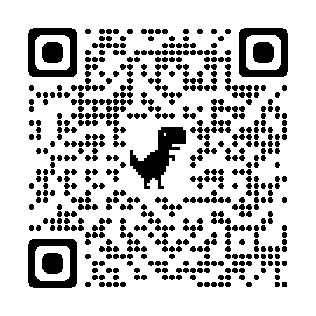

Implement the Toolkit
Catheter injury prevention
  Coude Catheter Insertion Video

Slide 23
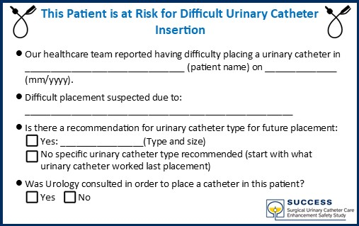
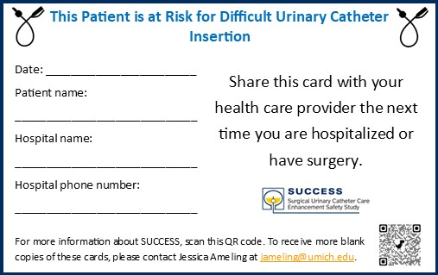
Implement the Toolkit
Catheter injury prevention
  Post Difficult Urinary Catheter Insertion Card
    This card is a patient resource that would be provided to any patient who was difficult to catheterize

Slide 24
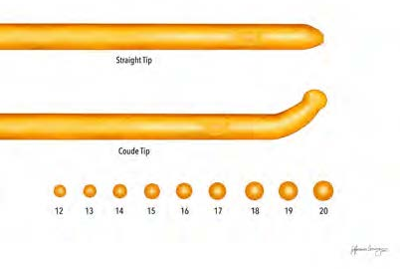
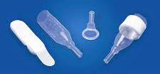
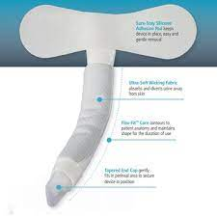
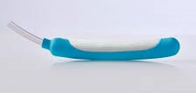
Implement the Toolkit
Coude catheter
Condom catheters
Catheter injury prevention
  Supplies needed for the SUCCESS project
  Bladder scanners
  Coude catheters
  Catheter alternatives such as condom catheters and female wicking devices
  Printed SUCCESS toolkit items (retention algorithm, MAP poster, safe insertion booklet, post difficult catheter insertion cards)
External wicking catheter
External wicking catheter

Slide 25
Implement the Toolkit
Resources for your SUCCESS kick-off meeting:
Kick-off meeting agenda template
SUCCESS kick-off video
Other Implementation Resources:
One-pager SUCCESS flyer with QR codes and screenshots of the tools

Slide 26
Implement the Toolkit
Tips:
Redeployment of bladder scanners and Coude catheters to areas of highest need
Implementation of a Difficult Catheter Care Kit to targeted units
Catheter blitz to introduce toolkit
Monthly stakeholder meeting
Introduce project to ED
Hang posters in surgical rooms
Keep Urinary Retention and Safe Catheter Insertion Algorithm and 10 Practical Tips for Safe Urinary Catheter Insertion Booklet at nurse stations

Slide 27
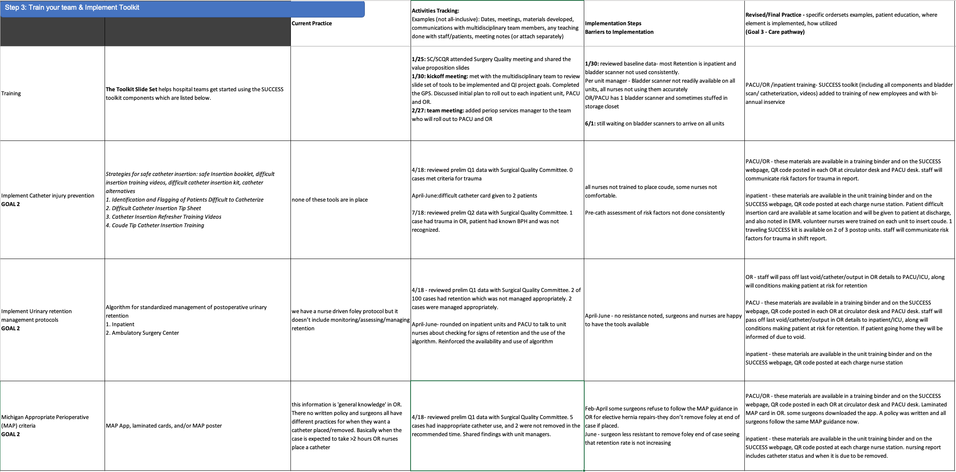
Develop/Refine your Urinary Care Pathway
(Example from 2023)
GOAL 4

Slide 28
Step 4: Evaluate
GOAL 1
Capture all SUCCESS data in MSQC workstation for eligible cases
Review SUCCESS data with your multidisciplinary team, submit meeting minutes with your final project
  SUCCESS Data Feedback Report (one-pager for easy sharing)
  Source data export from workstation (SUCCESS data pull guide)
Ad hoc check-ins or site visits with SUCCESS team
Peer-to-peer sharing on listserv or at MSCQ Collaborative Meetings
Perform quality review; monitor process/outcome measures

Slide 29
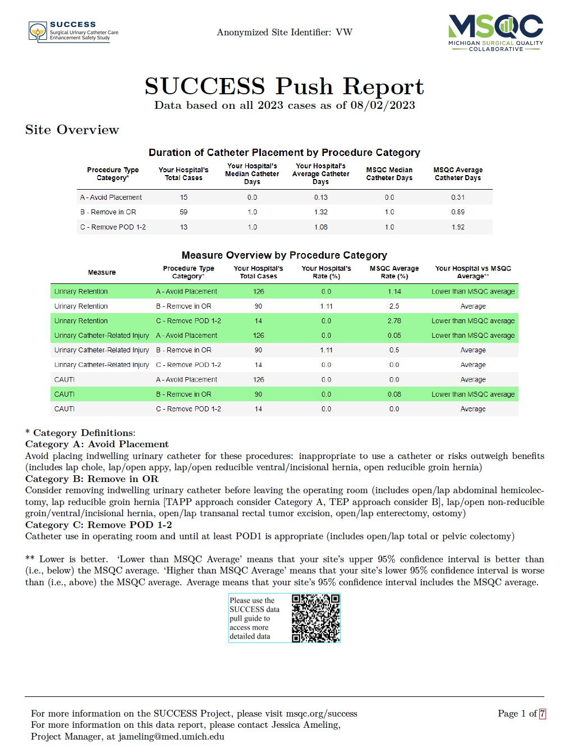
Evaluate
SUCCESS Data Feedback Report
  Pushed to your hospital’s Dropbox on a regular basis
  Distribute your SUCCESS data to your leaders and frontline clinicians

Slide 30
Total cases in each category with a catheter

Slide 31
Total cases in each category (with or without a catheter)

Slide 32
Evaluate
GOAL 3
Monitor process/outcome measures [continuing sites]
  Measurement period 1/1/2024-12/31/2024
Catheter use measures
a. Avoid indwelling catheters intraoperatively in Category A*: < 10% of cases have an indwelling catheter
b. Catheter is removed in OR for > 75% of Category B* cases
Urinary retention diagnosis and management measures
c. Bladder scan volume is documented > 90% of the time if urinary catheterization for retention was performed
d. No urinary catheter is used for bladder scan volumes < 300 ml for > 90% of cases
e. ISC was performed as opposed to an indwelling catheter (unless volume > 500) for > 90% of cases
Notes:
Meet the process/outcomes measures for appropriate catheter use and urinary retention diagnosis and management (15 points total, 3 points each measure). Measurement period 1/1/2024-12/31/2024 OR dates

Slide 33
Evaluate
GOAL 5
Perform quality review for these cases [all sites]
new sites from 4/1/2024 to 12/1/2024 OR dates, continuing sites from 1/1/2024 to 12/1/2024 OR dates
a. Patients in Category A who have an indwelling urinary catheter placed in OR.
b. Retention is assigned for patients who had a urinary catheter (ISC or indwelling) placed when < 300 ml is documented via a bladder scanner or the catheter use
c. Patients who return to ED with Retention
d. Patients who were discharged with an indwelling catheter or need for ISC
e. Patients who have Urinary Catheter-Related Trauma assigned
Notes:
Perform a quality review of each case that meets any of the criteria below, new sites from 4/1/2024 to 12/1/2024 OR dates, continuing sites from 1/1/2024 to 12/1/2024 OR dates. An overall findings summary (trends identified, action plans implemented) should be submitted with your 2024 Project Summary (8 points)

Slide 34
Next Steps
Assemble your multidisciplinary team, convene before March 29, 2024
NEW SITES: Complete the Urinary Catheter GPS (Guide to Patient Safety)
Bookmark the project website and develop your implementation plan: https://msqc.org/success/
Questions? Contact Jessica Ameling – jameling@umich.edu
Also let us know about mentoring, SUCCESS Stakeholder Advisory Board interest

Slide 35
Data Variable Changes from 2023 to 2024
1. Moved all 4 exception options to Intraop Tab (if any are selected it disables the remaining intraop tab catheter use variables and SUCCESS tab.)
Did the patient have any of the following exception criteria? (select all that apply) | 0. No 1. Surgical entry into urinary tract during surgery (not including ureteral stents/catheters) 2. Patient has other permanent urinary diversion (e.g., urostomy or suprapubic catheter) 3. Patient has a pre-existing or surgically created bowel to bladder connection such as colovesical fistula or enterovesical fistula 4. Patient has a chronic indwelling catheter or chronic straight catheterization requirement which was present before admission and/or in place for greater than 2 weeks before surgery
2. The same exceptions apply to Retention (do not assign if any are applicable)
3. Added more date validation rules (cannot select certain dates for better data integrity

Slide 36
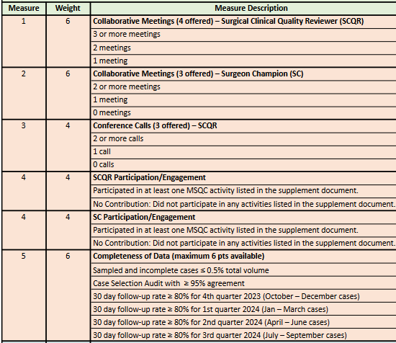
What else is on the P4P Scorecard?
SCQR/SC Collaborative Meetings
SCQR conference call
SCQR/SC Participation/Engagement (see requirements document on 2024 QI webpage)
Completeness of Data
  Sampled and incomplete < 0.5%
  Case selection Audit > 95% agreement [all sites]
  Follow Up rate > 80% x 4 quarters

Slide 37
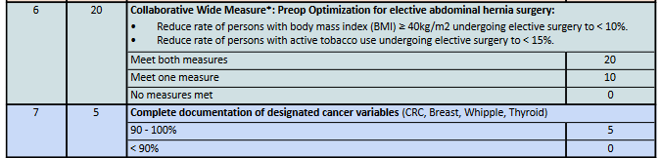
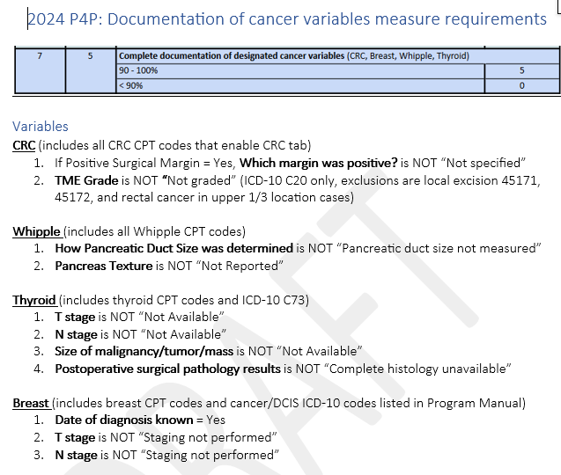
What else is on the P4P Scorecard?
CWM
Document cancer variables (see requirements document on 2024 QI webpage)
MOQC bonus points

Slide 38

Thank You!
Questions?

