Slide 1


2024 Breast Surgery QI Kickoff
January 22, 2024

Slide 2
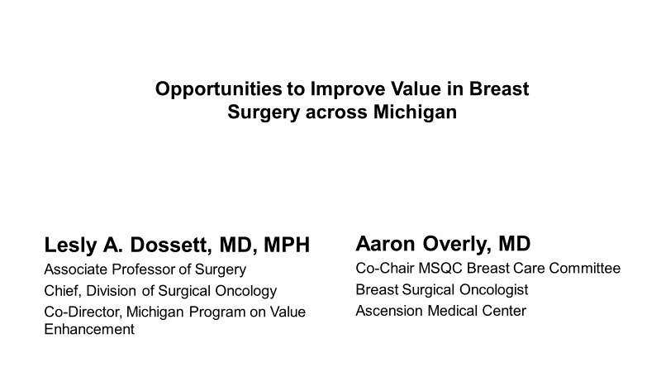

Slide 3
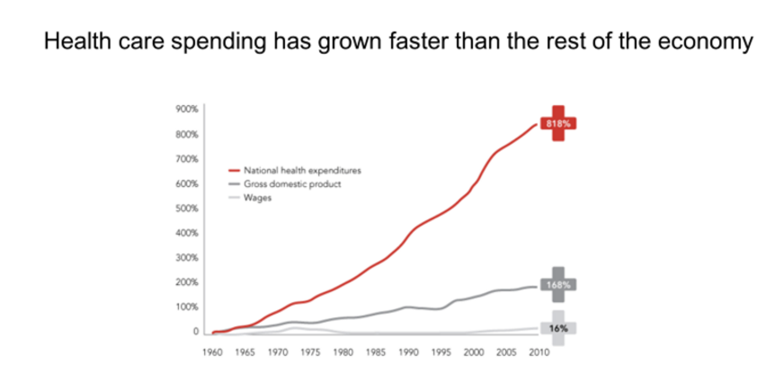
McKinsey. Accounting for the cost of US health care. 2011.

Slide 4
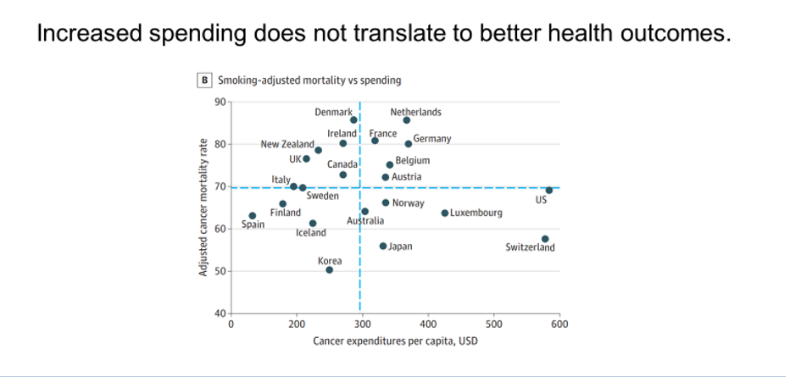
Chow et al. Comparison of cancer related spending and mortality rates in the US vs. 21 high-income countries. JAMA Health Forum 2022.

Slide 5
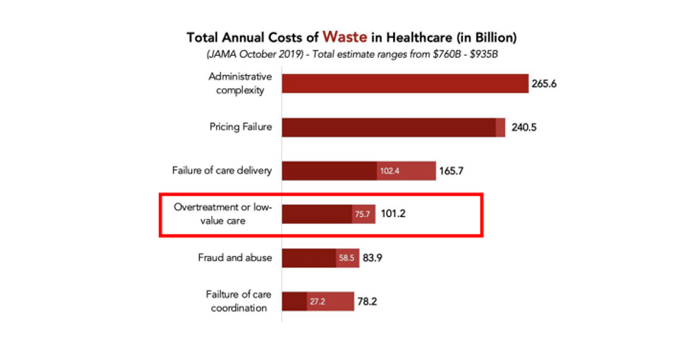
Shrank et al. Waste in the US Healthcare system: estimated costs and potential for savings. JAMA 2019.

Slide 6
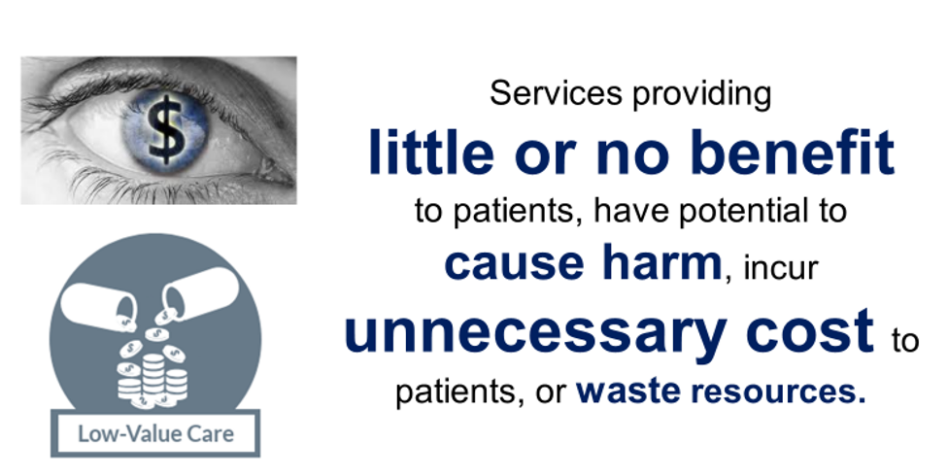
Notes:
Now some would say that value is the the eye of the beholder and to some extent that is true as different stakeholders view value through different lenses and preferences.
[CLICK] But in many areas, there is consensus on tests are treatments that are low-value. That is, they offer little or no benefit to patients, potentially cause harm and incur unnecessary cost and waste resources.
I’m not going to talk to you today primarily about defining low-value services or value measurement. In our work, we rely on trial data and national guidelines to define areas were services offer little or no benefit. What I’m primarily going to focus on today is how and why we stop doing some things, but not others, and how we can work to de-implement the persistent use of low-value care.

Slide 7
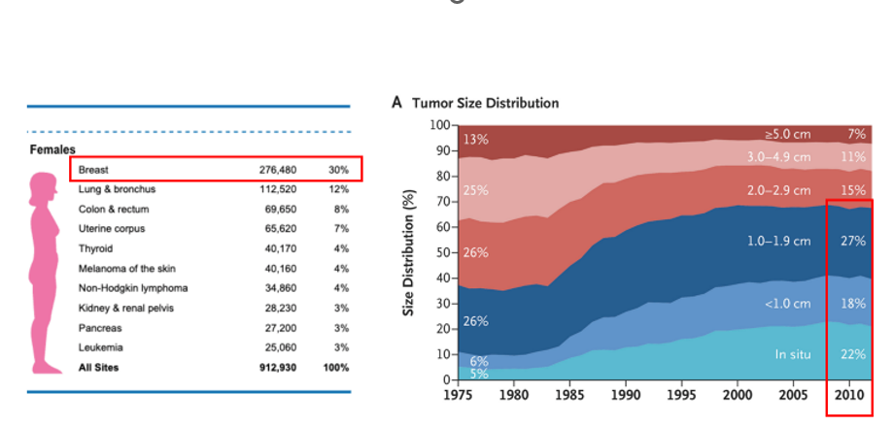
Welch et al. Breast cancer tumor size, overdiagnosis and mammography screening effectiveness. NEJM. 2016.
Notes:
As I walk through this framework today, I’m going to draw on our work in breast cancer. For a number of reasons, breast cancer care is the perfect test case for de-implementation. First, as you all know breast cancer is common –the most common cancer among women.
[CLICK] Second, thanks to aggressive screening campaigns, most patients have small tumors and early-stage disease. In fact, the 5-year overall survival from screening detected breast cancer exceeds 99%.

Slide 8
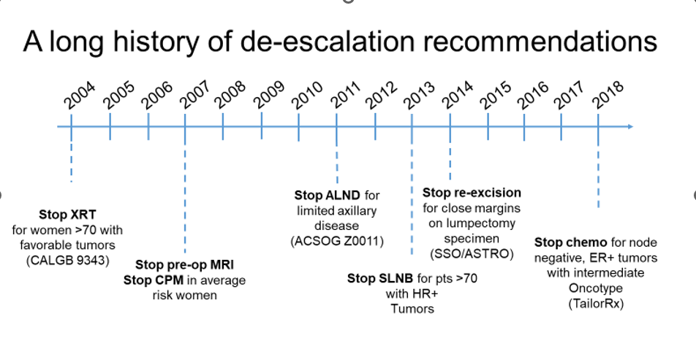
Notes:
In addition to these factors, breast cancer makes a great case for de-implementation because many of the treatment decisions are informed by Level 1 data, and a number of landmark, randomized controlled trials. Importantly, over the last 20 years a number of these trials have demonstrated no survival benefit for many previously routine therapies generating a number of de-escalation recommendations by multi-disciplinary oncology groups.

Slide 9
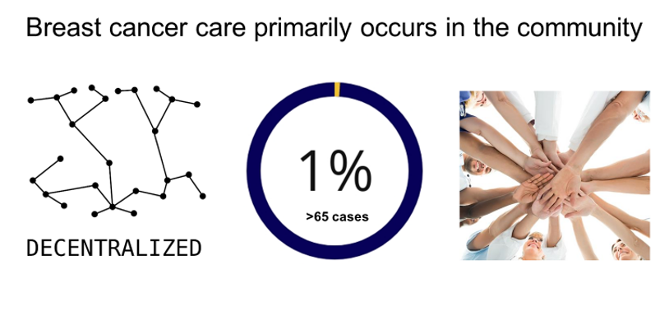
Notes:
Finally, breast cancer care makes a great test case for de-implementation because as since it is common, care largely is decentralized from academic medical centers and occur in the community. This translates into few high-volume providers with fewer than 1% of general surgeons treating more than 65 cases per year. And, obviously care occurs in the setting of a multi-disciplinary team, so practices can be influenced by other providers and de-implementing low-value care requires the buy in of the entire team

Slide 10
QI Implementation Goals and Requirements:
Cancer-Specific Goals (10 points): Sites will pick two goals to focus on that need improvement. Included diagnosis codes: Cancer and DCIS diagnoses which are listed in the breast tab of 2024 Program Manual. Measurement Period is 4/1/2024 – 12/31/2024.
a. Preoperative MRI rate to < 30%
b. Reduction of use of SLNB in women >70 years old to < 50%
c. Reduction of re-excision rates for positive margin after lumpectomy to < 15%
d. Increase in the use of outpatient mastectomy to > 25%
Notes:
These four surgical targets include:
Axillary lymph node dissection (ALND) for limited nodal disease which is based on the ACSOG Z0011 trial
Re-excision for close but negative margins which is based on extensive retrospective data and a consensus statement issued jointly by SSO and ASTRO
Contralateral prophylactic mastectomy (CPM) for unilateral cancer which is based on multiple meta-analyses
Sentinel lymph node biopsy (SLNB) in women ≥70 years old with hormone receptor positive (HR+) cancer which is based on the CALBG 9343 trial

Slide 11
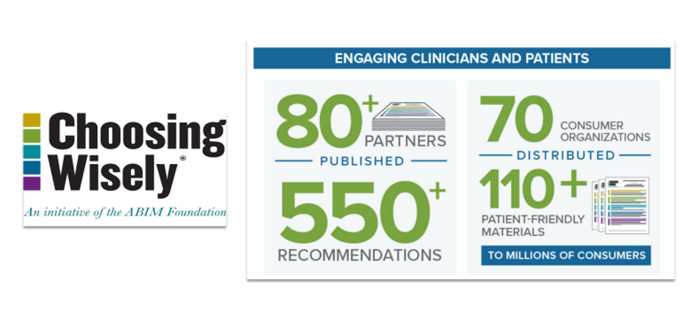
Notes:
One of the easiest ways to identify areas of low-value are within your area of practice is by consulting the recommendations provided by the Choosing Wisely campaign. Choosing Wisely is an international initiative launched by the American Board of Internal Medicine foundation that has engaged over 80 specialty societies to submit over 550 recommendations. Most of the major surgical specialty groups have participated in Choosing Wisely including the American College of Surgeons, SSO, SAGES, ASBS and the list goes on.

Slide 12
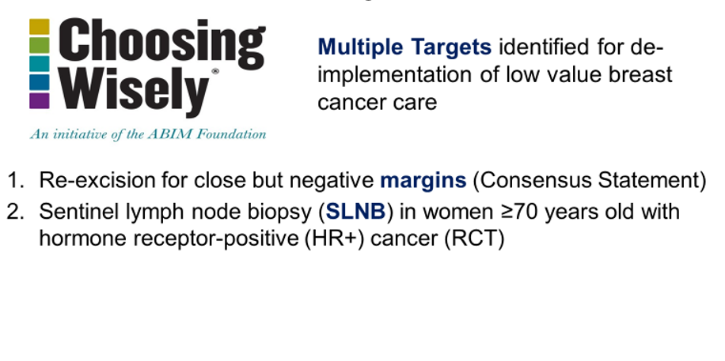
Notes:
These four surgical targets include:
Axillary lymph node dissection (ALND) for limited nodal disease which is based on the ACSOG Z0011 trial
Re-excision for close but negative margins which is based on extensive retrospective data and a consensus statement issued jointly by SSO and ASTRO
Contralateral prophylactic mastectomy (CPM) for unilateral cancer which is based on multiple meta-analyses
Sentinel lymph node biopsy (SLNB) in women ≥70 years old with hormone receptor positive (HR+) cancer which is based on the CALBG 9343 trial

Slide 13
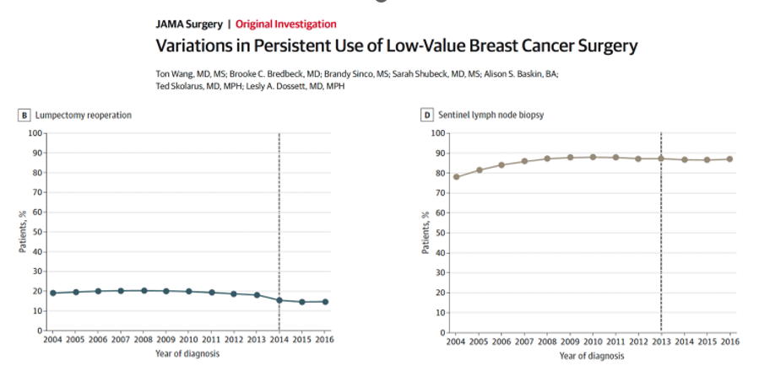
Wang et al. Variations in persistent Use of Low Value Breast Cancer surgery. JAMA. 2021.
Notes:
Using the National Cancer Database, we examined patients with early surgery breast cancer meeting criteria for omission of one of the four Choosing Wisely procedures. What we found is that ALND was rapidly and substantially de-implemented. For re-excision, NCDB does not contain granular enough clinical data to examine re-excision specifically, but re-operations after initial lumpectomy similarly declined by about 25%.
[CLICK] One thing we found interesting was that the de-implementation occurred about one year prior to the seminal paper being published in the literature, but around the same time the results and recommendations were disseminated via national meetings suggesting that national meetings and the resulting media attention surrounding major trials is a key method in disseminating new recommendations and perhaps even more important that publications in traditional medical journals.

Slide 14
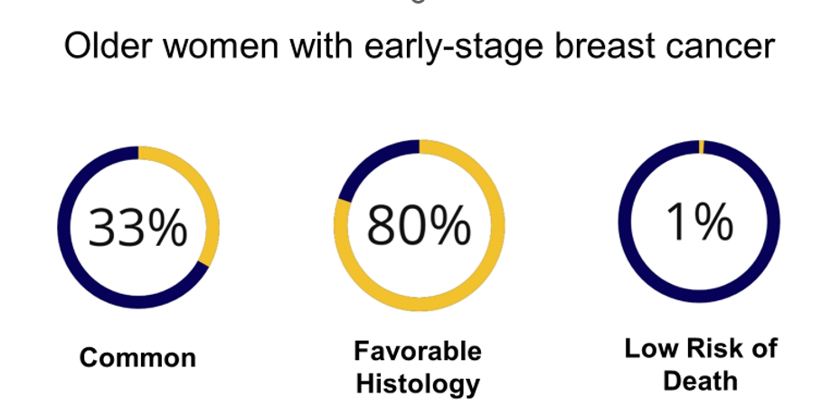
Notes:
To reorient you specifically to this population so that you understand the context of the de-implementation recommendations I’ll remind you that one third of patients with breast cancer are ≥70 years old. The majority of these older women with breast cancer have early-stage, hormone receptor positive (HR+) disease which has an excellent prognosis. Consequently, the probability of a woman ≥70 years old dying from breast cancer is less around 1%. At the same time, older women with competing co-morbidities at higher risk of toxicity from common cancer treatments, and overall, these conditions put these women at substantial risk of overtreatment and provide the basis for the desire to explore de-escalation.

Slide 15
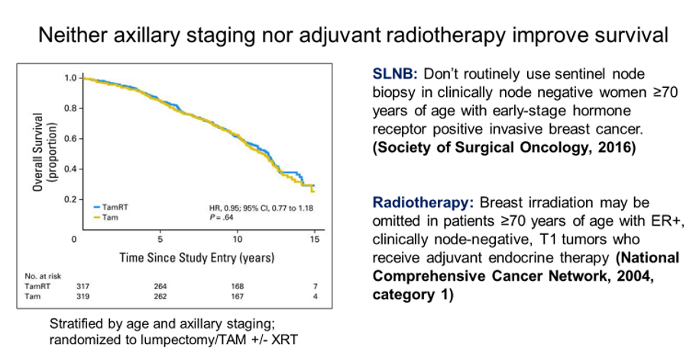
Hughes et. al. Lumpectomy plus tamoxifen with or without irradiation in women age 70 or older with early breast cancer: long term follow up of CALGB 9343. J Clin Oncol. 2013.
Notes:
Recommendations by SSO to omit axillary staging and by the NCCN to omit adjuvant radiation therapy in older women with hormone receptor positive breast cancer is based on the CALGB 9343 trial which randomized older women with early-stage breast cancer to lumpectomy and the hormone therapy tamoxifen (abbreviated here as TAM) with or without radiation therapy stratified by axillary staging. The results of this trials with over 15 years of follow-up demonstrated no difference in overall survival between the groups. Based on these result national guidelines now support omission of both of these previously routine therapies.

Slide 16
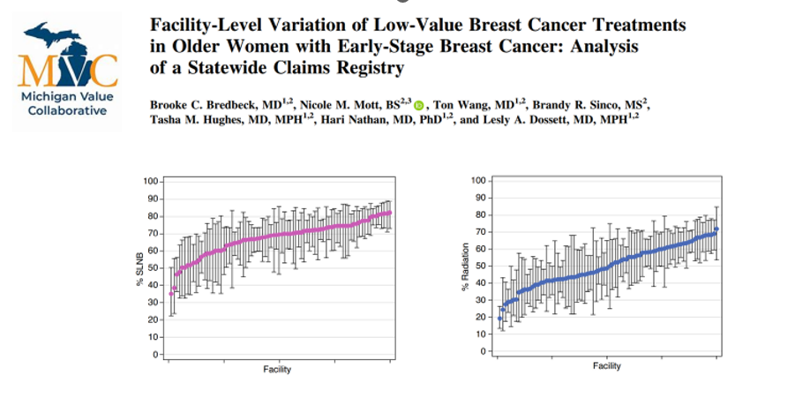
Bredbeck et al. Facility level variation of low value breast cancer treatments. ASO. 2022.
Notes:
After having explored patient and provider-level determinants to de-implementation, we were interested in learning if there were any facility-level variables, such as facility-type or volume, that might make a center particularly good or bad at de-implementation.
[CLICK] What we found was significant variation among facilities ranging from 25% to 99% for sentinel lymph node biopsy, with similar variation for the other four procedures.

Slide 17
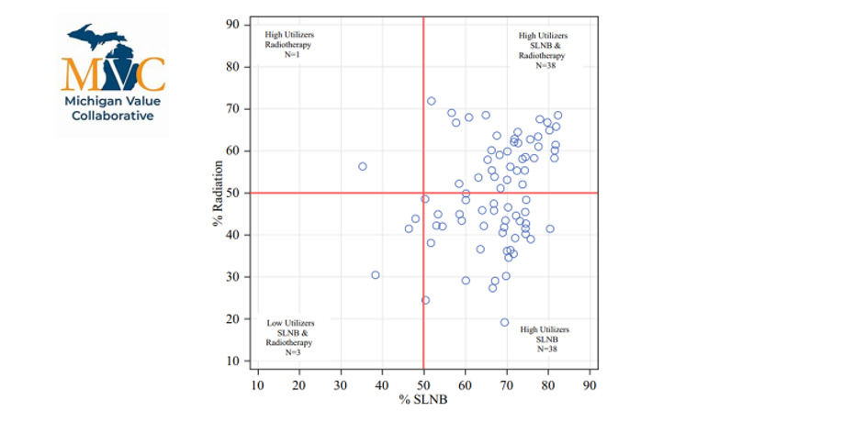
Notes:
After having explored patient and provider-level determinants to de-implementation, we were interested in learning if there were any facility-level variables, such as facility-type or volume, that might make a center particularly good or bad at de-implementation.
[CLICK] What we found was significant variation among facilities ranging from 25% to 99% for sentinel lymph node biopsy, with similar variation for the other four procedures.

Slide 18
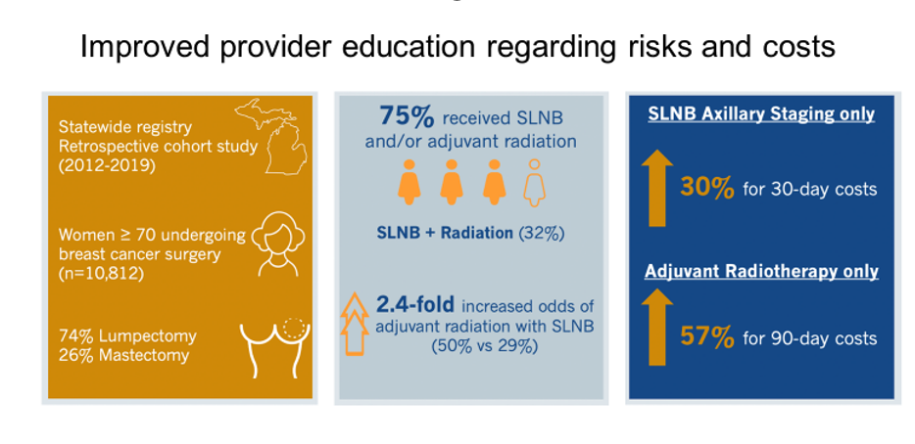
Bredbeck et al. Incremental cost associated with low value breast cancer treatments in older women. SSO 2021. manuscript under review
Notes:
Beyond patient education, we are working to increase provider education, particularly around the harms and costs of these low-value treatments. To understand the incremental costs associated with SLNB and adjuvant radiation, we leveraged the Michigan Value Collaborative to conduct a statewide cohort study. We included all women over 70 who underwent surgery for breast cancer between 2012 and 2019. We exclude women who received chemotherapy. We measured utilization of sentinel lymph node biopsy and radiation and 30- and 90-day episode payments.
[CLICK] We found that consistent with other studies, the use of these treatments remains common with over 75% of women receiving SLNB and/or adjuvant radiotherapy.
[CLICK] We found that SLNB increased the 30-day episode costs by 30%, or approximately $3500. This increased costs is due to fees associated with radiology, surgical, and pathology services. Adjuvant radiotherapy increased 90-day costs by nearly 60%, or approximately $7000.
[CLICK] We also found that patients undergoing SLNB were nearly 2.5 times as likely to undergo radiation, suggesting a possible cascade relationship for women who might have been found to have micro-metastatic disease that would have otherwise been controlled with hormone therapy.

Slide 19
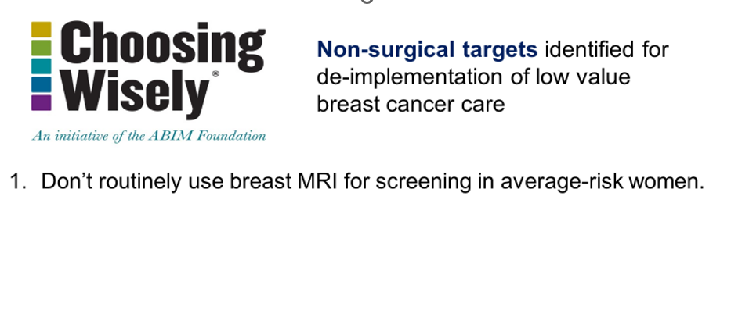
Notes:
Beyond patient education, we are working to increase provider education, particularly around the harms and costs of these low-value treatments. To understand the incremental costs associated with SLNB and adjuvant radiation, we leveraged the Michigan Value Collaborative to conduct a statewide cohort study. We included all women over 70 who underwent surgery for breast cancer between 2012 and 2019. We exclude women who received chemotherapy. We measured utilization of sentinel lymph node biopsy and radiation and 30- and 90-day episode payments.
[CLICK] We found that consistent with other studies, the use of these treatments remains common with over 75% of women receiving SLNB and/or adjuvant radiotherapy.
[CLICK] We found that SLNB increased the 30-day episode costs by 30%, or approximately $3500. This increased costs is due to fees associated with radiology, surgical, and pathology services. Adjuvant radiotherapy increased 90-day costs by nearly 60%, or approximately $7000.
[CLICK] We also found that patients undergoing SLNB were nearly 2.5 times as likely to undergo radiation, suggesting a possible cascade relationship for women who might have been found to have micro-metastatic disease that would have otherwise been controlled with hormone therapy.

Slide 20
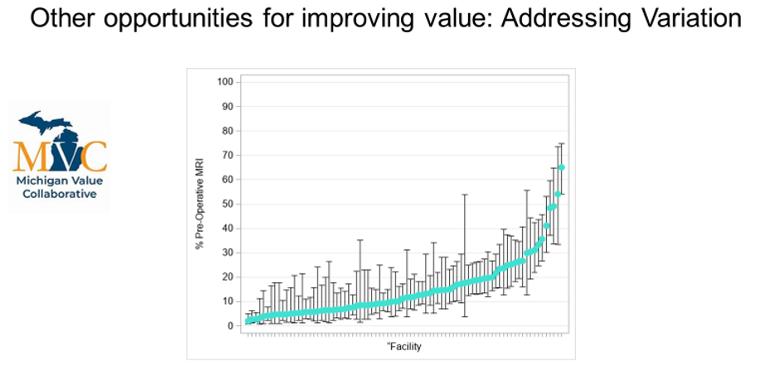
Notes:
Beyond patient education, we are working to increase provider education, particularly around the harms and costs of these low-value treatments. To understand the incremental costs associated with SLNB and adjuvant radiation, we leveraged the Michigan Value Collaborative to conduct a statewide cohort study. We included all women over 70 who underwent surgery for breast cancer between 2012 and 2019. We exclude women who received chemotherapy. We measured utilization of sentinel lymph node biopsy and radiation and 30- and 90-day episode payments.
[CLICK] We found that consistent with other studies, the use of these treatments remains common with over 75% of women receiving SLNB and/or adjuvant radiotherapy.
[CLICK] We found that SLNB increased the 30-day episode costs by 30%, or approximately $3500. This increased costs is due to fees associated with radiology, surgical, and pathology services. Adjuvant radiotherapy increased 90-day costs by nearly 60%, or approximately $7000.
[CLICK] We also found that patients undergoing SLNB were nearly 2.5 times as likely to undergo radiation, suggesting a possible cascade relationship for women who might have been found to have micro-metastatic disease that would have otherwise been controlled with hormone therapy.

Slide 21
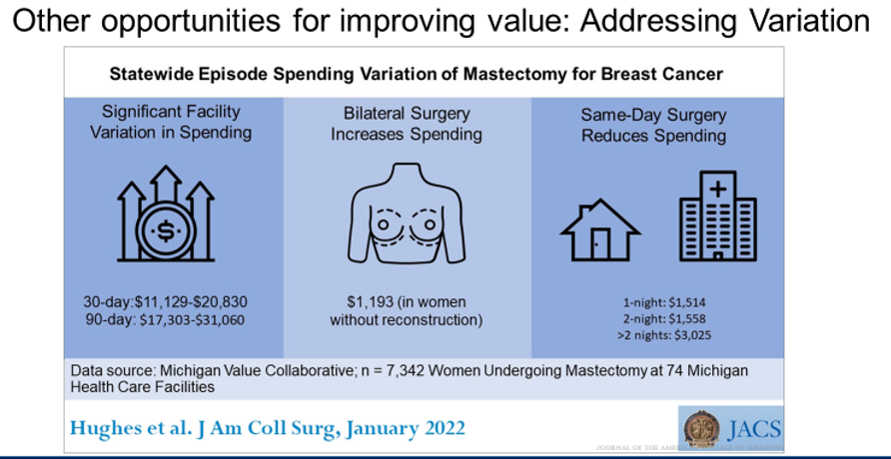
Hughes et al. Statewide episode spending variation of mastectomy for breast cancer. JACS 2022.
Notes:
Beyond patient education, we are working to increase provider education, particularly around the harms and costs of these low-value treatments. To understand the incremental costs associated with SLNB and adjuvant radiation, we leveraged the Michigan Value Collaborative to conduct a statewide cohort study. We included all women over 70 who underwent surgery for breast cancer between 2012 and 2019. We exclude women who received chemotherapy. We measured utilization of sentinel lymph node biopsy and radiation and 30- and 90-day episode payments.
[CLICK] We found that consistent with other studies, the use of these treatments remains common with over 75% of women receiving SLNB and/or adjuvant radiotherapy.
[CLICK] We found that SLNB increased the 30-day episode costs by 30%, or approximately $3500. This increased costs is due to fees associated with radiology, surgical, and pathology services. Adjuvant radiotherapy increased 90-day costs by nearly 60%, or approximately $7000.
[CLICK] We also found that patients undergoing SLNB were nearly 2.5 times as likely to undergo radiation, suggesting a possible cascade relationship for women who might have been found to have micro-metastatic disease that would have otherwise been controlled with hormone therapy.

Slide 22
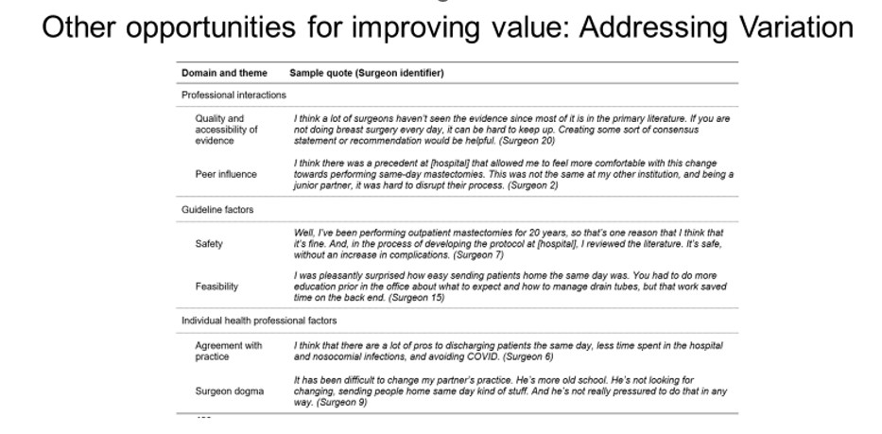
Ellsworth et al. Barriers to same day discharge after mastectomy in Michigan. Submitted.
Notes:
Beyond patient education, we are working to increase provider education, particularly around the harms and costs of these low-value treatments. To understand the incremental costs associated with SLNB and adjuvant radiation, we leveraged the Michigan Value Collaborative to conduct a statewide cohort study. We included all women over 70 who underwent surgery for breast cancer between 2012 and 2019. We exclude women who received chemotherapy. We measured utilization of sentinel lymph node biopsy and radiation and 30- and 90-day episode payments.
[CLICK] We found that consistent with other studies, the use of these treatments remains common with over 75% of women receiving SLNB and/or adjuvant radiotherapy.
[CLICK] We found that SLNB increased the 30-day episode costs by 30%, or approximately $3500. This increased costs is due to fees associated with radiology, surgical, and pathology services. Adjuvant radiotherapy increased 90-day costs by nearly 60%, or approximately $7000.
[CLICK] We also found that patients undergoing SLNB were nearly 2.5 times as likely to undergo radiation, suggesting a possible cascade relationship for women who might have been found to have micro-metastatic disease that would have otherwise been controlled with hormone therapy.

Slide 23
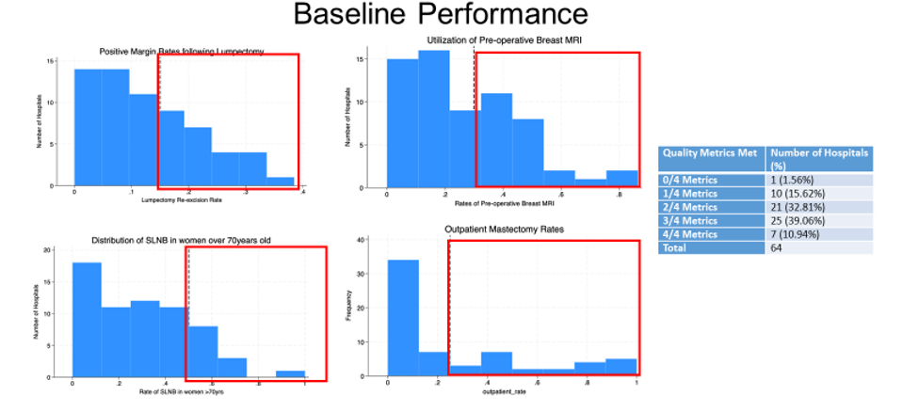
Notes:
Beyond patient education, we are working to increase provider education, particularly around the harms and costs of these low-value treatments. To understand the incremental costs associated with SLNB and adjuvant radiation, we leveraged the Michigan Value Collaborative to conduct a statewide cohort study. We included all women over 70 who underwent surgery for breast cancer between 2012 and 2019. We exclude women who received chemotherapy. We measured utilization of sentinel lymph node biopsy and radiation and 30- and 90-day episode payments.
[CLICK] We found that consistent with other studies, the use of these treatments remains common with over 75% of women receiving SLNB and/or adjuvant radiotherapy.
[CLICK] We found that SLNB increased the 30-day episode costs by 30%, or approximately $3500. This increased costs is due to fees associated with radiology, surgical, and pathology services. Adjuvant radiotherapy increased 90-day costs by nearly 60%, or approximately $7000.
[CLICK] We also found that patients undergoing SLNB were nearly 2.5 times as likely to undergo radiation, suggesting a possible cascade relationship for women who might have been found to have micro-metastatic disease that would have otherwise been controlled with hormone therapy.

Slide 24


Slide 25
QI Implementation Goals and Requirements:
Data collection: For elective partial mastectomy and mastectomy surgical patients, participating hospitals will perform supplemental data collection that will allow the measurement of breast surgical quality.
  *Data collected in the Breast Tab on the workstation
Surgeon Champion: Each site will designate a surgeon champion who performs breast surgery to lead this project. The expectations are the surgeon lead will help the SCQR disseminate information at the hospital, be actively engaged in developing and implementing a care pathway and be engaged with MSQC for the Breast Surgery QI project, which includes being a member of the Breast Care Committee meetings (either in person or virtual).
*If unable to attend the Breast Care Committee meetings due to other priorities, MSQC will utilize other formats to help them stay actively engaged (virtual touch base meetings, site visits,surveys…..)

Slide 26
QI Implementation Goals and Requirements:
Multidisciplinary team (6 points total):
Participating hospitals will form a multidisciplinary team to review baseline data, guide quality improvement plans, and implement the care pathway. The multidisciplinary team should include the breast cancer surgeon champion, other surgeons who perform breast cancer surgery, nursing, patient navigator, plastics and reconstructive, breast radiology and others as relevant.
Hold a multidisciplinary meeting before March 29, 2024. Meeting notes, including attendees, must be submitted to the coordinating center with the final project submission. (2 points).
Two (2) additional multidisciplinary meetings (minimally) before December 1, 2024, which
include a review of breast data (2 points each).

Slide 27
QI Implementation Goals and Requirements:
Implement Breast Surgery Care Pathway (4 points): Within the multidisciplinary team, create and modify the care pathway template to your hospital’s practices. This will be implemented and utilized by the care team beginning in the preoperative period and extending into the postoperative period to ensure the implementation of each element of the breast surgery care pathway. Submit the final product to MSQC.

Slide 28
QI Implementation Goals and Requirements:
Perioperative Process Goals (20 points): Implement all the following process measures for each elective breast surgical patient as detailed below. Measurement Period is 4/1/2024 – 12/31/2024.
Preoperative Goals (8 points total)
5a: Preadmission teaching that discusses expectations after surgery, including multimodal pain management ≥ 70%, discussion of opioid-free surgery (if applicable), and expected use of surgical drains (if applicable) (4 points)
  ERP tab=Preadmission teaching
  ERP tab= Postoperative wound teaching
  ERP tab=Pain Management
5b: Patient optimization discussion related to smoking cessation (if applicable) ≥ 80% (4 points)
  ERP tab=Tobacco Cessation

Slide 29
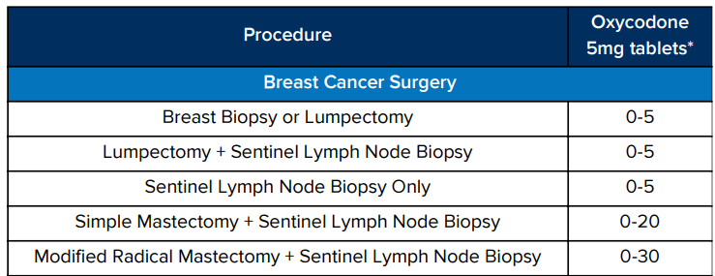
QI Implementation Goals and Requirements:
Intraoperative Goals (4 points total)
5d: Use of intraoperative multimodal pain management > 80% (4 points)
  ERP tab-intraoperative Multimodal =YES
Postoperative Goals (8 points total)
5e: Postoperative order for multimodal pain management > 70% (4 points)
  ERP tab-postoperative multimodal ordered=YES
5f: Opioid prescriptions meeting M-OPEN recommendations > 70% (4 points)

Slide 30
QI Implementation Goals and Requirements:
Cancer-Specific Goals (10 points): Sites will pick two goals to focus on that need improvement. Included diagnosis codes: Cancer and DCIS diagnoses which are listed in the breast tab of 2024 Program Manual. Measurement Period is 4/1/2024 – 12/31/2024.
a. Preoperative MRI rate to < 30%
b. Reduction of use of SLNB in women >70 years old to < 50%
c. Reduction of re-excision rates for positive margin after lumpectomy to < 15%
d. Increase in the use of outpatient mastectomy to > 25%

Slide 31
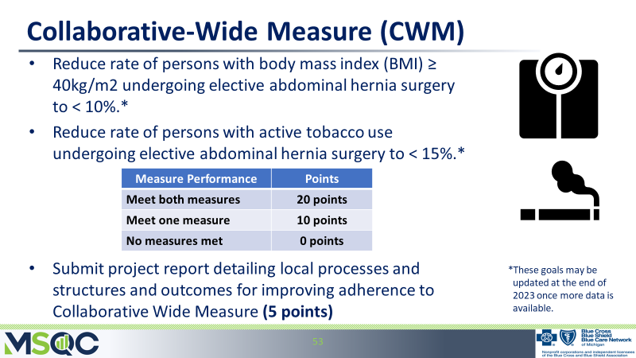

Slide 32
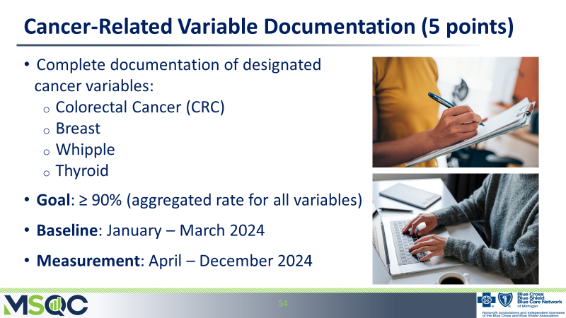

Slide 33
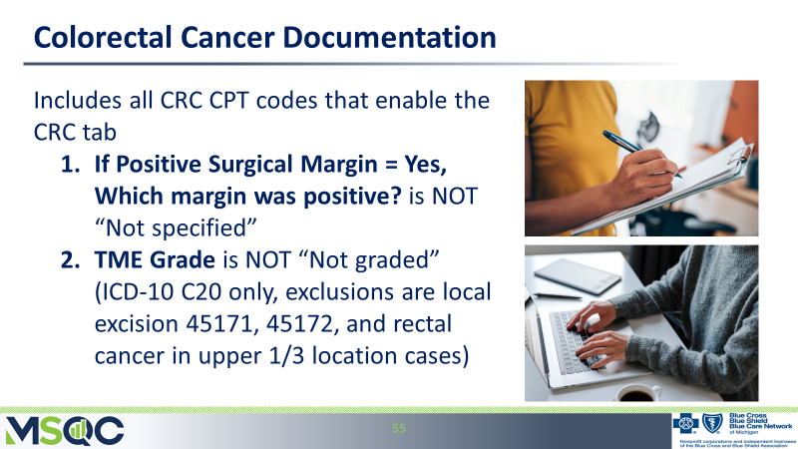

Slide 34
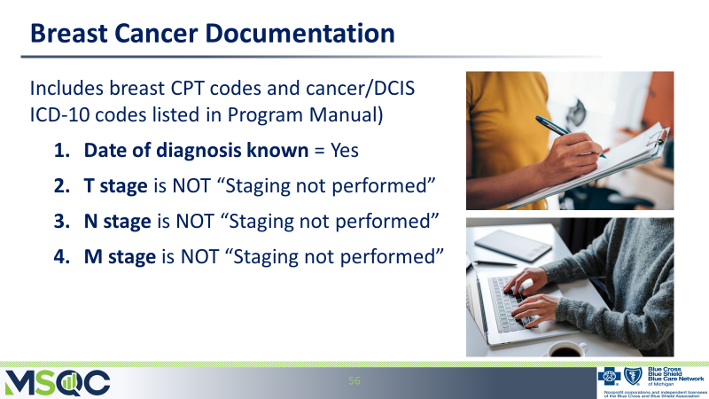

Slide 35
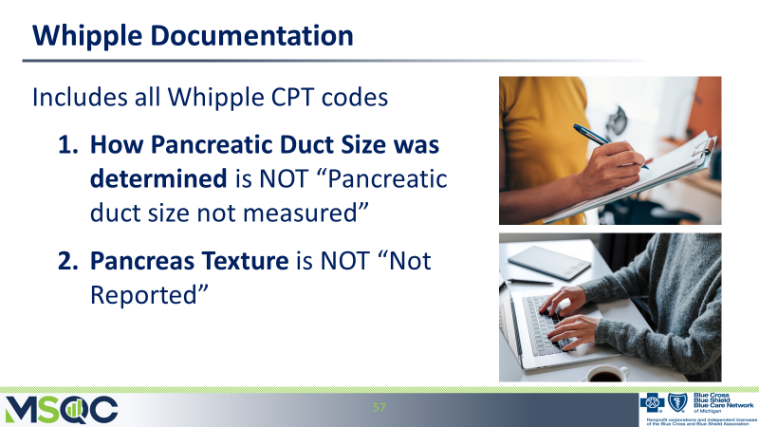

Slide 37


