Slide 1
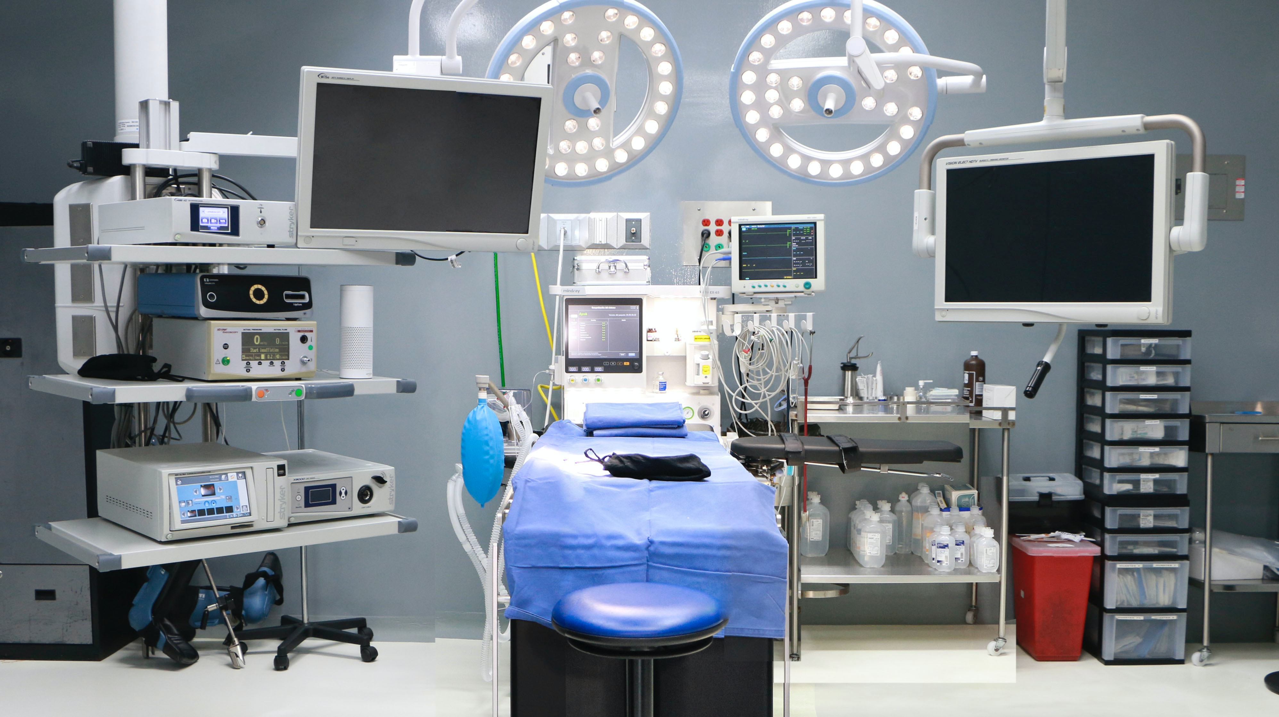

Collaborative Wide Measure
January 26, 2023

Slide 2

Collaborative Wide Measure
Official January 2023 baseline data pull: 16.37% of elective cases were smokers
48.7% of those smokers had tobacco cessation counseling captured in the Workstation
Average tobacco cessation counseling rate for each project: Abdominal Hernia sites (47 total): Average 75.6%; Median 83.3%
Hysterectomy sites (13 total): Average 64.4%; Median 83.3%
CRC sites (8 total): Average 93.8%; Median 100%
All QI project patients: Average 72.3%

Slide 3
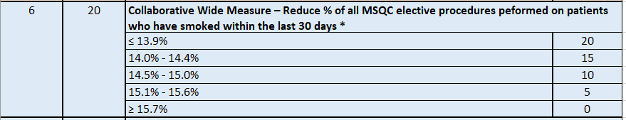
Collaborative Wide Measure

Slide 4
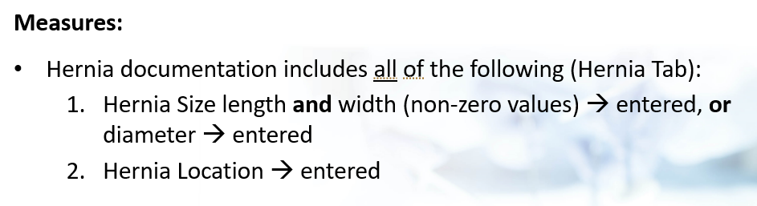
Complete Hernia size and location at >=90% (5 points)

Slide 5
Site Direct Measure Kickoff
January 26, 2023

Slide 6
Project Goal and Summary: Sites will choose an outcome measure to focus on from the outcomes listed below:
ED visits related to surgery
30-day readmission related to surgery
30-day reoperation related to surgery
Sepsis
SSI
Pneumonia
UTI
VTE
Reports for monitoring all these measures are available on the Workstation reports dashboard. Choosing a baseline timeframe of 2019-2022 YTD will provide a good perspective and should offset pandemic-related influence on the data, but baseline data will be based on 2022 year alone. Ranking reports show individual site performance compared to the collaborative, which allows identification of measures that have opportunities for improvement. Trend reports allow identification of measures which are negatively trending (getting worse) over time and that may be improved with quality improvement.

Slide 7
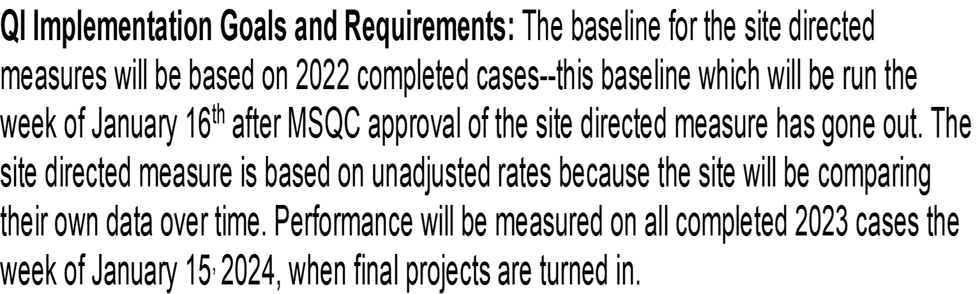
Goals and Requirements:

Slide 8
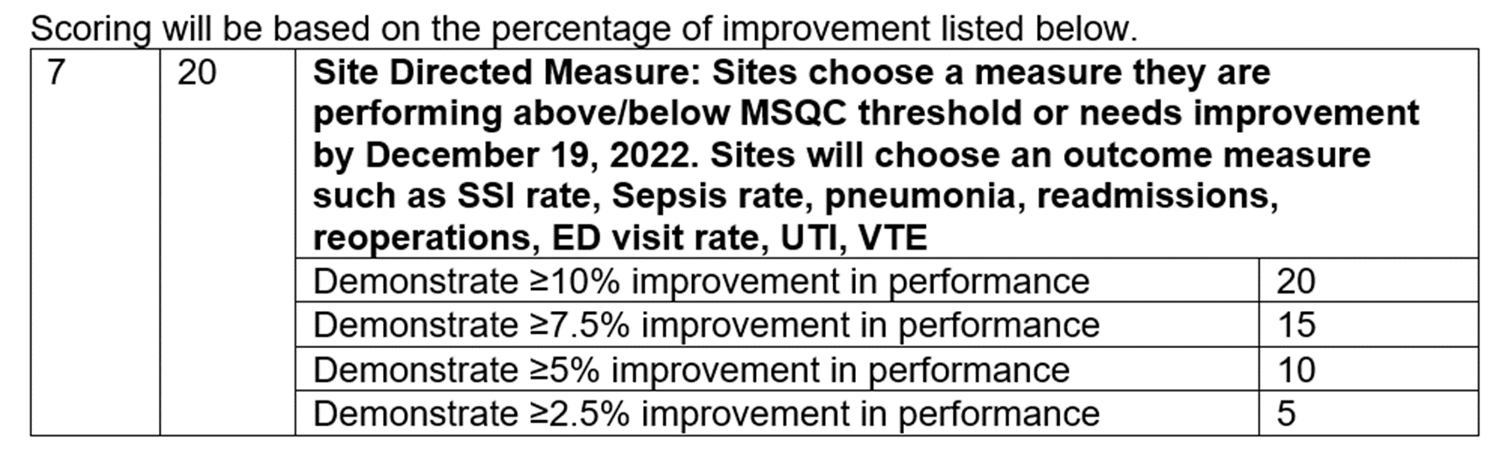
Scoring:

Slide 9
Scoring:
Example:
Baseline is =7.5%
20 points > 10% improvement = 6.75%
15 points> 7.5% improvement =6.94%
10 points> 5% improvement =7.13%
5 points > 2.5% improvement =7.31%
Implementation Points:
The 20 points for the Site Directed Measure is from the outcome of the improvement made, but as always there is an opportunity to make up some points for the implementation. For the Site Directed Measure there will be the opportunity to earn 0-5 implementation points for the project write up describing the processes that were implemented and the efforts that were made in improving your measure.

Slide 10
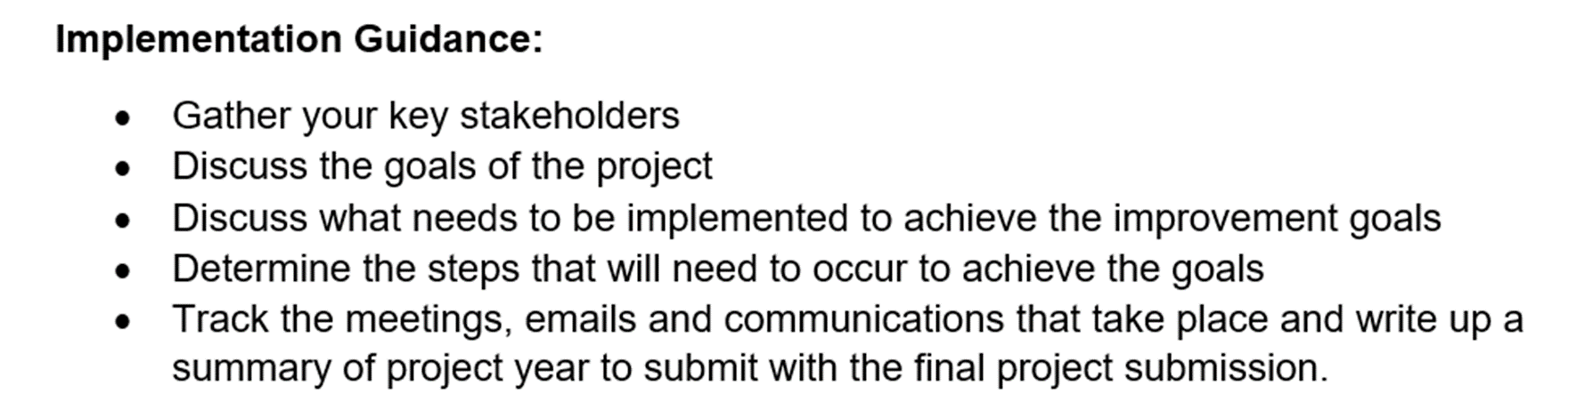
Guidance:

Slide 11


Slide 12
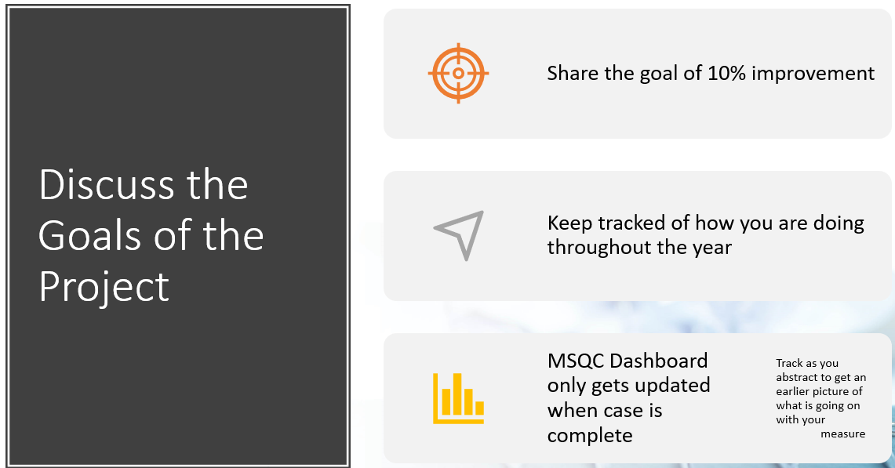

Slide 13
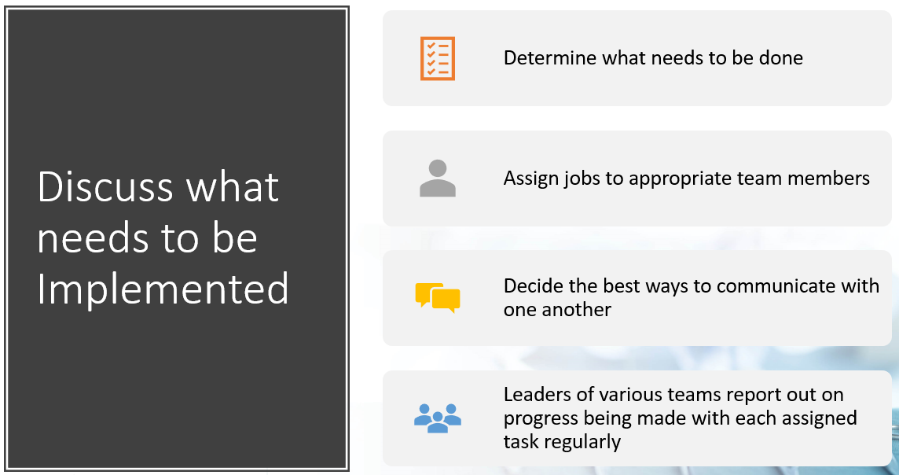

Slide 14
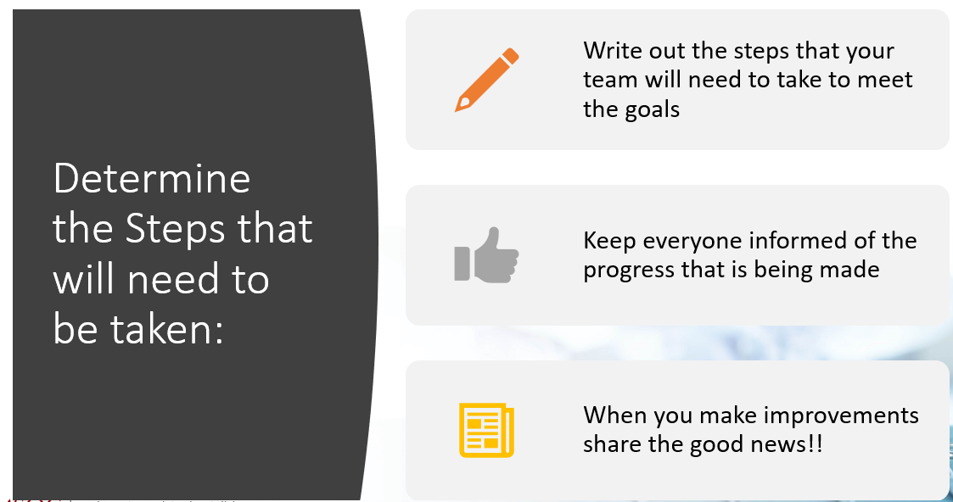

Slide 15
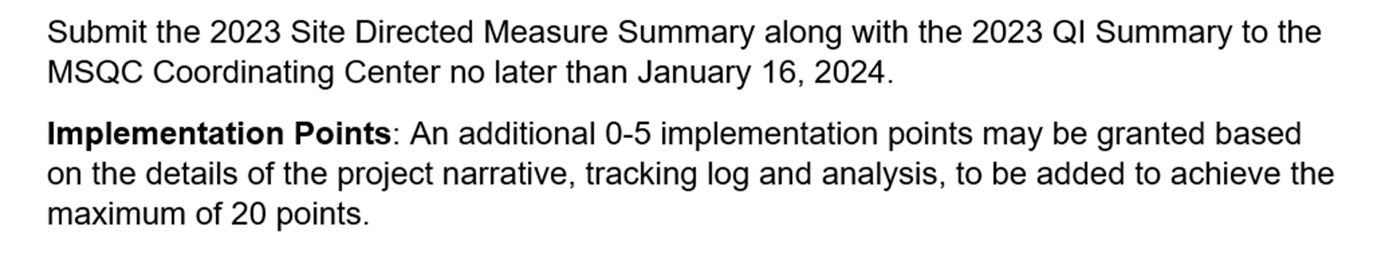
Keep Track of Everything:

Slide 16
What is Related to Surgery:
Easy
  Surgical site infection
  Pain not controlled
  Constipation/ nausea—from opioids
  Dehydration
  Urinary retention
Not related
  Trauma—falls, accidents
  Virus—flu, COVID

Slide 17
Ways to Improve: Return to ED related to Surgery
Pain
Review discharge instructions on pain management
Do the patients know how to manage their pain at home?
Are the patients getting and understanding multimodal pain management?
Are the patients taught before surgery and then again after surgery?
Do patients know who to contact after hours if refills are needed?
Surgical Site Infection
Review the case to see if anything was not done and look at patient factors (BMI, DM)
What did the incision look like when they were discharged?
Was the case dirty? Should they have been on Antibiotics if they were not?
Constipation
Instructions on taking stool softeners when using opioids –on most instructions but is it buried in the back?
List of laxatives that are OTC if stool softeners are not working
hydration

Slide 18
Ways to Improve: Return to ED visits related to Surgery
Dehydration (especially ileostomy patients)
Consider oral rehydration fluid (Drip Drop)
Home care with IV fluids
Patient teaching before discharge
Ileus
Ambulation
Multimodal pain management—limit opioids
Urinary Retention
Did patient void prior to discharge?
Did they check a post void residual?
Does the patient have history of urinary retention?

Slide 19
Ways to Improve: Readmissions related to Surgery
Pain
Review discharge instructions on pain management
Do the patients know how to manage their pain at home?
Are the patients getting and understanding multimodal pain management?
Are the patients taught before surgery and then again after surgery?
Surgical Site Infection
Review the case to see if anything was not done and look at patient factors (BMI, DM)
What did the incision look like when they were discharged?
Was the case dirty? Should they have been on Antibiotics if they were not?

Slide 20
Ways to Improve: Readmissions related to Surgery
Dehydration (especially ileostomy patients)
Consider oral rehydration fluid (Drip Drop)
Home care with IV fluids
Patient teaching before discharge
Ileus
limit use of NG tube
Ambulation—reduce to clear liquids
Multimodal pain management—limit opioids
Urinary Retention
Did patient void prior to discharge?
Did they check a post void residual?
Does the patient have history of urinary retention?

Slide 21
Ways to Improve: Reoperation related to Surgery
Need to look at your 2022 Reoperation baseline rate
Drill down each case—look for trends
Discuss with your team to look for action steps and plan for improvement

Slide 22
Ways to Improve: Sepsis
Look at your hospitals process—
Do you have a Sepsis Coordinator? (Team up with them to help with this work)
Someone who reviews all sepsis cases in the hospital (infection prevention)
Is your site good at identifying and treating sepsis in a timely matter
Take advantage of all the Sepsis materials online—
February has Sepsis Survivor Week 12th through 18th –
Team up with marketing to share throughout the hospital with staff and visitors
September is Sepsis Awareness Month—
Marketing throughout the hospital
Communicate –newsletters, emails, meetings
Sepsis Alliance
The Sepsis Alliance Institute | Sepsis Education (sepsisinstitute.org)
Sepsis | CDC

Slide 23
Ways to Improve: Surgical Site Infections
Deep dive into 2022 cases—identify into any trends or patient factors
Patient factors—BMI, DM, smoking
Dirty case? Did the patient go home on antibiotics? Should they have?
Look at:
Skin Prep
Antibiotics used and timing
Gowns and gloves changed at closing (if needed)
Terminal clean of the OR being done

Slide 24
Ways to Improve: Pneumonia
#1-Deep Dive into the cases of Pneumonia from 2022 (include 2021 if needed)
Look for trends, patient factors
Is there anything that could have prevented these cases?
VAP bundles being used?
Preoperative Education
Smoking Cessation
Importance of Deep Breathing (Incentive Spirometer)
Importance of Ambulation
Postoperative
Encourage Incentive Spirometer
Encourage Ambulation

Slide 25
Ways to Improve: VTE
Deep Dive into your 2022 VTE cases
Did the patients get postop heparin ordered?
Did the patients need extended VTE prophylaxis postop?
Does the hospital policy need to be updated?
Update VTE prophylaxis Policy if needed

Slide 26
Ways to Improve: UTI
Deep dive into UTI cases-identify any trends
Limit the use of intraop catheter use to when necessary
SUCCESS project

Slide 27
Next Steps:
Baselines will be sent out soon.
Gather your team.
MSQC will create subgroups of sites who are working on the same project to share ideas
*Group email
*Have a couple zoom gatherings to share with one another
MSQC-info@med.umich.edu

Slide 28


Questions
28
28

