Slide 1
2022 Colorectal Cancer Surgical Quality
Project Kickoff Session
January 2022

Slide 2
2022 Colorectal Cancer Surgical Quality Project Overview
Focus on improving performance of evidence-based quality measures for surgical patients with colorectal cancer to promote high-quality treatment to improve short- and long- term outcomes.
CRC QI Project participants were invited based on room for improvement of the measures and prior or current participation with CRC variable data collection.
Dr. Hendren’s project overview video:
https://vimeo.com/485583099
(00:00-03:10 is background of project
03:10-end includes measures from 2021 project)

Slide 3
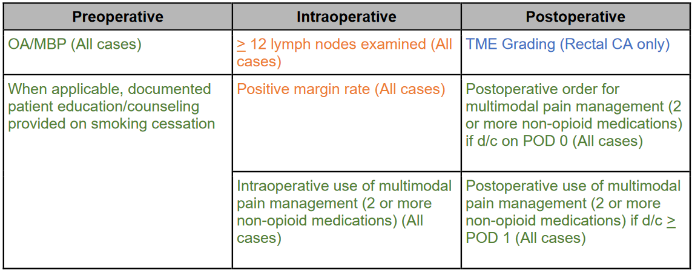
2022 Colorectal Cancer QI Project Overview
Preoperative, intraoperative, and postoperative measures
Colorectal cancer surgery-specific quality measures rectal cancer in blue, all colorectal cancer in orange
Also includes recommendations from MSQC Colectomy Care Pathway (in green)
Source: CRC Project Summary https://msqc.org/wp-content/uploads/2021/11/QII-Colorectal-Cancer-2022-Project-Summary.11.16.2021.pdf

Slide 4
2022 Colorectal Cancer QI Project Overview
Includes elective colorectal cancer surgical cases
Cases must be abstracted by SCQR that has successfully completed CRC variable abstraction training
Additional “deep dive” review of all SSI, Return to ED Related to Surgery, and Positive Margin cases
Create/maintain/revise a CRC patient care plan, order set, or care pathway template
Multidisciplinary meeting to be held by 3/31/2022
Complete the Colorectal Cancer Care Surgical Quality Measures QI Project Tracking Sheet & Summary Report

Slide 5
2022 QI Timeline
Measurement Period for QI measures is 1/1/2022 – 12/31/2022
3/31/2022 – must hold multidisciplinary meeting by this date
1/16/2023 – Completed 2022 Colorectal Cancer QI Project Tracking Sheet and Summary Report due to MSQC

Slide 6
2022 Colorectal Cancer QI Project Changes
QI 2021 – 2022 Project Changes comparison document
Individual measure scoring, rather than aggregate measure category scores
Continuing measures may have different threshold requirements
Changes in goal thresholds based on 2021 measure performance
New measures
Smoking cessation counseling – new measure
Maintain or decrease positive margin rate – new measure

Slide 7
2022 Colorectal Cancer QI Project Changes, con’t.
Retired measures
Pre-treatment staging testing: MRI or endorectal US
Ostomy site marked
Neoadjuvant therapy
CEA level obtained after diagnosis
Mesorectal excision performed
New Project Goals
Internal quality review of each postoperative SSI or return to ED related to surgery, and each positive margin case

Slide 8
CRC Project Case Eligibility
Elective cases only
Included CPT Code: MSQC 2021 Program Manual, Appendix B
Included ICD-10 Code:
CRC Tab: Presence of Adenocarcinoma = Yes – Adenocarcinoma is the tumor type, and the portion of bowel with the cancer is removed
ICD-10 code | Adenocarcinoma Location
C18.0 | Cecum/ileocecal valve
C18.2 | Ascending colon
C18.3 | Hepatic flexure
C18.4 | Transverse colon
C18.5 | Splenic flexure
C18.6 | Descending colon
C18.7 | Sigmoid colon
C18.8 | Overlapping sites of colon
C18.9 | Unspecified location of colon [double check path report before assigning this ICD-10]
C19 | Rectosigmoid junction
C20 | Rectum [only this ICD-10 enables rectal CA variables]

Slide 9
Goal #1: Colorectal Cancer Preoperative Measures
5 points each (10 points total)
Goal = 90% compliance for each measure
1a. Oral antibiotics/mechanical bowel prep (all CRC cases)
1b. Smoking cessation counseling (all CRC cases)

Slide 10
Goal #1: Colorectal Cancer Preoperative Measures, con’t.
1a. Oral antibiotics/mechanical bowel prep (all CRC cases)
Goal = 90% compliance
Preop Tab: Mechanical Bowel Prep →Yes selected AND Were Oral Antibiotic(s) Ordered as part of the Bowel Prep? →Yes selected
Continuation of measure from 2021 QI project
Excludes cases where Mechanical Bowel Prep = Exception

Slide 11
Goal #1: Colorectal Cancer Preoperative Measures, con’t.
1b. Smoking cessation counseling (all CRC cases)
Goal = 90% compliance
New measure for 2022 QI project
Cases with Tobacco Use within 1 month – Cigarette = “Yes”
Verbal and written counseling provided
Can include referral to smoking cessation program
Preadmission counseling/ teaching (ERP Tab) → Tobacco Cessation selected
Patient education resource materials and MSQC FAQs

Slide 12
Goal #2: Colorectal Cancer Intraoperative Measures
5 points each (15 points total)
2a. > 12 lymph nodes (all CRC cases)
2b. Use of intraoperative multimodal pain management (all CRC cases)
2c. Maintain or decrease positive margin rate (all CRC cases)
From 2021 compared to 2022 (continuing sites only)
From Q1 2022 compared to Q3 & Q4 2022 (new sites)

Slide 13
Goal #2: Colorectal Cancer Intraoperative Measures, con’t.
2a. > 12 lymph nodes (all CRC cases)
Goal = 90% compliance
Revised measure from 2021 QI project – excludes CPT 45171 and 45172 cases (local excision)
CRC Tab: Total Number of Lymph Nodes Examined →
value > 12 entered

Slide 14
Goal #2: Colorectal Cancer Intraoperative Measures, con’t.
2b. Use of intraoperative multimodal pain management (all CRC cases)
Goal = 90% compliance
Continuation of measure from 2021 QI project
At least 2 non-opioid pain medications must be administered in the preoperative holding area or intraoperatively.
If urgent or emergent surgery cases, non-opioid medications administered within 4 hours of surgery start time can be included This will account for situations where these patients receive multimodal pain medication in locations other than the preop holding area (e.g., emergency room, inpatient nursing unit).

Slide 15
Goal #2: Colorectal Cancer Intraoperative Measures, con’t.
Multimodal Pain Management ordered Preop/Intraop? (ERP Tab) → Yes selected
AND
All administered medications are abstracted
Minimum of two medications entered
Acetaminophen will only count once, even if both the oral and intravenous options are abstracted
If no or only one medication is administered, must abstract “Postop multimodal not used” option (case will fail measure)

Slide 16
Goal #2: Colorectal Cancer Intraoperative Measures, con’t.
2c. Maintain or decrease positive margin rate (all CRC cases)
Goal > 90%
New measure for 2022 QI project
Continuing sites: maintain or decrease rate from 2021 compared to 2022
New sites: maintain or decrease rate from Q1 2022 compared to Q3 & Q4 2022

Slide 17
Goal #3: Colorectal Cancer Postoperative Measures
5 points each (15 points total)
3a. TME grading (rectal CA only)
3b. Postoperative order for multimodal pain management if discharged on POD 0 (all CRC cases)
3c. Postoperative use of multimodal pain management if discharged on or after POD 1 (all CRC cases)

Slide 18
Goal #3: Colorectal Cancer Postoperative Measures, con’t.
3a. TME grading (rectal CA only)
Goal = 100%
Continuation of measure from 2021 QI project
Excludes CPT codes 45171 and 45172 cases (local excision)
Includes Preoperative Rectal Cancer Location = Middle 1/3rd of rectum or Lower 1/3rd of rectum
CRC Tab: TME Grade →Grade 3 – Complete, Grade 2 – Near Complete, or Grade 1 – Incomplete selected
Performed by Pathologist

Slide 19
Goal #3: Colorectal Cancer Postoperative Measures, con’t.
3b. Postoperative order for multimodal pain management if discharged on POD 0 (all CRC cases)
Goal = 90% compliance
Continuation of measure from 2021 QI project
Discharge Destination = Home, or Home with Home Health Care
At least 2 non-opioid pain medications ordered within first 24 hours postoperatively
Multimodal Pain Management ordered within the first 24 hours following surgery? (ERP Tab) → Yes selected

Slide 20
Goal #3: Colorectal Cancer Postoperative Measures, con’t.
3c. Postoperative use of multimodal pain management if discharged on or after POD 1 (all CRC cases)
Goal = 90%
Continuation of measure from 2021 QI project
All discharge destinations included in measure
Multimodal medication administration required for patient's D/C on or after POD 1
At least 2 non-opioid pain medications must be administered within first 24 hours postoperatively

Slide 21
Goal #3: Colorectal Cancer Postoperative Measures, con’t.
Multimodal Pain Management ordered within the first 24 hours following surgery? (ERP Tab) → Yes selected
AND
All administered medications are abstracted
Minimum of two medications entered
Acetaminophen will only count once, even if both the oral and intravenous options are abstracted
If no or only one medication is administered, must abstract “Postop multimodal not used” option (case will fail measure)

Slide 22
Goal #4: Case Review of SSI, Returns to ED, and Positive Margin Results (5 points)
Review and analysis of all CRC cases with SSI, return to ED related to surgery, or positive margins.
New project requirement for 2022
Instructions to identify cases contained in QI Tips and Tricks document
Most sites will have 1 – 5 cases to review; some may have zero cases
Include SSI cases with PATOS-Yes in the review
Your site may already have an existing process for quality review of cases (infection control, quality department) that can be used/adapted for this review.

Slide 23
Goal #4: Case Review of SSI and Returns to ED, and Positive Margins, con’t.
AHRQ Surgical Site Infection Investigation Tool (can also download a Word version of the document)
Additional SSI resources available:
MSQC SSI Toolkit
AHRQ Healthcare-Associated Infections Program
Provide overall findings summary (# cases and overall rate for each category, trends identified, action plans implemented) with QI project submission by 1/16/2023

Slide 24
Goal #4: Case Review of SSI
Questions to consider when analyzing review findings:
Are our SSIs primarily due to skin contaminants or enteric organisms?
Do we have a firm policy to culture all SSIs?
Is the problem primarily in emergent or elective cases?
Do we have a policy to use CHG-alcohol as skin prep?
Does our institution have an evidence-based policy regarding intra-operative blood transfusion?
Do the SSIs seem localized to particular surgeon, or operating room?
Do we have a concerted approach to increase bundle compliance?
Do we need a policy of culturing nares pre-operatively (if high volume of MRSA cases)?
Are our high-risk patients enrolled in an Enhanced Recovery Program?

Slide 25
Goal #4: Case Review of Returns to ED*
Questions to consider when analyzing review findings:
Do the returns seem localized to particular reason (pain, bleeding, urinary symptoms, wound issues, N/V, etc.)?
Are the reasons for return to ED essentially non-urgent, avoidable issues?
Do we have established discharge criteria that must be met for these potential issues prior to discharging the patient (e.g., void post catheter removal, ability to tolerate oral fluids, understands pain management strategy)?
Does our patient education content adequately prepare the patient for what to expect related to these issues, and how to seek assistance in the appropriate care setting?
What time of day/day of week do the majority of these cases occur? Are they during business hours when the office is regularly open?
Do we have an “after-hours” contact method for patients to use, rather than automatically going to the ED?

Slide 26
Goal #4: Case Review for Positive Margins
A group (tumor board or other) should discuss every case with a positive margin (< 1 mm), to see what might have been improved to prevent it. There will be some positive margin cases for which everyone will agree “nothing was done wrong”, but for most there will be room for improvement.
Questions to consider when analyzing review findings:
Was preoperative imaging performed via MRI or CT showing a risk for positive margin?
Could chemo or radiation have been given preop to decrease risk of positive margin?
Are positive margin findings more prevalent in rectal CA vs. colon CA?

Slide 27
Goal #4: Case Review for Positive Margins, cont.
Questions to consider when analyzing review findings, cont.
Patient factors: body habitus, social risk, palliative situation, gender, ascites
Hospital factors: surgical volume by surgeon and hospital
Surgical factors: open vs. MIS approach
Should bowel diversion have been performed instead of tumor resection?
Should additional organs have been resected to avoid a positive margin?
Resource:
Gutsche N, et. al. Toward 0% Positive Margins for Colorectal Cancer Surgery in Michigan. Pre-recorded session for the MSQC Collaborative Meeting December 10, 2021.

Slide 28
Goal #5: CRC Surgery Care Pathway (5 points)
New sites:
Create patient care plan, order set or care pathway template that covers preoperative period through postoperative period.
Work product should address implementation of each element of CRC care pathway which reflects the process at your hospital.
Include hospital or surgeon office plan/process/materials for smoking cessation education and referrals before surgery.
Continuing sites:
Submit patient care plan, order set or care pathway template which has been revised for any measure which did not meet the goal in 2021.
Include hospital or surgeon office plan/process/materials for smoking cessation education and referrals before surgery.

Slide 29
CRC Multidisciplinary Meeting
Conduct and document at least one multidisciplinary meeting by 3/31/2022
Meeting can be in-person, virtual, or hybrid format
Attendees to include surgeons who perform CRC surgery, nurses, quality specialists, pathologists, radiologists, oncologists, ostomy/wound care staff, anesthesia, pharmacy, other relevant staff
Create a patient care plan, order set or care pathway template to ensure implementation the CRC surgery care pathway

Slide 30
CRC Multidisciplinary Meeting, continued
Discuss/review prior year/baseline performance
Strategize how to sustain/improve performance
Continuing sites must also include analysis (FMEA, RCA, PDCA or other QI methodology) for all measures that did not meet the goal in 2021, with improvement strategies for 2022.
Submit meeting documentation to MSQC with 2022 QI Project Tracking Sheet & Summary Report (due 1/16/2023)

Slide 31
Goal #6: QI Project Summary Report
Due to MSQC by 1/16/2023
May be eligible for additional Implementation Points based on thoroughness and completeness of the Summary
Take credit for QI work on project measures, standardized documentation development and implementation
Document throughout year to track progress on measure performance, capture QI implementation efforts
Meetings, communications, process changes, key dates
Describe improvement efforts, successes, barriers, challenges

Slide 32
Goal #6: QI Project Summary Report, continued
Submit QI Project Tracking Sheet and Summary Report
Include all required documentation/attachments
Multidisciplinary meeting documentation
Summary of review findings of SSI, returns to ED related to surgery, and positive margin cases (Goal #4)
Patient care plan, order set or care pathway template (Goal #5)
Smoking cessation education and referral materials (Goal #5)

Slide 33
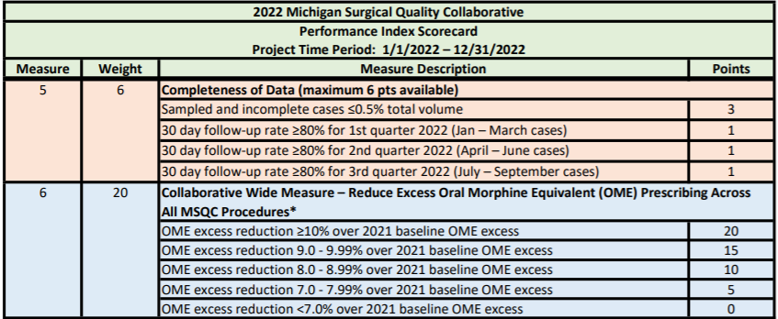
Other QI and Performance Index Scorecard Requirements
Sampled and incomplete cases < 0.5% of total volume (3 points)
30-day follow-up rate > 80% per calendar quarter (max. 3 points)
Collaborative-Wide Measure: Reduce Excess Oral Morphine Equivalent (OME) Prescribing Across All MSQC Procedures (max. 20 points)

Slide 34
Sampled and Incomplete Cases < 0.5% (3 points)
Locked, sampled, incomplete cases cannot exceed 0.5% of total case volume
Will be calculated on locked cases beginning with OR dates in Q4 2021 through Q3 2022*
Monitor regularly throughout year using Case List filters
Year = 2022
Case Status = Sampled
Complete Status = No
Look for cases that locked prior to current date in Lock Date column
*Q4 2021 cases were excluded from 2021 Sampled and Incomplete case calculations due to shift in project timelines

Slide 35
30 Day Follow-Up Rate* (maximum 3 points)
1 point awarded per calendar quarter where follow-up rate > 80%
Q1, Q2, and Q3 2022 to be calculated at or near the case lock date:
Q1 (1/1 – 3/31/2022 OR dates)
Q2 (4/1 – 6/30/2022 OR dates)
Q3 (7/1 – 9/30/2022 OR dates)
30 Day Follow-Up Dashboard report for monitoring
Denominator: Case Status = Sampled
Complete Status = Complete
Numerator: Follow Up Status = Yes
*Follow-up rates for Q4 2022 cases will be monitored in the 2023 QI P4P scorecard calculations due to shift in project timelines

Slide 36
PRO Follow Up Abstraction Workflow Tips
Upload sample frame prior to, or as soon after POD 30 as possible
PRO email will be sent as early as POD 31 if the following are entered:
Patient first and last name (Demographics tab)
Patient email (Demographics tab)
Surgeon name (Surgical Profile tab)
Death status = No (Surgical Profile tab)
Followed for 30 days = No or blank (Follow Up tab)
Takes advantage of automated PRO survey distribution; patient can respond to PRO even before chart is abstracted by SCQR
Patient will have better recall to answer PRO questions when surveyed closer to POD 30; patient more likely to be home and available to answer the survey

Slide 37
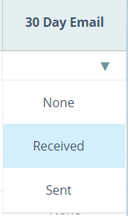
PRO Follow Up Abstraction Workflow Tips, continued
Check for patient response in Case List 30 Day Email field = Received
Emailed survey responses received will auto-populate PRO 30 Day tab
Do not edit this tab
Pain responses will auto-populate Pain tab the day after response received after an overnight run
Saves SCQR time and effort as compared to hard copy letter and/or phone call process to all patients. Only need to contact those that did not answer the emailed PRO survey
Ensure Registration department is capturing email addresses
You can run Source Data Export to monitor if email address is being captured

Slide 38
2022 Collaborative Wide Measure (CWM)
Measure: Reduce excess oral morphine equivalent (OME) prescribing across all MSQC procedures, as compared to 2021 baseline OME excess*
Measurement Period: 1/1/2022 – 12/31/2022
CWM Score | Points Awarded
OME excess reduction ≥ 10% of the 2021 baseline OME excess | 20 points
OME excess reduction 9.0 – 9.99% over the 2021 baseline OME excess | 15 points
OME excess reduction 8.0 - 8.99% over the 2021 baseline OME excess | 10 points
OME excess reduction 7.0 - 7.99% over the 2021 baseline OME excess | 5 points
OME excess reduction <7.0% over the 2021 baseline OME excess | 0 points
All sites will receive points based on the “MSQC-All” performance as a group, rather than the individual site performance.
*goals may be updated at end of 2021 once more data is available

Slide 39
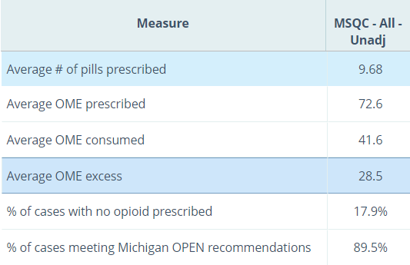
2022 Collaborative-Wide Measure (CWM), continued
Population:
All MSQC-eligible procedures
D/C destination of Home, or Home with Home Health Care
Complete abstraction of D/C prescription (opioid type, unit, dose, qty)
Number of doses taken (collected in 30-day PRO survey, call, or letter)
OME excess = amount of opioid prescribed minus amount consumed
Monitor using Opioid Prescribing
Dashboard in Workstation
*

Slide 40
2022 Collaborative-Wide Measure (CWM), continued
Key Points:
30-day PRO Follow-Up is critical for calculating this measure.
Educate surgery team (surgeons, anesthesia, PAs, NPs, residents) about M-OPEN Prescribing recommendations and multimodal pain management strategies to reduce opioid use.
Educate patients on multimodal pain management strategies so they know what to expect and how to manage postoperative pain.
Even cases prescribed opioids within recommended amounts can still have OME excess if patient requires few opioids
Should prescribe based on individual patient need

Slide 41
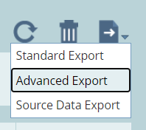
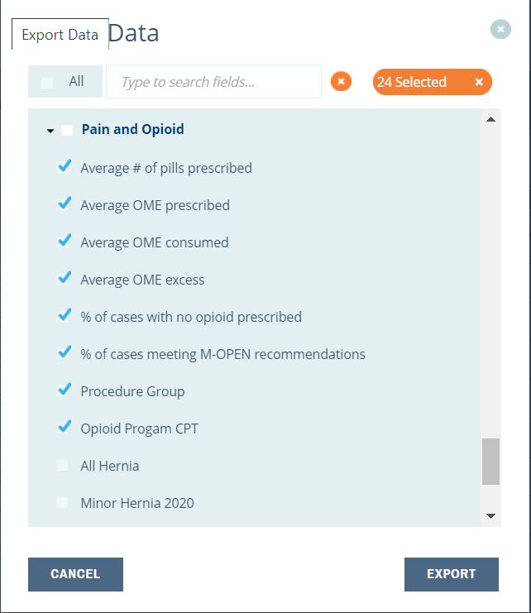
Collaborative-Wide Measure, continued
Advanced Export from OME Excess case list will show case-specific OME excess.
Select Average # pills prescribed measure, select site denominator value, generate Case List, and do Advanced Export.
This will export all cases prescribed an opioid, whether they returned PRO or not.
Can review all cases for over-prescribing
Cases with Quantity Consumed will have OME excess calculated

Slide 42
Resources
2022 MSQC QI Initiatives web page (PI Scorecard; QI Timeline; CRC QI Project Summary; CRC QI Project Tracking Sheet and Summary Report; CRC QI one-page reference sheet)
QI 2021 – 2022 Project Changes comparison document
Workstation Colorectal Cancer, Opioid Prescribing Dashboard Reports
QI site visits during 2022
MSQC Colectomy Care Pathway
Towards 0% Positive Margins for Colorectal Cancer Surgery in Michigan. Nicholas Gutsche. Pre-recorded session for MSQC Collaborative Meeting on December 10, 2021.

Slide 43
Resources, continued
From Opioid-Only to “Opioid-Free” – Where Does Multimodal Analgesia Fit In? Edward Mariano, MD, MAS. Presentation at MSQC Virtual Collaborative Meeting with ASPIRE, April 23, 2021.
Video and Slides
Surgical Pain Management: Procedure Specific Evidence. Melanie Simpson, PhD, RN-BC, OCN, CHPN. Presentation at MSQC SCQR Training Day, June 19, 2020
Video Introduction and Part 1; Video Part 2; and Slides
CAP (pathology) guidelines (2017) https://documents.cap.org/protocols/cp-gilower-colonrectum-17protocol-4010.pdf

Slide 44
Resources, continued
Operative Standards in Cancer Surgery - Defining the Critical Elements for Surgical Success; Kelly Hunt, MD, FACS, FSSO Presentation at December 4, 2020 MSQC Collaborative Meeting
Video Slides
Presentations at December 10, 2021 MSQC Collaborative Meeting (video)
The CRM as a Quality Improvement Target for Rectal Cancer Treatment (11:32-57:10) George Chang, MD, MS
Panel Discussion- Best Practices for Low Positive Margins (1:28:43-2:11:29)
Michigan TME Project video and supplementary documents available here: https://www.dropbox.com/sh/pvc49r6ns4mpdab/AAAEg0Pr2Kq1cXfePJY_-mvta?dl=0

Slide 45
Resources, continued
QI Tips and Tricks document
Patient education resource materials and MSQC FAQs
Michigan OPEN Prescribing Recommendations
MSQC SSI Toolkit with case review worksheet
AHRQ Healthcare-Associated Infections Program
2022 MSQC Program Manual: Follow Up Expectations and Tips, p. 268

Slide 46
Questions
46

