Slide 1
SUCCESS –
Source Data Export
How to pull your data for SUCCESS Project
March 2023

Slide 2
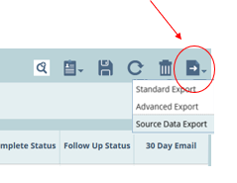
Case List to Source Data Export
1. In Case List, adjust the filters to
  Year: 2023
  Case Status: Sampled
  Complete Status: Yes
3. Now export the case data by clicking Source Data Export
  2. This will return a list of ALL cases from 2023, which are sampled and complete

Slide 3
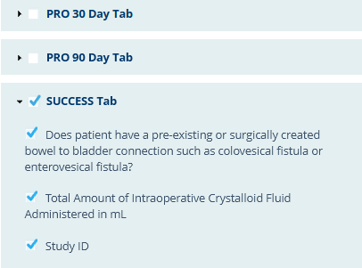
Source Data Export selections
4. Select variables of interest
MSQC recommends selecting the following variables for this export:
Demographics
  MRN, DOB, Sex at birth
Surgical Profile Tab
  Case Number
  Operation Date
  Hospital Discharge Date/Time
  Principal Operative Procedure (which is CPT code)
  Hospital Admission Date
  Attending Surgeon Name
  Postop ICD-10 Code
Intraop Tab – Surgical Approach, 5 urinary catheter variables
Post Outcomes Tab – Postop Outcomes category, Timeframe of outcome, 4 Urinary Retention sub-variables
SUCCESS tab (all variables)
5. After all selections are made, click Export

Slide 4
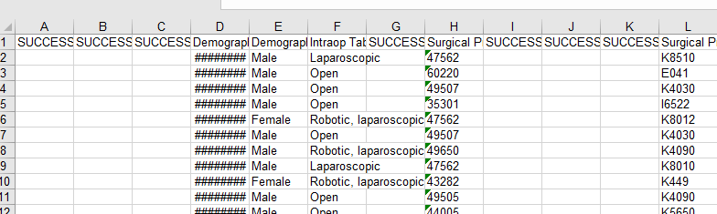
Excel File Download
6. An Excel (.xls) file will download, open the file
7. The downloaded Excel spreadsheet will be a list of ALL sampled and complete 2023 cases
8. Save the file as an Excel Workbook (.xlsx)

Slide 5

Filter to SUCCESS Cases
9. Sort and filter to just the SUCCESS cases:
  Select “Filter” from the Sort and Filer field in the home tab
  Find the column that says “SUCCESS Tab.Study ID” and click the Filter drop-down button next to that column header name.
  The rows with Case Numbers in this column are the SUCCESS cases, so in the pop-up Filter List with all the Case Numbers, deselect “(Blanks)” from the very bottom of the list. This will filter for only the SUCCESS cases.
  Copy all of these cases to a new sheet in the document and rename the sheet “SUCCESS data” for example.
  Select “Filter” again in the new Sheet

Slide 6
Clean the Data
10. The data output in Excel Sheet will be very unorganized. Some data cleanup will help with data analysis.
  Using Cut and Insert Cut Cells editing options, arrange the columns - Demographics, then Surgical Profile then Intraop and Postop Outcomes Fields, then SUCCESS measures into a more logical order
  Some fields will have a 5 digit number instead of date (like epidural d/c date and catheter d/c date). Highlight the column and change these to Short Dates in Format Cells
  Some fields will have numbers instead of “Yes”, “No”, “<300”, etc. These can be replaced with the actual wording - see the references at the end of these slides for the key to convert these columns
  Add derived fields like Retention-Yes, Trauma-Yes, POD foley d/c (see next 3 pages)

Slide 7
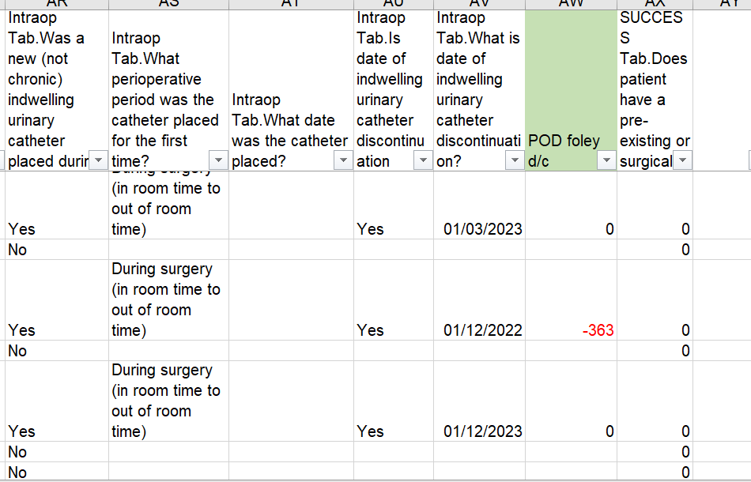
Clean the Data, cont.
Add new POD foley d/c column
Intraop Tab.Was a new (not chronic) indwelling urinary catheter placed during the perioperative period?
  Select 1 (=Yes, in OR) or 2 (=Yes, after OR). These are patients who had Foley
Enter the formula into the new field =[foley d/c date] – [op date].
  This will return what POD the Foley was d/c’d for patients who had a Foley
The data should be cleaned if necessary. The POD should never be > 30 or less than 0.
Check that Foley D/C date was entered correctly (check definition)

Slide 8
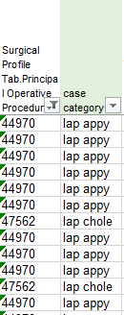
Clean the Data, cont.
Add new Case Category column
Using the Surgical Profile Tab.Principal Operative Procedure column, filter by each group of CPT code to create new procedure type categories such as the following
  Lap Chole
  Lap Appy
  Open Appy
  Lap Hernia
  Open Hernia
  Lap Bowel
  Open Bowel
This will make it easier to analyze the metrics by procedure type

Slide 9
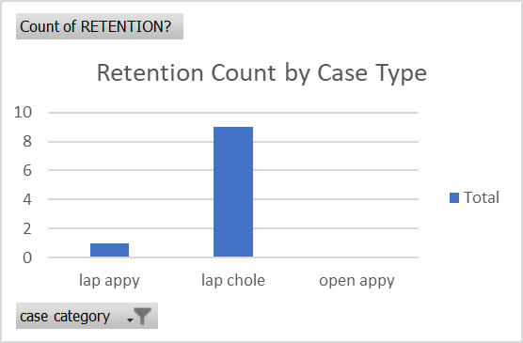
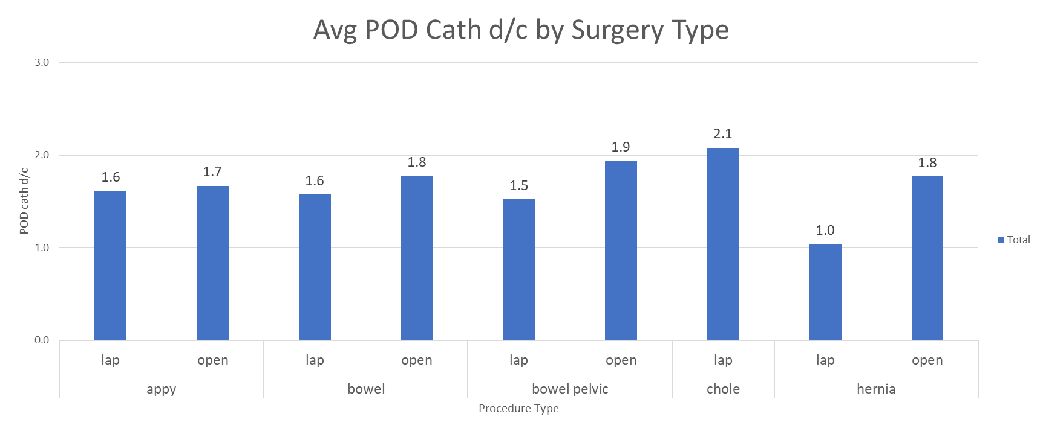
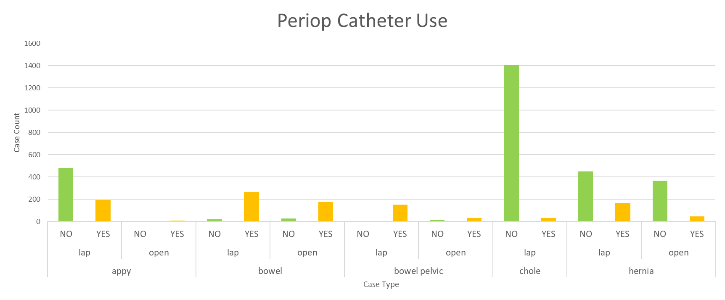
Creating Reports
Once the data is cleaned, reports can be created using Pivot Tables and Charts

Slide 10
Data Mapping Reference – General Variables
Did the patient have any of the following exception criteria? | 0. No 1. Surgical entry into urinary tract during surgery (not including ureteral stents/catheters) 2. Patient has other permanent urinary diversion (e.g., urostomy or suprapubic catheter)
Did the patient have an epidural during the Principal Operative Procedure? | 0. No 1. Yes
When was the epidural discontinued? | mm/dd/yyyy
Total Amount of Intraoperative Crystalloid Fluid Administered in mL
Did the patient go to the ICU after surgery within the same hospitalization (admission) as principal surgery? | 0. No 1. Yes

Slide 11
Data Mapping Reference –Indwelling Catheter Variables - Intraop tab
Was a new (not chronic) indwelling urinary catheter placed during the perioperative period? | 0. No 1. Yes 2. Exception
What perioperative period was the catheter placed for the first time? | 1. Prior to OR in room time 2. During surgery (in room time to out of room time) 3. After OR out of room time 4. Unknown
What date was the catheter placed? | mm/dd/yyyy
Is date of indwelling urinary catheter discontinuation documented? | 0. No 1. Yes
What is date of indwelling urinary catheter discontinuation? | mm/dd/yyyy

Slide 12
Data Mapping Reference –Retention - Postop Tab
Postop Occurrences Tab.Post Op Occurrence Category | Postop Urinary Retention captured
What Urinary Retention criteria were met? | 1. Diagnosis, clinician documentation, or ICD-10 diagnosis code of urinary retention 2. Bladder catheterization for postoperative urinary retention 3. Initiation of new medications to address urinary retention
What type(s) of catheterization did the patient require when the patient had postop Urinary Retention? | 1. ISC performed during index hospitalization 2. Indwelling (Foley) catheter during index hospitalization 3. Both ISC/foley during index hospitalization 4. ISC after hospital discharge 5. Indwelling (Foley) after hospital discharge 6. Both ISC/foley after hospital discharge
Was a bladder scanner used to measure bladder urine volume before catheterizing? | 0. No 1. Yes

Slide 13
Data Mapping Reference – Retention, SUCCESS Tab
Did the patient have a chronic indwelling catheter or chronic straight catheterization requirement which was present before admission and/or in place for greater than 2 weeks before surgery? | 0. No 1. Yes
What was the first urine volume documented that was relieved by urinary catheterization by ISC or indwelling urinary catheter placement when the patient was diagnosed with post-op urinary retention? | 1. <300 cc/mL 2. 300-499 cc/mL 3. >=500 cc/mL 5. ISC or indwelling urinary catheter placement was not used for Urinary Retention 4. Urine volume relieved by catheterization at time of post-op urinary retention was not documented
What was the first urine volume documented by bladder scanner when the decision was made to catheterize or start new medications for post-op urinary retention? | 1. <300 cc/mL 2. 300-499 cc/mL 3. >=500 cc/mL 4. Bladder scanner was not used in work-up of post-op urinary retention 5. Bladder scanner used but volume scanned not documented
Did the patient have any clinical signs and symptoms of urinary retention with no other recognized cause (e.g., indwelling catheter in place)? | 0. No 1. Yes
Was there a Urology Consultation for postop Urinary retention? | 1. Yes - inpatient 2. Seen by or referred to urology as an outpatient 3. No
Prior to this surgery, did this patient have conditions that increased risk of urinary retention? | 0. No 1. Yes
Was the patient noted to have been treated for a urinary tract infection in the week prior or week after retention criteria was met? | 0. No 1. Yes

Slide 14
Data Mapping Reference – Trauma
Is there a diagnosis, clinician documentation, or ICD-10 diagnosis code of urinary catheter-related trauma in the medical record? | 0. No 1. Yes
Was Urology consulted for urinary catheter-related trauma? | 0. No 1. Yes
Assign Urinary Catheter-Related Trauma | 0. No 1. Yes
What was the timeframe of the first occurrence of urinary catheter-related injury? | 1. Prior to OR in room time 2. During surgery (in room time to out of room time) 3. Out of OR day POD 0-7 (early complication) 4. POD 8-30 (late complication) 5. Unknown
Does the patient have a preoperative diagnosis of a chronic urologic condition that increases the risk for trauma? | 0. No 1. Yes 2. Unknown

Slide 15
Resources
For more general information about running and functionality of MSQC reports, see the “MSQC User Guide Data Entry and Reports” (pp. 18 – 31): in MSQC Workstation Resources
Source Data Export Video (2021). https://vimeo.com/561479356
2023 MSQC Program Manual, p. 278 – Excel tutorial, Excel charts video

