Slide 1



Surgeon Specific Reports
Michigan Surgical Quality Collaborative

Slide 2
What is MSQC?
An established Quality Improvement Initiative
  MSQC has been collecting and analyzing surgical data since 2005 for the purpose of improving patient care.
A high quality, clinically collected data registry
  MSQC data is collected by a dedicated Registered Nurse employed at each hospital
  All data abstraction nurses are required to pass yearly certification exams and Inter-Rater Reliability Testing is performed by MSQC on the data collected.
    2012 Results: All hospitals demonstrated greater than 95% accuracy

Slide 3
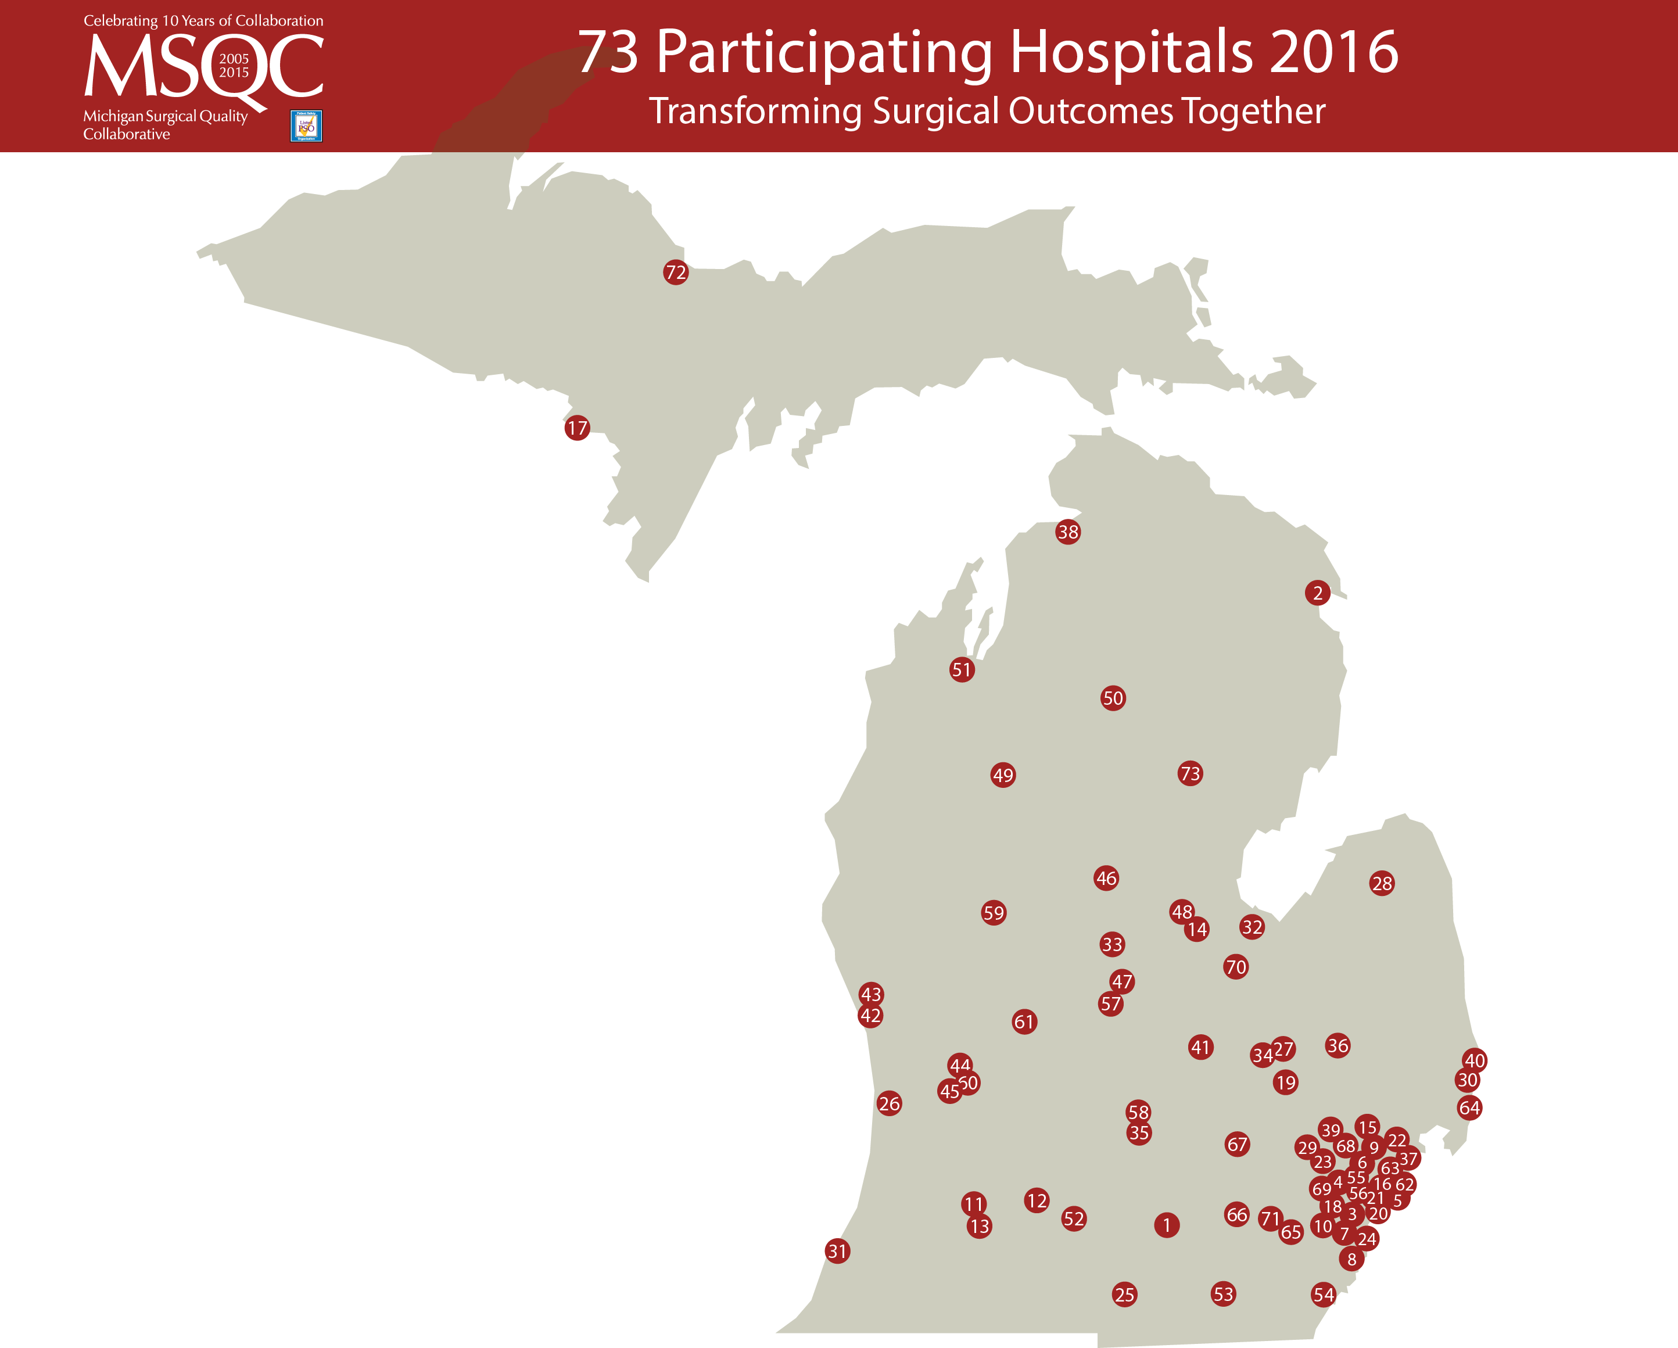
37 McLaren – Macomb
38 McLaren – Northern Michigan
39 McLaren – Oakland
40 McLaren – Port Huron
41 Memorial Healthcare – Owosso
42 Mercy Health Hackley
43 Mercy Health Partners
44 Mercy Health Saint Mary's
45 Metro Health Hospital
46 MidMichigan Medical Center – Clare
47 MidMichigan Medical Center – Gratiot
48 MidMichigan Medical Center – Midland
49 Munson HealthCare Cadillac Hospital
50 Munson HealthCare Grayling Hospital
51 Munson Medical Center
52 Oaklawn Hospital
53 ProMedica Bixby Hospital
54 ProMedica Monroe Regional Hospital
55 Providence Hospital – Southfield
56 Sinai-Grace Hospital
57 Sparrow Carson Hospital
58 Sparrow Hospital
59 Spectrum Health Big Rapids Hospital
60 Spectrum Health Butterworth Hospital
61 Spectrum Health United Hospital
62 St. John Hospital and Medical Center
63 St. John Macomb Oakland Hospital
64 St. John River District Hospital
65 St. Joseph Mercy Ann Arbor
66 St. Joseph Mercy Chelsea
67 St. Joseph Mercy Livingston
68 St. Joseph Mercy Oakland
69 St. Mary Mercy Hospital, Livonia
70 St. Mary’s of Michigan
71 University of Michigan Health System
72 UP Health System – Marquette
73 West Branch Regional Medical Center
1 Allegiance Health
2 Alpena Regional Medical Center
3 Beaumont Hospital – Dearborn
4 Beaumont Hospital – Farmington Hills
5 Beaumont Hospital – Grosse Pointe
6 Beaumont Hospital – Royal Oak
7 Beaumont Hospital – Taylor
8 Beaumont Hospital – Trenton
9 Beaumont Hospital – Troy
10 Beaumont Hospital – Wayne
11 Borgess Medical Center
12 Bronson Battle Creek Hospital
13 Bronson Methodist Hospital
14 Covenant HealthCare
15 Crittenton Hospital Medical Center
16 Detroit Receiving Hospital
17 Dickinson County Healthcare System
18 Garden City Hospital
19 Genesys Regional Medical Center
20 Harper University Hospital
21 Henry Ford Hospital
22 Henry Ford Macomb Hospital
23 Henry Ford West Bloomfield Hospital
24 Henry Ford Wyandotte Hospital
25 Hillsdale Hospital
26 Holland Hospital
27 Hurley Medical Center
28 Huron Medical Center
29 Huron Valley Sinai Hospital
30 Lake Huron Medical Center
31 Lakeland HealthCare
32 McLaren – Bay Region
33 McLaren – Central Michigan
34 McLaren – Flint
35 McLaren – Greater Lansing
36 McLaren – Lapeer Region

Slide 4
The MSQC Database
http://www.msqc.org/
Secure Web-based login
Dashboard Reporting
  Real-time, risk adjusted benchmarking of provider performance
Hospital and Surgeon level reports
  In 2015, MSQC expanded reporting capabilities to include surgeon comparisons

Slide 5
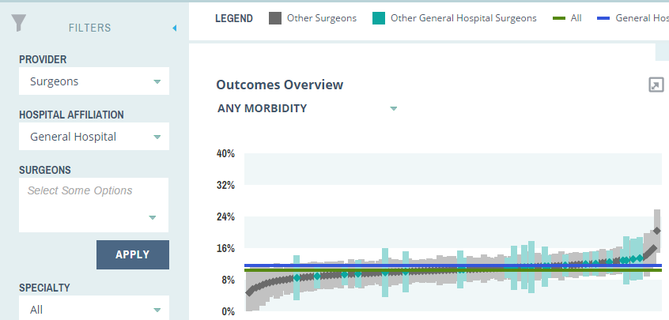
Surgeon Champion View
    De-identified surgeon view when no surgeons selected
    Compare all surgeons at a single site to other surgeons in the collaborative

Slide 6
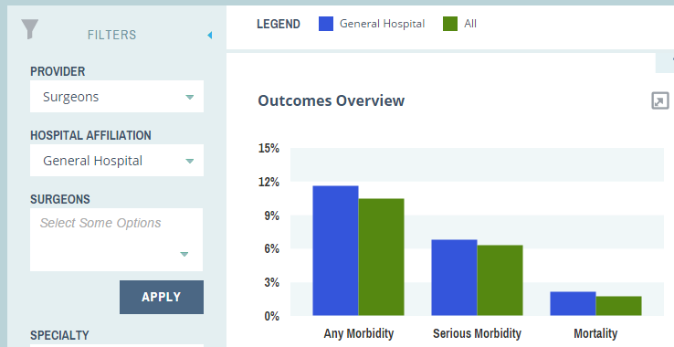
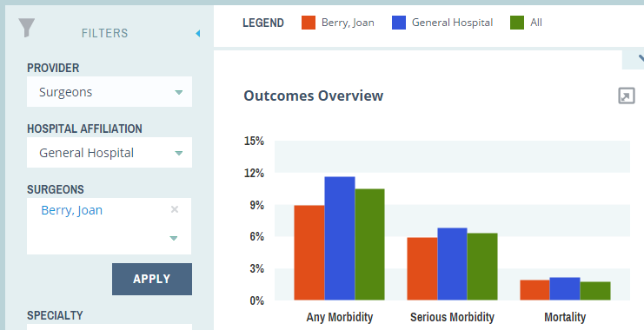
Surgeon level Reporting
    For users with hospital and surgeon level reporting privileges
    Surgeons can view performance relative to both their hospital or collaborative as a whole
    Available for surgeons with 30 or more total cases

Slide 7
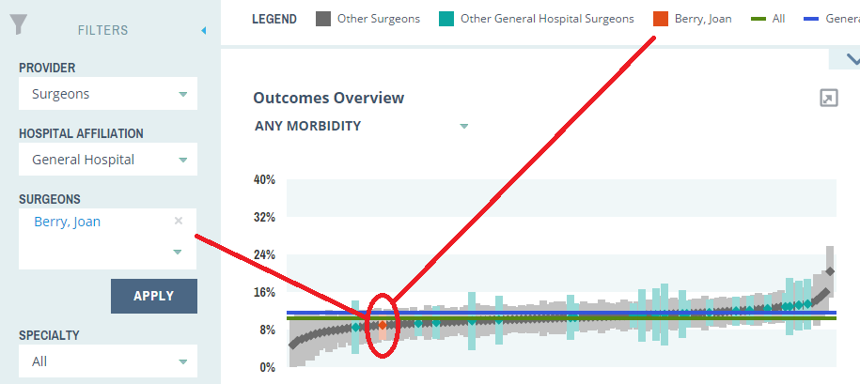
Surgeon level Reporting
Compare selected surgeon(s) to all other surgeons at a site, and to all other surgeons in the collaborative in rankings charts

Slide 8
Who Can View the Reports?
All Surgeon Champions
  Each surgeon champion will be able to view a de-identified comparison of surgeons at their institution vs. all other surgeons in the collaborative database.
Individual Surgeons
  Surgeons with 30 cases or more existing in the database will be able to view their own results.
  These are accessible ONLY to the surgeon identified in the reports

Slide 9
What are the intended uses of these reports?
At the Hospital level
  New way to assess hospital performance
At the Individual level
  Self-policing and motivation for improvement

Slide 10
What these reports should NOT be used for:
Punitive purposes
  These reports must remain separate from any other hospital or employee record.
  Only the individual surgeon will be able to access an identified view of his/her own reports.

Slide 11
Confidentiality and Privilege
MSQC is a listed Patient Safety Organization (PSO), which provides federal protections to its data.
Under the Patient Safety and Quality Improvement Act (PSQIA), Surgeon Specific Reports are considered Patient Safety Work Product (PSWP).
As PSWP, these reports are considered privileged and confidential and are not subject to legal discovery.
Reports will be accompanied with the following disclosure statement:

Slide 12
MSQC Surgeon Specific Reporting Access
to access to your performance reports CONTACT:
MSQCCustomerSupport@med.umich.edu

