Slide 1
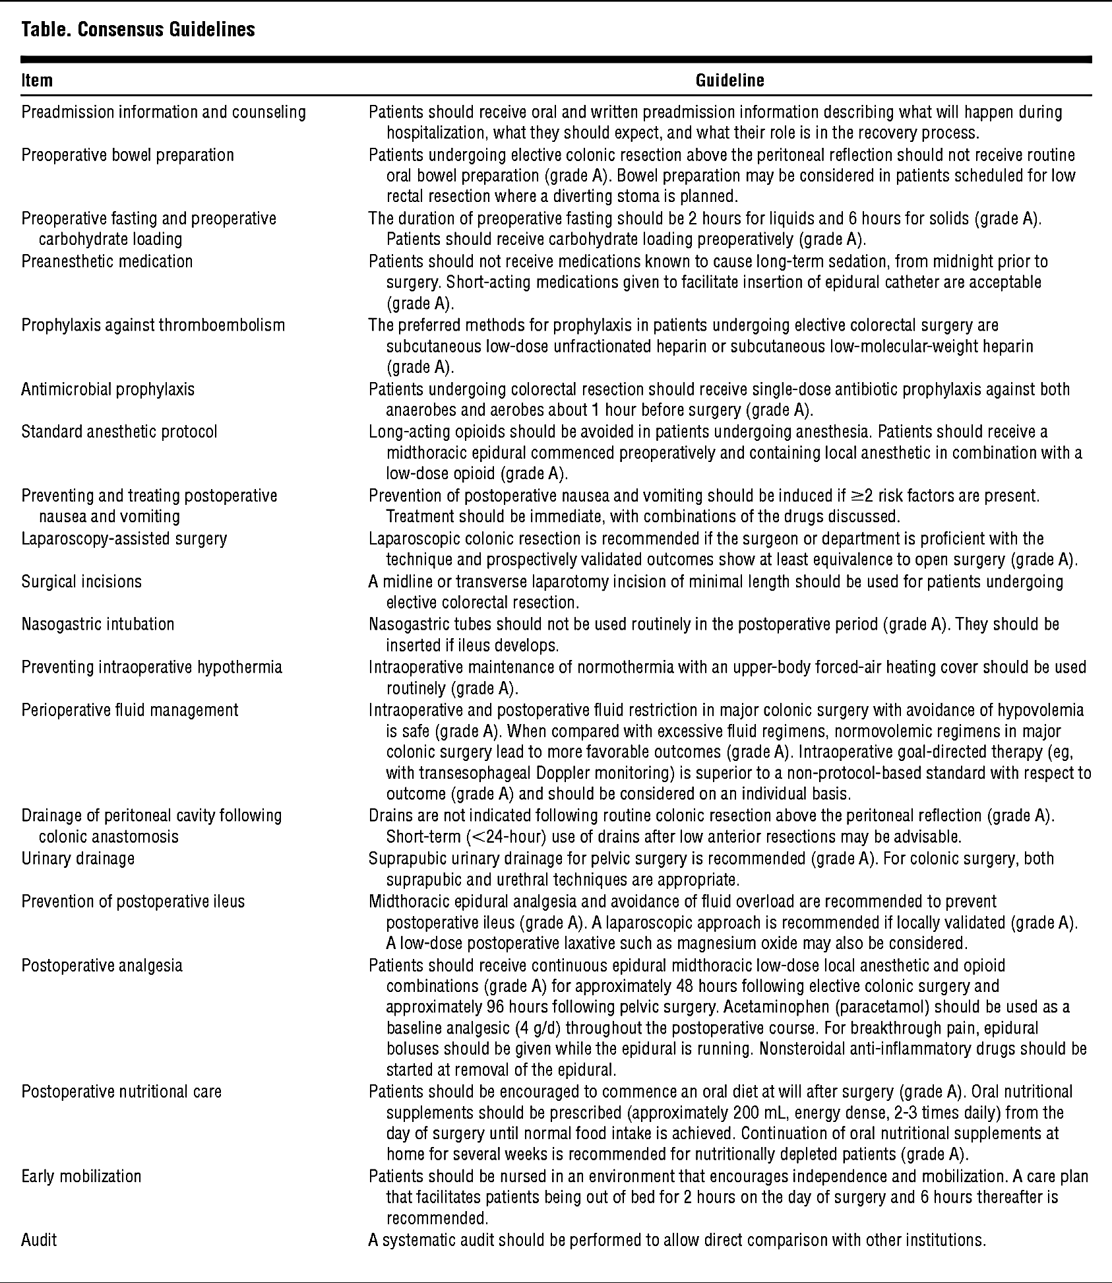
Grade A Evidence

